Slide 1
HMP Altcourse: A Whole Family Approach.

Slide 2
The Centre For Emotional Health: The Nurturing Programme
The nurturing programme is run on the family intervention wing for fathers who are on remand in HMP Altcourse. It is a rolling programme that gives dads ideas about how to communicate well with people around them and their family from a distance.
It looks at understanding why children behave as they do, recognising the feeling behind the behaviour, exploring different approaches to discipline, finding ways to develop cooperation and self-discipline in children and the learning the importance of looking after ourselves.
The programme is accredited through Open Awards.

Slide 3
Feedback from Dads
“I wasn’t sure what I would get out of this course, but I am so glad I have done it. It has opened my eyes to other ways to of being a better parent. Sue was such a lovely person, and we are very lucky, she delivers this course as it's her that can get the most out of inmates. She has a way of breaking down barriers and making you relax and engage. Thanks for this opportunity I have enjoyed every minute...”
“it was like opening Pandoras box an eye opener on how we should deal with all aspects of parenthood I have learnt so much from you and this course which I will take with me for the rest of my days as a father and a grandad…”

Slide 4
Feedback from Dads
“I enjoyed every bit of this course, Sue made each of us feel comfortable to speak and engage in each session and I feel I have learnt so much to help me as a father now and for when I get out, by how to deal with different situations. I would highly recommend this course to anyone, and I have already told all my friends to get signed up. Thank you for being the best teacher and just a lovely person treating us all with respect, thank you…”
“I found that the course is really helpful in parenting and would benefit anybody who would participate In this course, in the future it will help me massively and I found that I am already using aspects of it whilst on the telephone of an evening with my children… in my opinion they should keep the course going and I think as many fathers should take the course I really enjoyed it and once again found it a massive help, thanks again Sue for everything…”

Slide 5
Reducing Parental Conflict: Parenting Apart
Reducing Parental Conflict is facilitated on the Family Intervention Unit with scope of it being opened up to the rest of the prison.
RPC is a 6 session programme that looks at the effects of parental conflict on children that is frequent, intense and poorly resolved.
RPC is a universal programme offered to fathers who are finding that there are particular difficulties in there relationship with their co-parent.
It is not a domestic abuse programme.

Slide 6
Family Play Therapy
Family Play Therapy is a new initiative for children who are struggling with Dad being away from home
The work is completed in conjunction with the Family Counsellor from The Social Interest Group, Safe Ground, Linda Shrimpton.
I work with dad and child implementing Theraplay practices whilst Linda works with mum.
The programme is family led

Slide 7
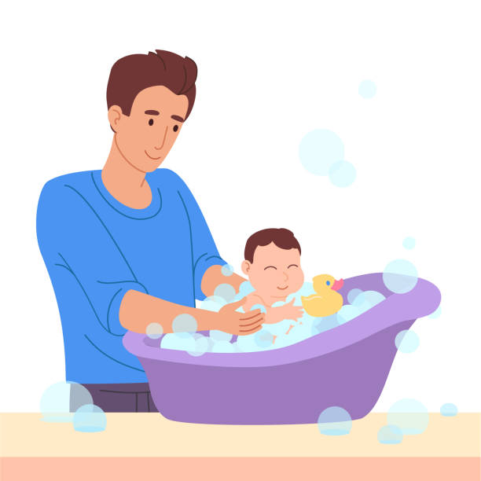
Baby Programme
The baby programme is tailored for dads who have babies aged 0-12 months. The programme consists of 5 sessions; one of baby bathing, where mum brings baby into the prison and dad gets to bath his baby, the four remaining sessions consist of baby massage for baby and dad. Dads can complete an accreditation through Open Awards to accompany this if they wish.

Slide 8
Feedback from Parents
Dad- “by completing the baby programme I learnt how to bond with my baby more than I thought and now I know what she likes. It has helped me realise how much family means to me…”
Mum- “ I really enjoyed the course because my baby got to bond with her dad and thats a relief for me because he’s not home and he’s missing out on everything…”
Dad- “the baby programme has taught me about being able to spend quality time with my family and learning how to be the best dad possible, it gave me insight.
Mum- “I thought it was amazing to just watch how happy both the boys get seeing their dad and watching how dad is with them I think that this is a very good programme, it has definitely improved the bond with the boys and their dad and gives me a lot of hope for dad for his future as being a dad…”

Slide 9
Dads Stay and Play
Dads stay and play includes four sessions for dads who have children aged 12 months to 5 years. Dads experience relaxing play sessions with their children in the visits hall and children get to play freely with dad. Activities include art and craft, imaginative play, reading stories and singing nursery rhymes. The family are able to eat a small snack together around a table promoting family time.

Slide 10
Feedback from Parents
Dad- “ the programme gave me a bit of normality and time to bond with my daughter it gave us quality time and I am able to interact with her in a way that I am not allowed on normal visits…”
Mum- “It was lovely to watch my daughter maintain the bond with her dad in a more normal environment, and it has benefited us as a family…”
Dad- “ the programme has made mine and my son’s relationship stronger, it’s made him realise that I am still here for him and that he can still play with me…”
Mum- “this programme has been amazing for my son to spend time with his dad, where he can move around and play. It has helped with the bond and it is lovely to see them play together…”

Slide 11
Feedback from Parents
Dad- “the programme has been something regular and consistent for us both to look forward to. We enjoyed the painting activities as he can take them home and put them in his room to remind him of me. I genuinely don’t know what I would have done without out the stay and play programme and the other interventions Sue offers, it gives me a reason to get up of a morning, it’s enabling us to continue to have a bond to see us through until I come home to him…”
Mum- “this has had such a huge impact on us as a family, I have seen such a difference in them both and they count down the days until the next stay and play. Before my partner got on the family intervention wing, I could see their bond diminishing however since being moved both are so much happier and contempt…”

Slide 12
Dads and Kids Club
Dads and kids club is an intervention for dads with children aged 5-11 years. It consists of four sessions once a week in the visit's hall. Dads are able to move around freely play and interact with their children in a more relaxed environment. Activities include, art and crafts, board games, reading corner and interactive activities.

Slide 13
Feedback from Parents
Dad- “it felt more like family time at home, and it helped to connect and talk naturally. The freedom of being able to move and connect with my child…”
Mum- “this programme has really helped my daughter feel closer to her dad in this difficult time. It has made our visits more like family time at home…”
Dad- “it helped me have 1 on 1 time that we don’t have on standard visits, it gave us a lot more to talk about and look forward to during the four weeks it was on, and I would like to say a thank you to Sue for everything…”
Mum- “this programme is interactive and great for additional bonding between dad and lad. They’re creative and educational in so many ways, it’s great to see the group of dads and children working together…”

Slide 14
Vinnies Visits: A Neurodiverse Friendly Initiative
Vinnies Visits is a neurodiverse friendly programme for Fathers who have a child who is neurodiverse, these children find it hard to regulate on a regular visit due to a range of things.
Working with the neurodiverse lead in the prison, Suzy Leonard, we identify those children who either have stopped coming to visit dad or who have never been to visit dad.
The process starts at security with staff recognising the difficulties these children face.
The visits hall is quiet with no other families in attendance and activities are planned on each individual child's needs.

Slide 15
Storytime Dads
Storytime Dads is a wonderful initiative that helps dads keep a real connection with their child through the love of stories.
Dads read a story that is recorded and sent via a link to their child.
Dad- “ I used to take my daughter to bed at 7oclock and read her bedtime stories and she would fall asleep, it was our thing, our dad and daughter thing, and now we have got it back, she plays it every night at bedtime.”
Mum-” He watched it in bed he was so calm and quiet, he smiled all the way through, at the end he got a little emotional said goodbye, goodnight love you then he went to sleep. He went to bed feeling very calm and contented”

Slide 16
From the establishments perspective Sue has been instrumental in raising the bar in relation to maintaining family contact and acting responsible as a parent.
Men under our care have had the opportunity to work with Sue to understand and enhance their parenting skills.
From the Nurturing programme to Reducing Parental Conflict , the prisoners attending these courses all talk in a positive manner about the skills they have learnt and are excited to put their new skills into practice.
The Stay and Play, Dads & Kids Club and the Family Play Therapy where dads can bath and message their babies are all aimed at fathers spending quality one to one time with their children after really understanding what children need and why they behave in certain ways, the level of interaction and emotion during these sessions is lovely to see and testament to the work that Sue undertakes within our establishment.
This is all topped of by the additional sessions for fathers of children with neurodiverse needs, these smaller sessions really assist the children in quieter and bespoke sessions and provides a relaxing environment for mum, dad and child to enjoy together.
Since Sue commenced at Altcourse the work she undertakes and her manner in delivering these sessions has had a hugely positive impact on mothers, fathers and children within our communities, many will take what they have learnt and ensure they become better parents on release.
From the establishments view, Sue is a credit to Liverpool City Council.
Lyndon Noonan
Deputy Director
HMP Altcourse

Slide 17
Any questions, comments, thoughts or feelings?

