Slide 1

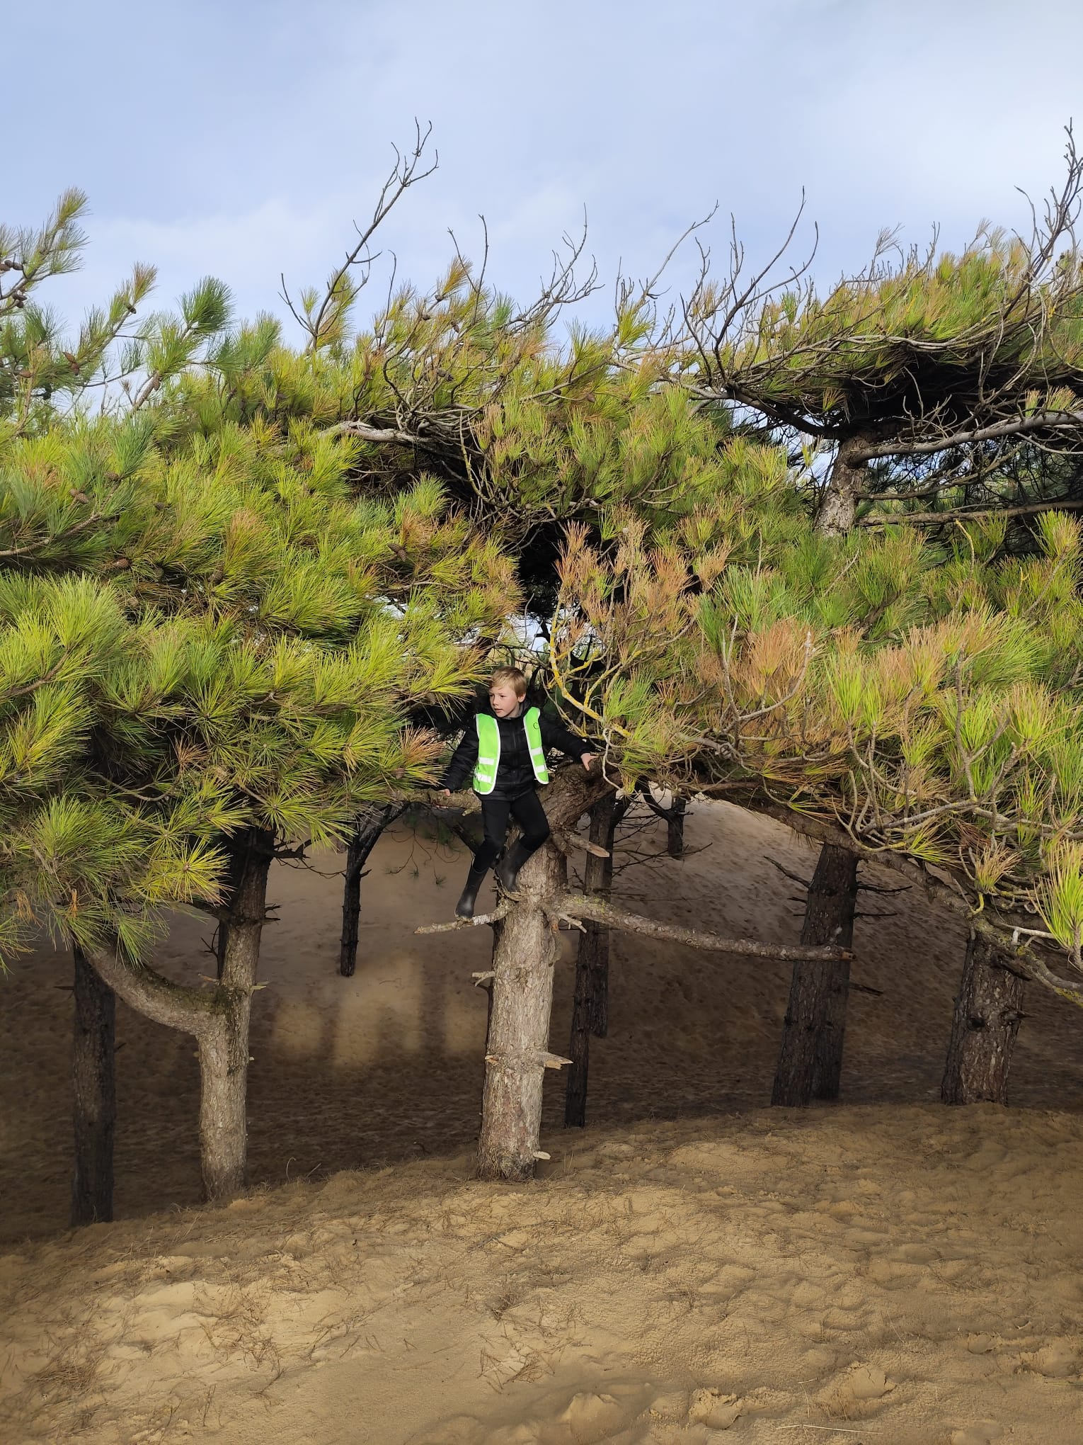
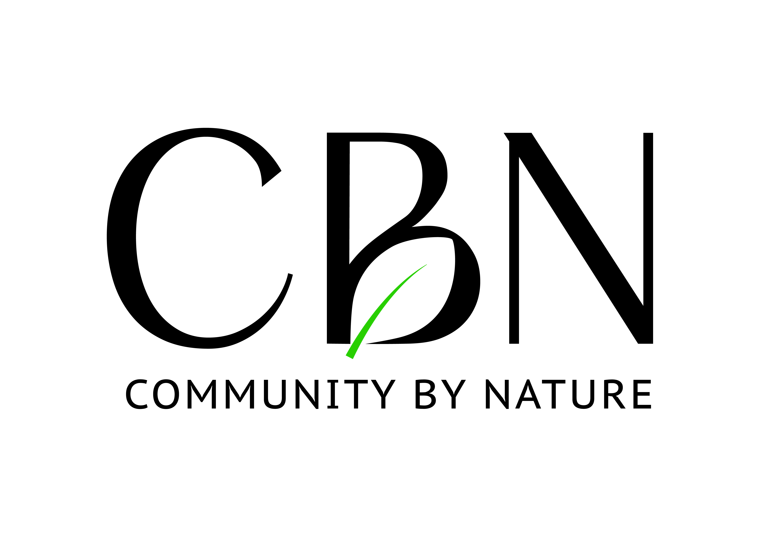
Community Forest Play
Kate Jameson CEO
Kyle Hindle – Mentor

Slide 2
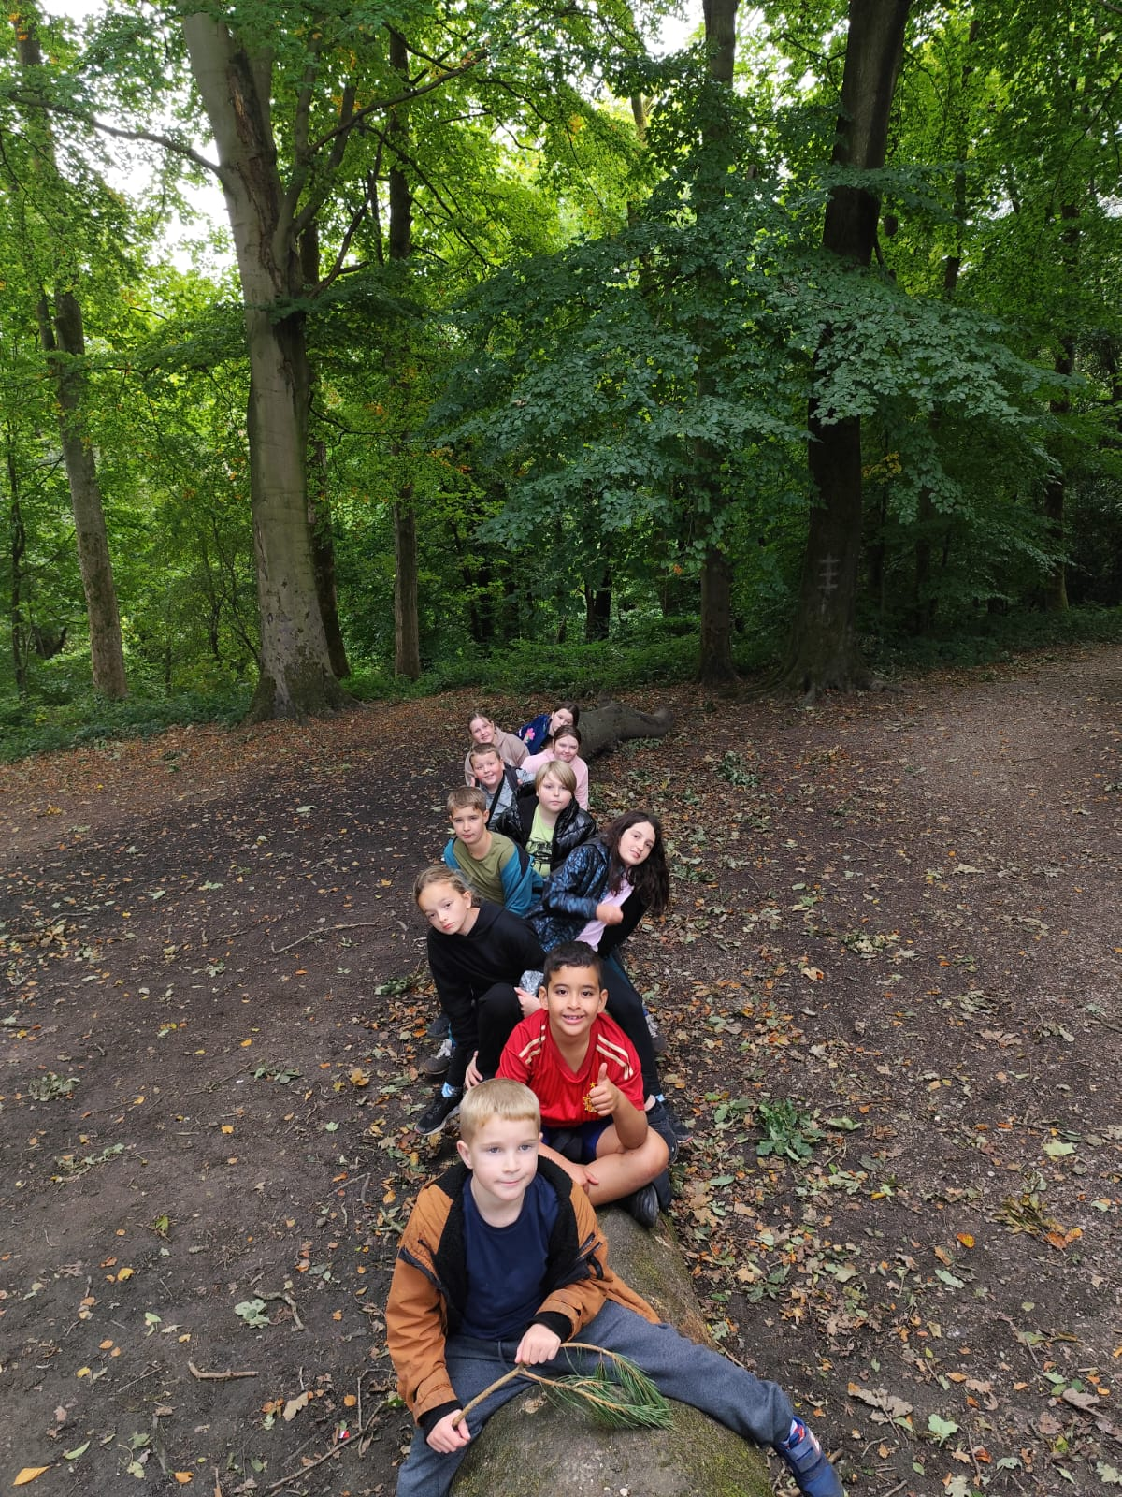
Presentation
Overview
Background
Project Origins
Project Details
Project Activities
Impact
Research
Contact Details

Slide 3
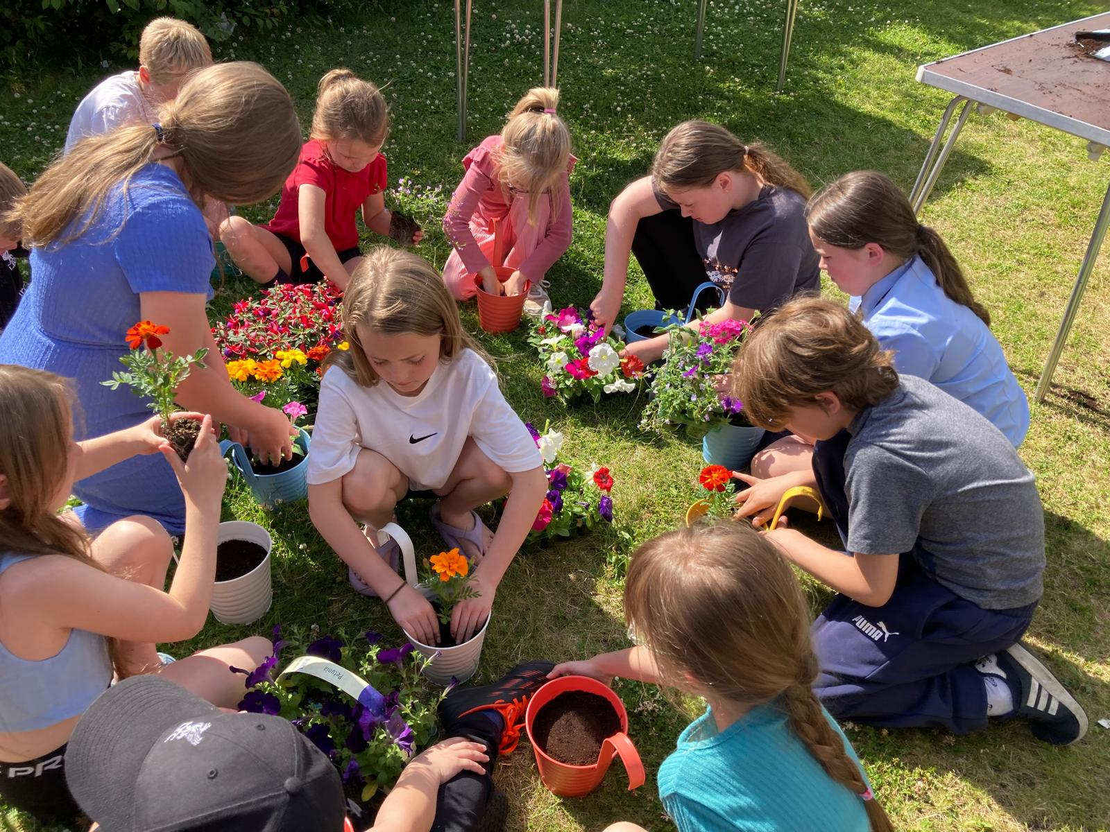
Background of Charity
Community by Nature (CbN) is a Merseyside-based Charity been in operation for 29 years
Aim to improve the lives of children and adults in local area (typically areas of deprivation) by encouraging participation in community learning/support, play, and forest engagement.
Focus outdoors, natural environment (woodland settings) Community Centre with on-site forest school
Based in Bootle –hot spot for violent crime
Children/young people in community at disproportionate risk of involvement in crime and anti-social behaviour (gun/gang/knife/county lines/drugs-running).

Slide 4
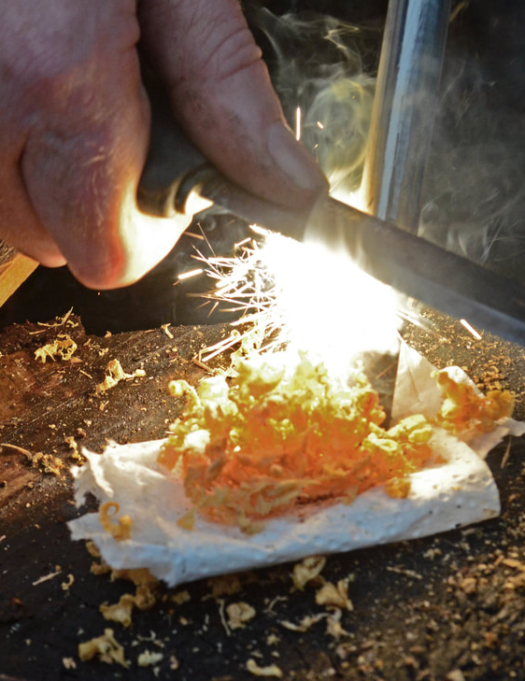
Project Origins
Delivery of forest school programmes in Primary & Secondary Schools, Early Years and Play and Youth Settings across Liverpool City Region since 2009
Ongoing overwhelming evidence of positive impact for children and young people disengaged in formal learning
Developed a full time Forest School outdoor learning Alternative Education Programme for Liverpool City Council (2016)

Slide 5
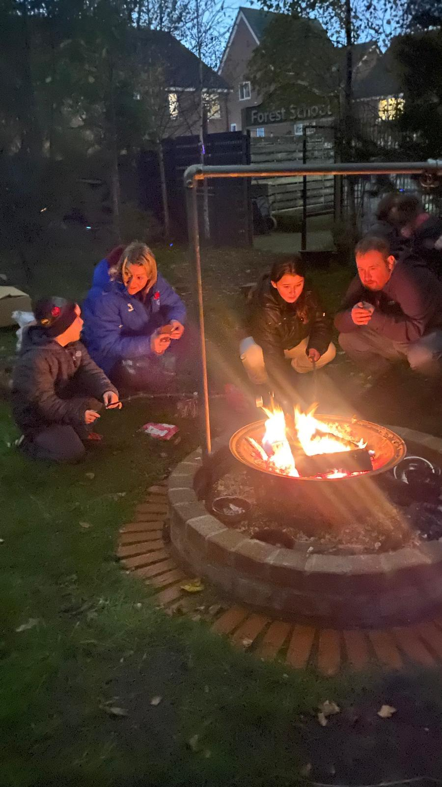
Project Details
Twice weekly enriching positive diversionary play/youth activities with Forest school theme in a safe environment to minimize the risk of involvement in gang/gun/knife/drugs crime.
Led by consistent skilled and experienced staff, positive role models building respect/trust
Supported by Mentor with background of involvement in gang/knife crime
Based outdoors predominantly, small groups for close supervision, support, nurturing
Practical, challenging activities including woodland survival and management skills and outdoor woodcraft
Family Days
Residentials

Slide 6
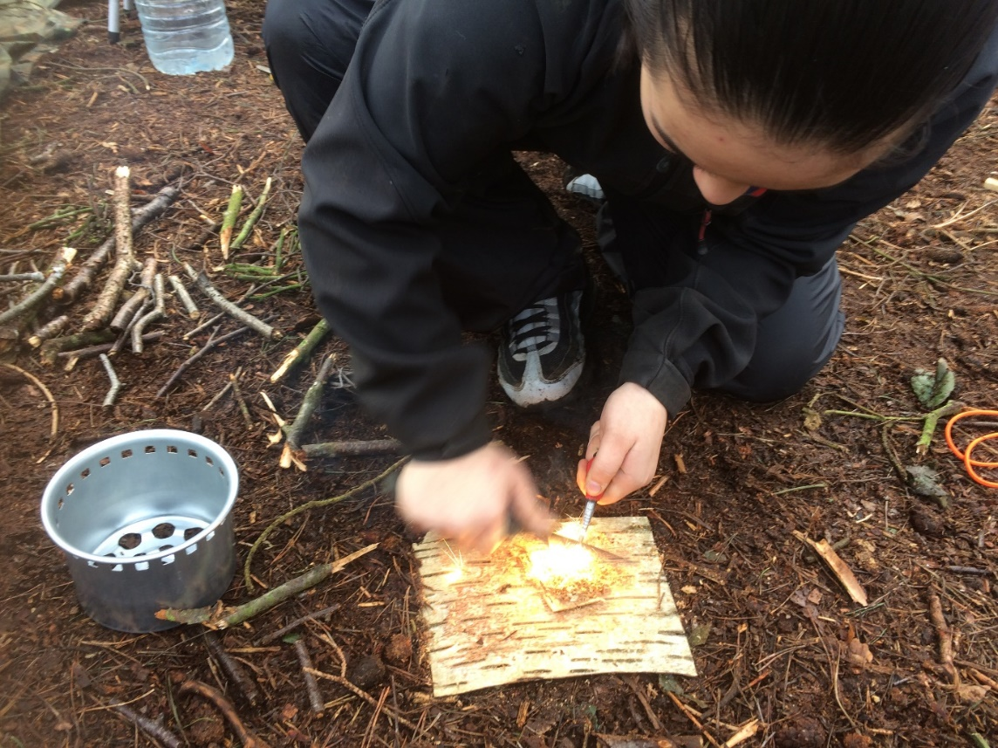
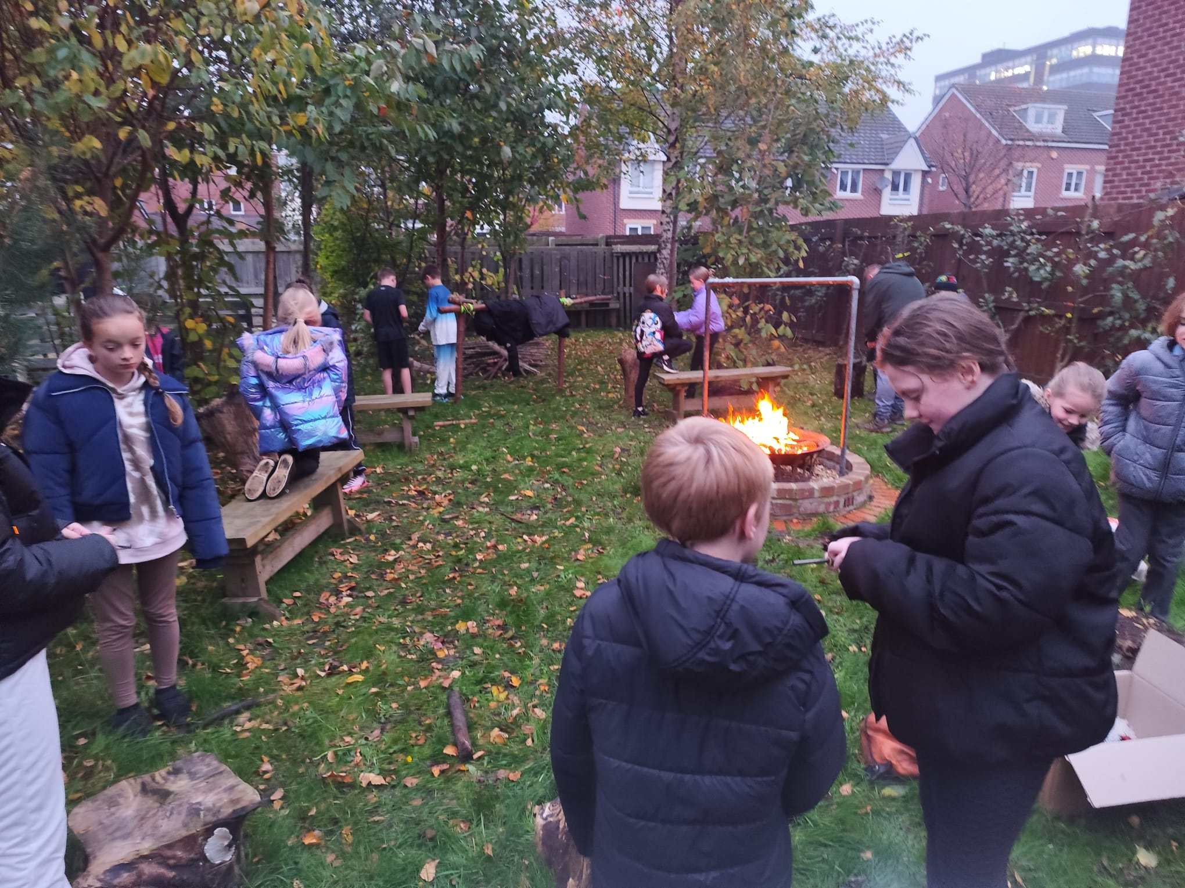
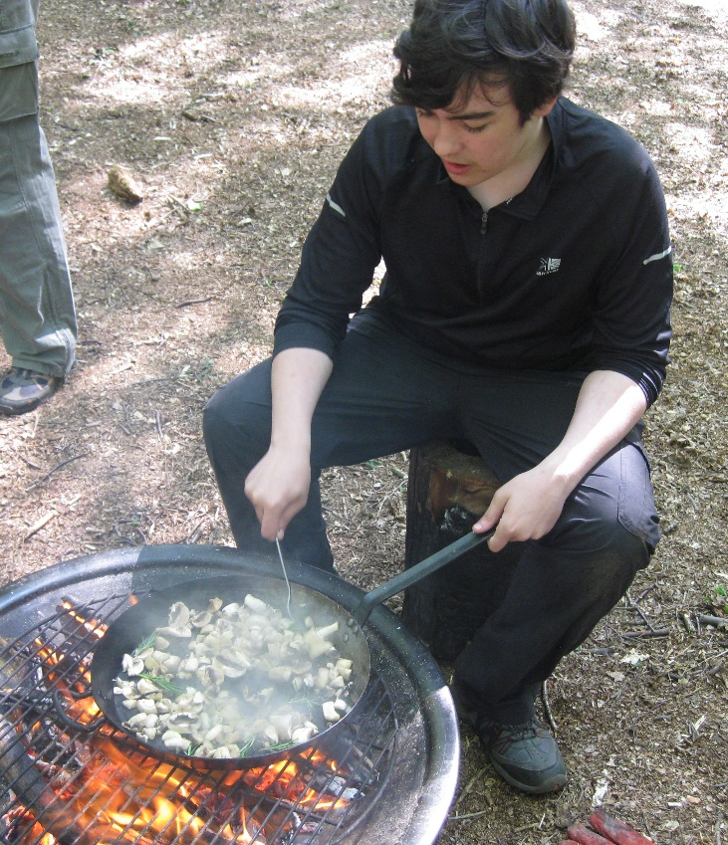
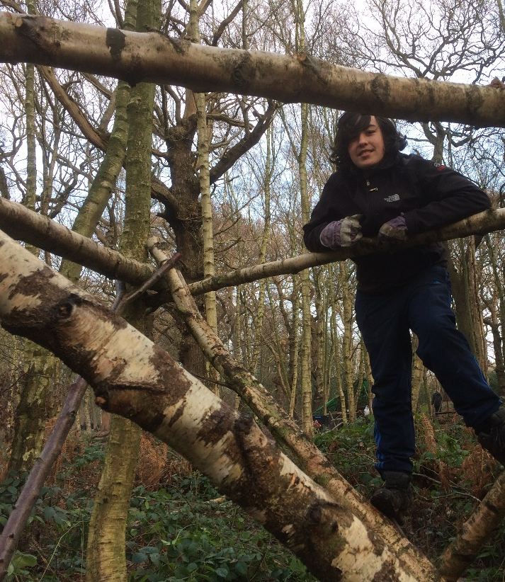
Activities
Outdoor-cooking, Building fires
Natural art sand crafts
Coppicing, tree-pruning
Building rope-structures
Cooking a healthy meal
Planting, foraging
Building/putting up shelter
Coppicing, tree-pruning
Use of tools - knives, bowsaws, axes
Building rope-structures

Slide 7
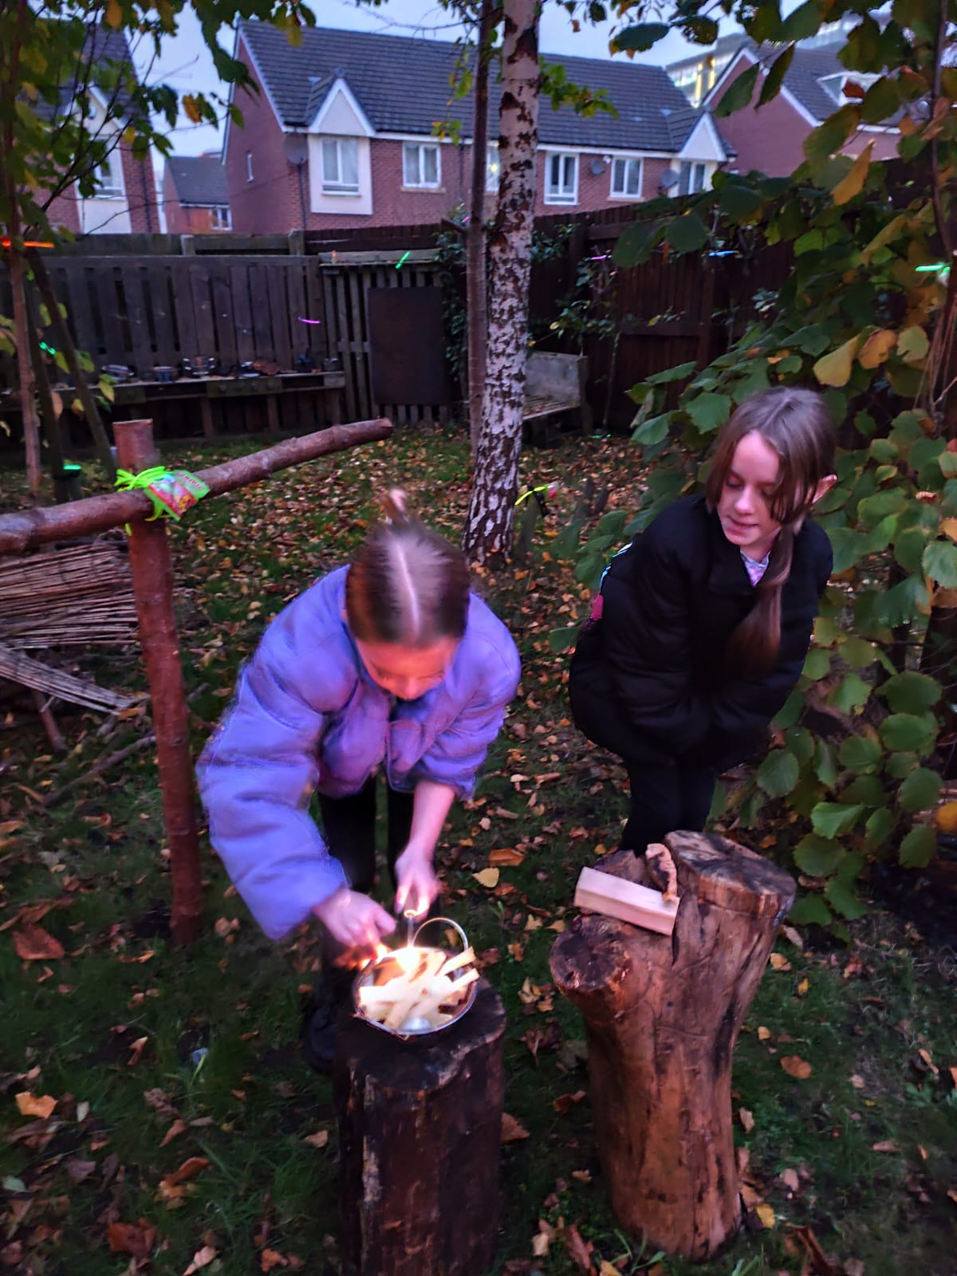
Planned Impact:
Improve emotional wellbeing: resilience, self-regulation
Improve aspirations and pro-social behaviours, attitudes, citizenship skills
Develop new vocational skills and knowledge (tool use, woodland management, arboriculture) and develop
Life-skills (cooking, fire lighting)

Slide 8
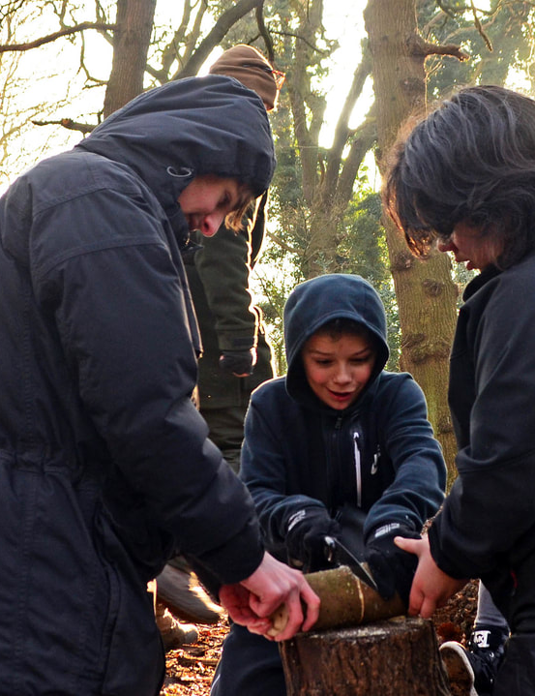
Research
Project impact is immense: transforming lives of young people (including Kyle)
Need for robust impact evaluation to demonstrate impact
Need to identify mechanisms of change
Accessed funding, linked with LJMU develop impact evaluation and conduct research
Research demonstrated significant improvement in social/emotional wellbeing, raised aspirations of young people involved in/at risk of involvement in crime and antisocial behaviour.

Slide 9
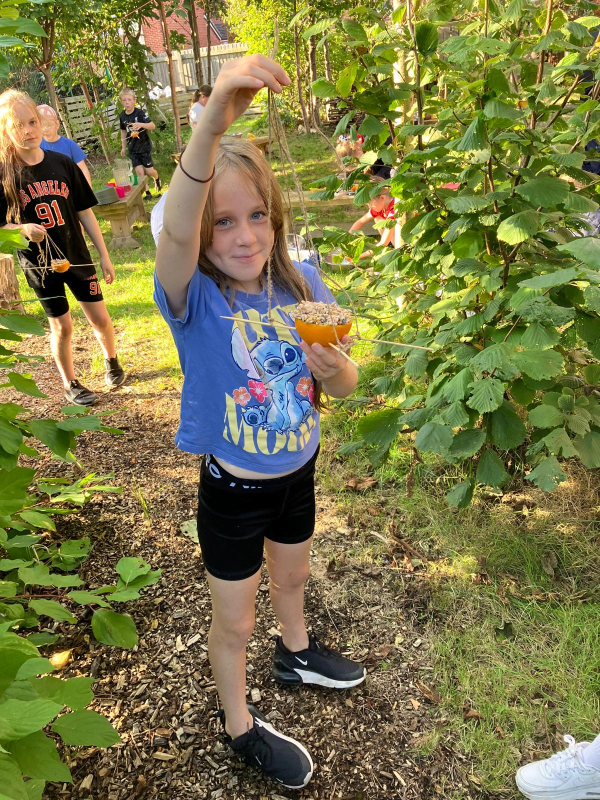
Contact Details:
Website:
www.communitybynature.org.uk
Email:
kate@communitybynature.org.uk
Telephone: 0151 9332363

