Slide 1
Umbrella Stay and Play:
Supporting Families and Children in the Early Years, with Emerging Neurodivergence

Slide 2
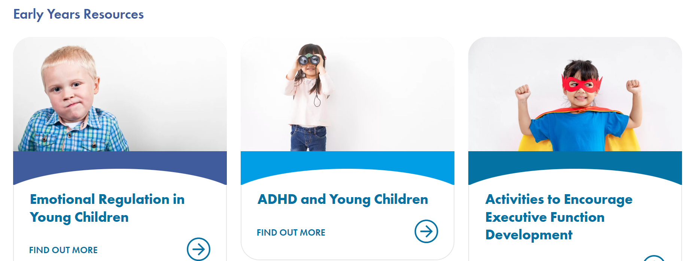
The Early Years Service

Slide 3
The Developing Mind
Image by Freepik

Slide 4
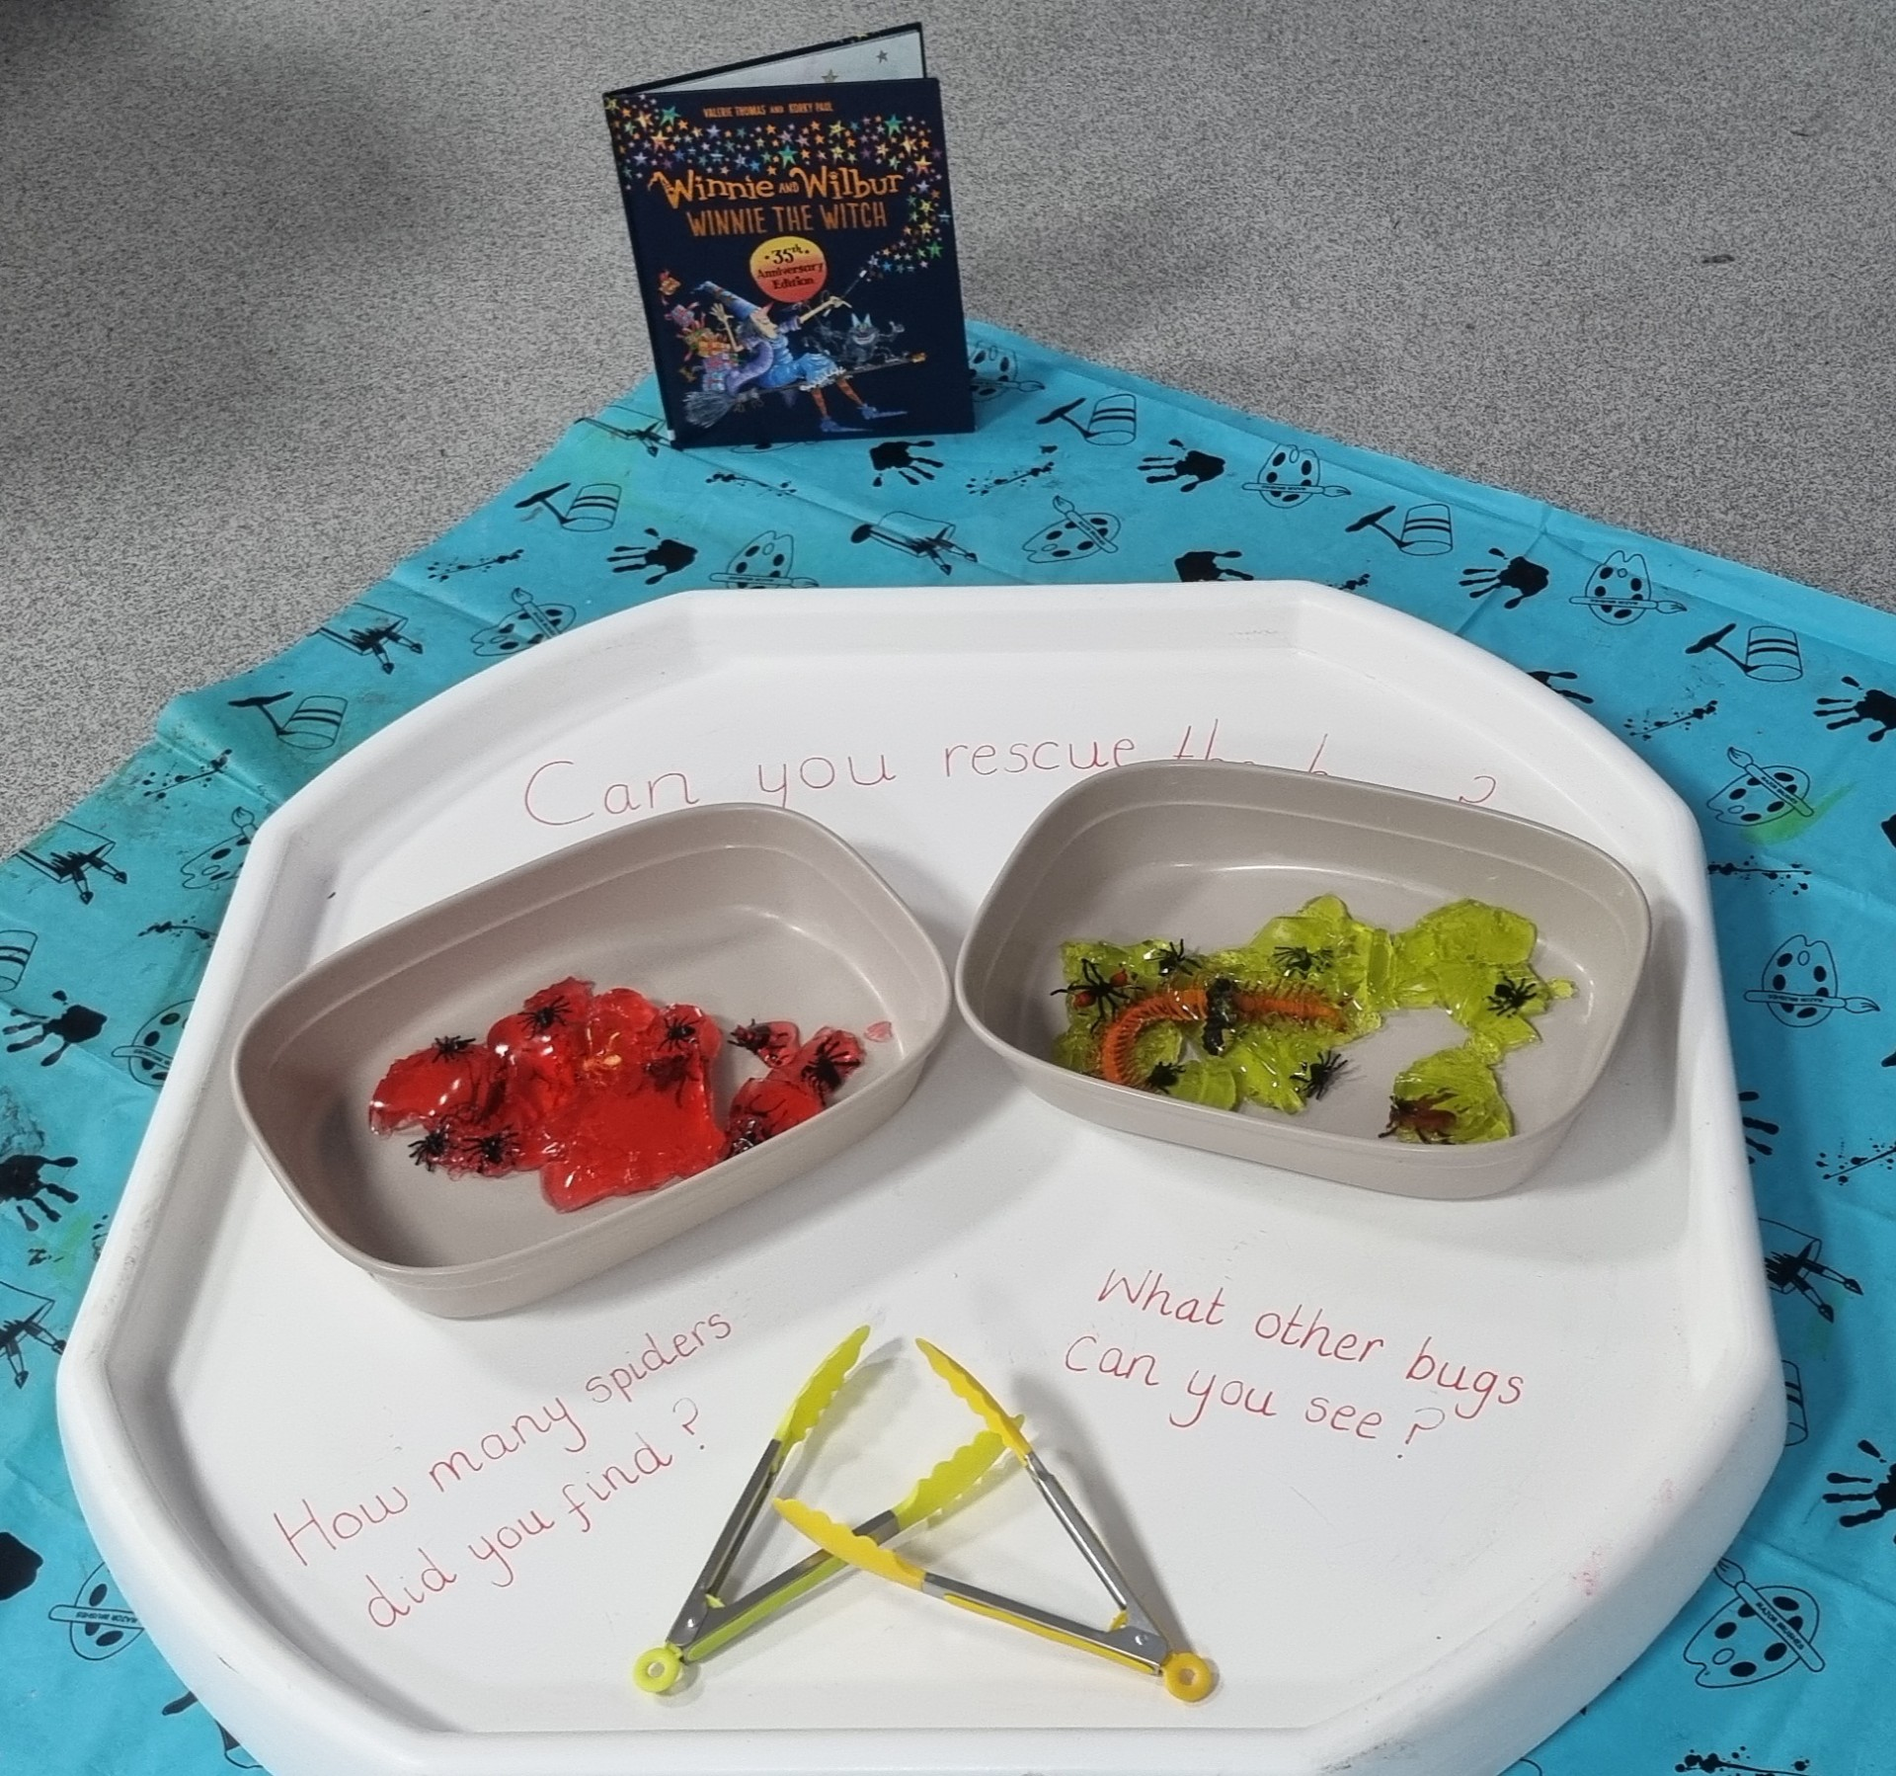
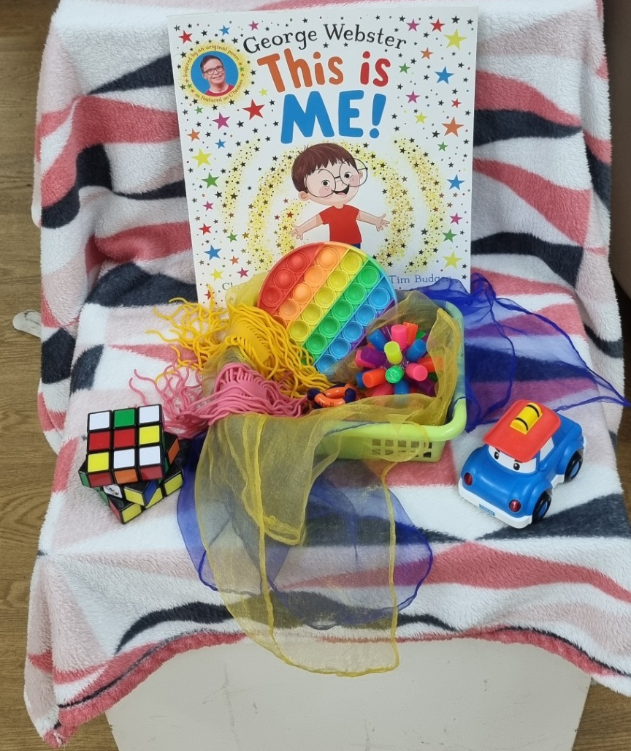
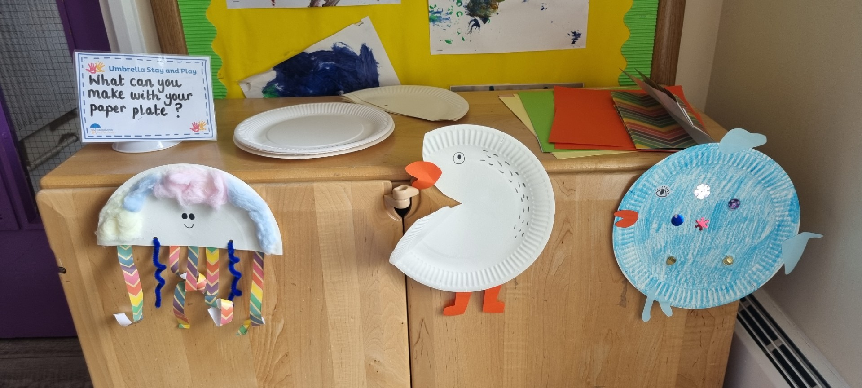
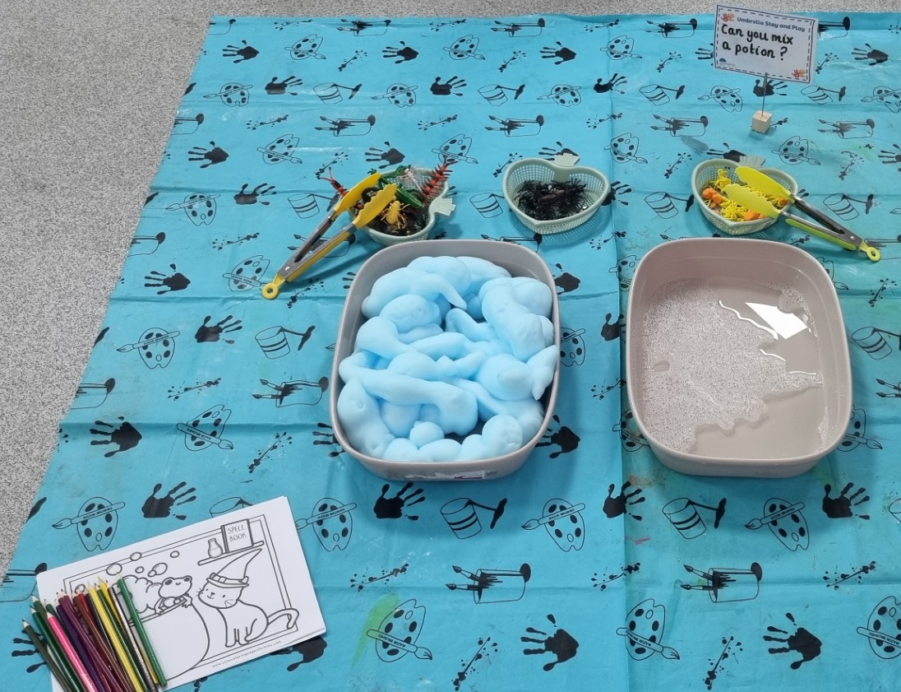
Umbrella Stay and Play
Child does not need a diagnosis
Emerging characteristics
Drop-In
Age

Slide 5
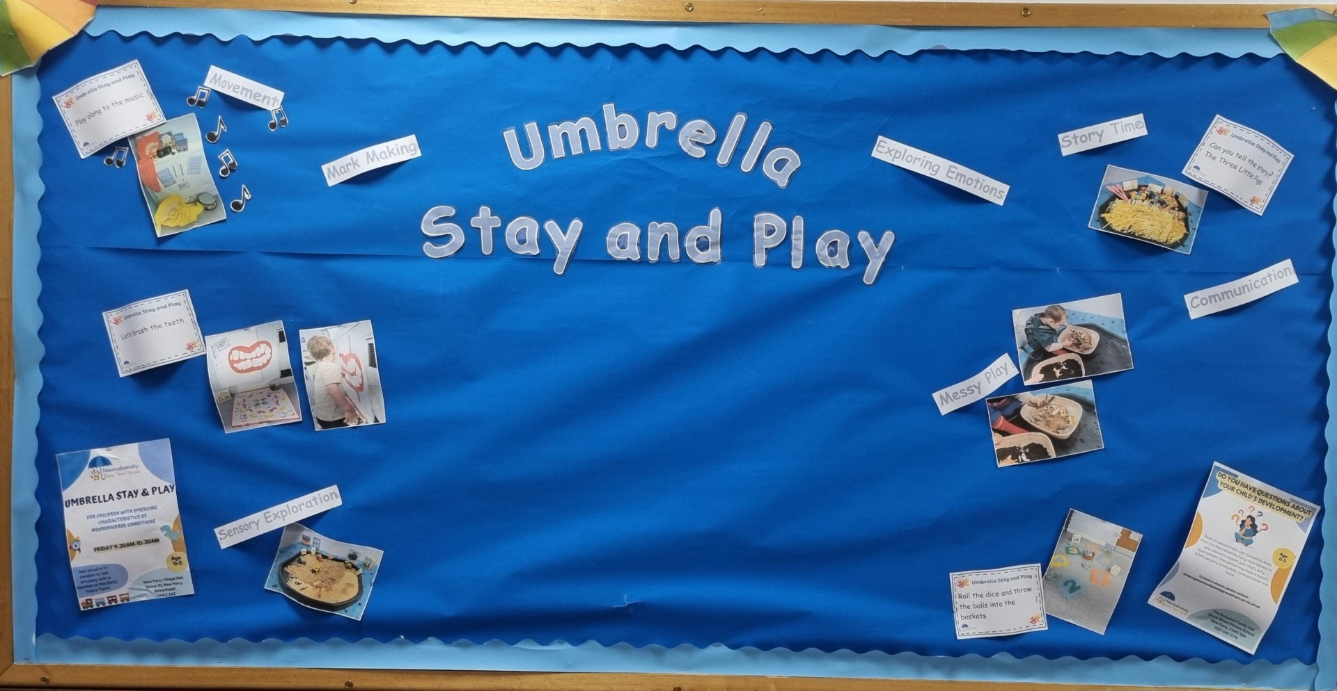

Slide 6
What do Parents/Carers Think?
“My child loved today's session. He loved exploring and seeing all of the new things. He also engaged with the practitioner really well which is unusual for him”
“This is the first Stay and Play that we have been able to stay at because my child becomes so overwhelmed”
“My child is a lot more confident and her speech and communication is getting better every week”

Slide 7
1:1 Parent/Carer Advice Sessions
Child does not need a diagnosis
Age
Common Themes
Bookable Sessions

Slide 8
What do Parents/Carers Think?
“The session made a lot of things make sense and helped me understand why my child may do things or eat certain foods. Really informative advice and explained very well”
“I felt listened to, without feeling judged. I feel I understand more about why my child may present the way they do”
“Being able to talk to someone about my concerns and find out different strategies and how to implement them at home. I feel a lot better and reassured 100%”

Slide 9
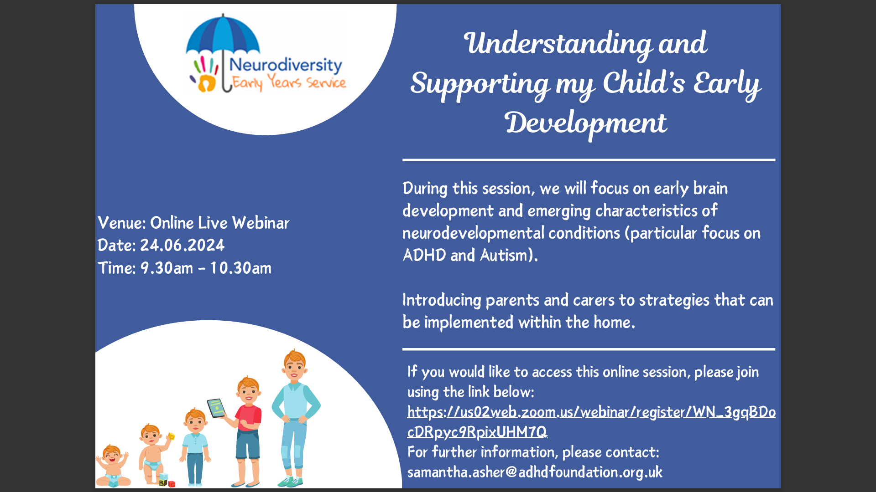
Training Offer

Slide 10
Early Years/KS1 Service Training
Average rating score – 4.9/5 Average confidence score increase - 3
“Such a practical, supportive and encouraging session. I feel both nurtured and energised by the presentation”
“Very useful information, exactly what we need as practitioners. Understanding and strategies and nothing unnecessary extra”
“This was excellent training. We were given a lot of information alongside what we can do to make a difference in our rooms. I would like a lot more of this type of training”

Slide 11
The Data
323 new families (children and parents/carers)
700+ returning families (children and parents/carers)
How beneficial is the service – 9.8
Confidence increased by 3.3
100% would return
Image by Freepik

Slide 12
Case Study

Slide 13
Any Questions?
Image by Freepik

Slide 14
Thank-you
Samantha.asher@adhdfoundation.org.uk
Samantha Asher
Neurodiversity Early Years Team Lead

