Slide 1



Community Safety, Violence & Adverse Childhood Experiences (ACEs) across Merseyside
Strengthening the evidence to advocate for investment & enhance evidence-informed prevention for the benefit of our children, families & communities
Prof Zara Quigg
Liverpool John Moores University
Nadia Butler, Charley Wilson, Rebecca Bates, Ann Marie Farrugia, Matthew Millings, Geraldine O'Driscoll, Mark A Bellis

Slide 2
A Public Health Approach to Violence Prevention
(1) Surveillance
Identifying the size & scope of the problem
(2) Risk (& protective) factor identification
What are the causes?
Violence is responsible for a large proportion of global morbidity & mortality
Interpersonal violence places huge impacts on individuals, communities & wider society
Violence is preventable
A whole system public health approach is required to address this complex issue
(3) Develop &
evaluate interventions
What works?
Implementation
Disseminate effective practice
Society
Community
Relationship
Individual

Slide 3

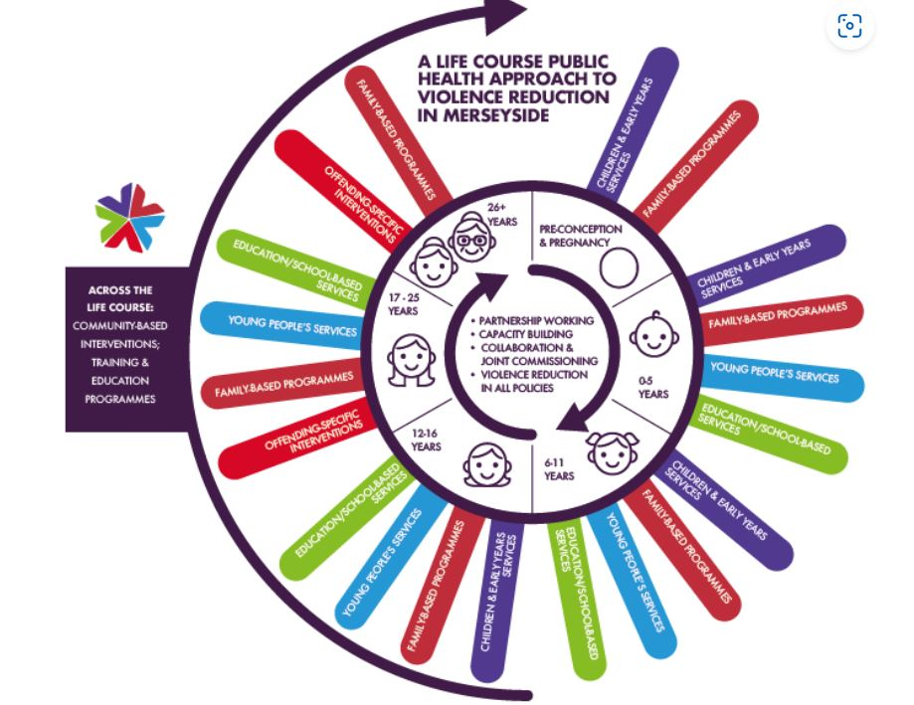
MVRP Public Health Approach to Violence Prevention
Refined based on whole system evaluation, community voices, partner insight & national policy/guidance
Key themes:
  Early years, Education, Health, Preventing offending, Whole family approach
  Youth voice (with & for the community)
  Place-based approaches
Underpinned by evidence & ongoing monitoring/evaluation
Taking an evidence-based approach to identifying root causes of serious violence to prevent & tackle serious violence. We will also use this evidence base, theory, data, & evaluation to inform our programmes & direct our funding in the best way

Slide 4


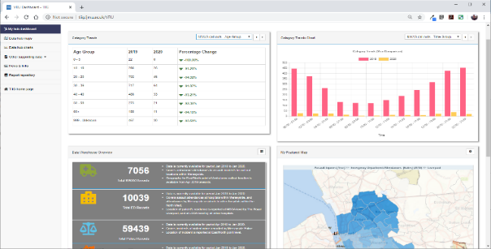
MVRP Evidence Hub Team, Surveillance, Research & Evaluation
Evidence hub:
  VRP Strategy & Strategic Needs Assessment
  Align provision with strategy, need & evidence
  Review, monitoring & evaluation
Surveillance - TIIG & MVRP data hub
  Bespoke interactive web-based data repository & dashboard
  Aggregates data from:
    EDs & UTCs – assault attendances; Ambulance Service – violence related call outs; Police – violence with injury / possession of weapon offences; Fire and Rescue Service – deliberate fires
  Hub allows MVRP to identify:
    Where serious violence is taking place & who is most at risk
Research & evaluation
  Evidence hub team
  LJMU academic partner since MVRP inception
  Wider evaluations & programme monitoring
Notes:
To

Slide 5
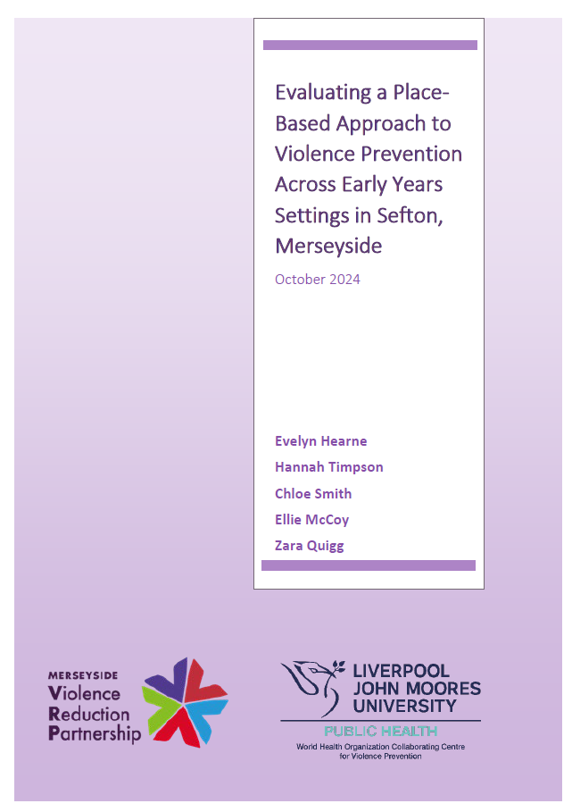

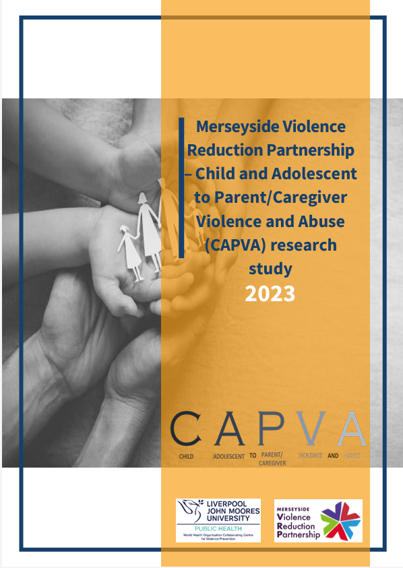


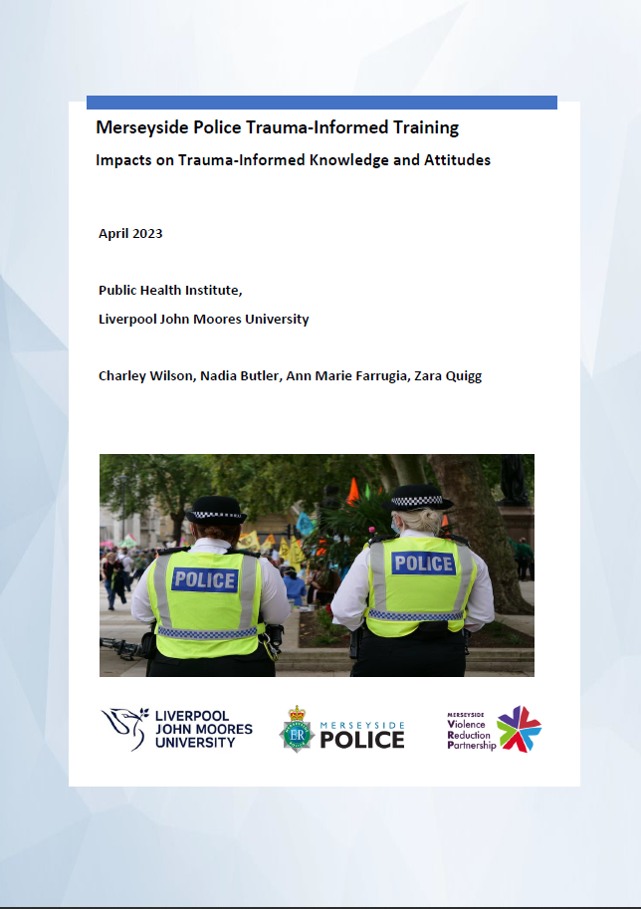
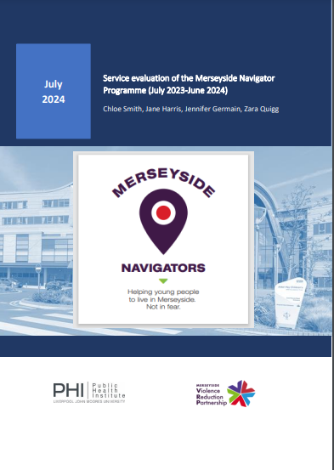

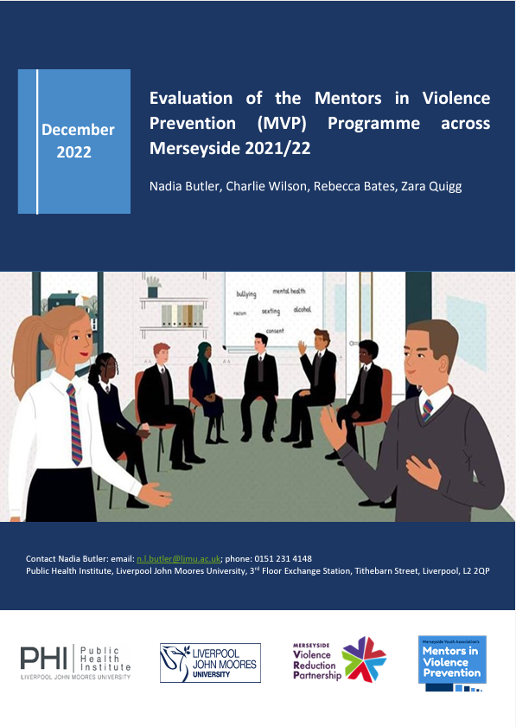
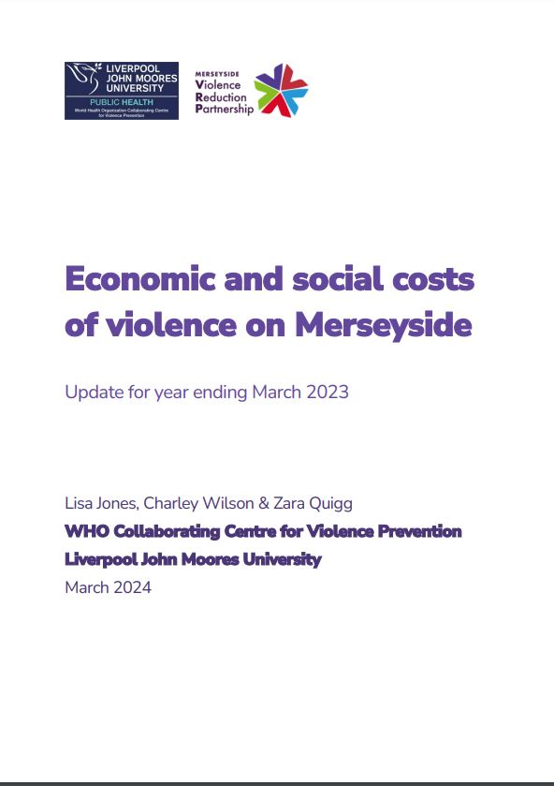
LJMU/MVRP Research & Evaluation
Whole family approach
Preventing offending
Health
Early years/ Place-based
Whole system
Education

Slide 6

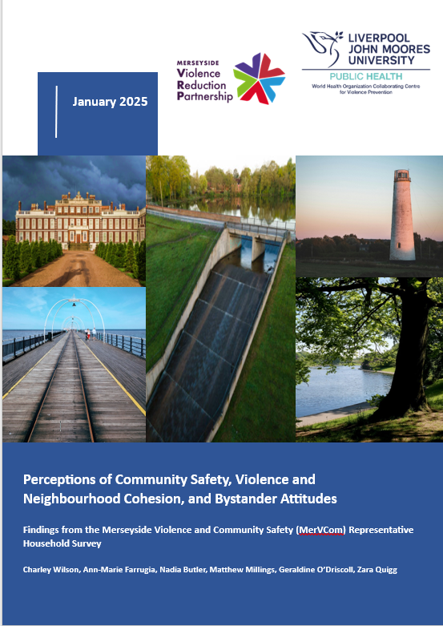
Merseyside Violence & Community Safety Survey
A population-level representative household survey of adults who are residents in Merseyside
Community safety and neighbourhood cohesion
Violence Victimisation in Adulthood
Adverse Childhood Experiences (ACEs)
Sociodemographics, health & wellbeing, health risk behaviours, exposure to criminal justice system
Themed & local authority specific reports

Slide 7




Methods
Adults aged 18+ who were residents across Merseyside
November 2023-April 2024
Sample size:
5395
4180 (77.5%) participants completed the survey face-to-face
1215 (22.5%) participants completed the survey online

Slide 8
Areas of Focus
Community safety & cohesion
Adult violence victimisation
ACEs
Feelings of safety in different settings across Merseyside during the day/ night
Perceptions of how common violence is in local neighbourhoods & in Merseyside generally
Perceptions of personal safety from violence & safety from violence for children/ young people in local neighbourhoods & across Merseyside generally
Perceptions of neighbourhood cohesion
Attitudes towards bystander behaviours
Prevalence of violence victimisation since aged 18 years
Identify the sociodemographics associated with violence victimisation
Examine the association between violence victimisation & adult:
  Health & wellbeing & health risk behaviours
  Criminal justice exposure
  Perceptions of personal safety & prevalence of violence, bystander behaviours, & relationship closeness
Examine the association between violence victimisation & childhood factors (e.g. ACEs, school exclusion, trusted adult support)
Prevalence of ACEs across Merseyside
  9 ACEs
  Additional ACEs (e.g. bullying)
Identify the sociodemographics associated with ACEs
Examine the associations between experiencing ACEs & adult outcomes:
  Health & wellbeing & health risk behaviours
  Violence & criminal justice exposure
  Feelings of community safety, neighbourhood cohesion, bystander behaviours, & relationship closeness

Slide 9




Perceptions of Community Safety, Violence & Neighbourhood Cohesion, & Bystander Attitudes
64.7% of participants felt safe in Merseyside generally during the daytime
42.9% felt safe during the nighttime
Females more likely to feel unsafe than males
Merseyside, nearest town, street (day & nighttime)
Those of white ethnicity more likely to feel unsafe than those of other ethnicities
Merseyside, nearest town, street (nighttime)
Those who lived in the most deprived areas more likely to feel unsafe than those from less deprived areas
Merseyside, nearest town, neighbourhood, street (day & nighttime)

Slide 10






Perceptions of Violence in Merseyside
86.3% thought that violence is common in Merseyside generally
34.8% of participants thought that violence is common in their neighbourhood
13.9% felt personally unsafe from violence in Merseyside generally
6.4% felt personally unsafe from violence in their neighbourhood
42.7% felt that children aged 10-17 years are unsafe from violence in Merseyside generally
25.9% felt that children aged 10-17 years are unsafe from violence in their neighbourhood
37.7% felt that young people aged 18-25 years are unsafe from violence in Merseyside generally
23.3% felt that young people aged 18-25 years are unsafe from violence in their neighbourhood

Slide 11





Community Cohesion
Bystander Attitudes
16.2% Low neighbourhood needs fulfilment
15.8% Low neighbourhood group membership
84.3% agreed with the statement ‘I need to set an example in my own behaviour for what I expect in others’
47.1% agreed with the statement ‘It is my responsibility to intervene when I notice a problematic situation’
31.6% agreed with the statement ‘There is no need to get involved in a problematic situation’
21.0% Low neighbourhood influence
18.7% Low neighbourhood emotional connection

Slide 12




Adulthood Violence Victimisation across Merseyside
Any violence victimisation since the age of 18
Merseyside
32.9%
4.5% in past 12 months
Across Merseyside
Any sexual assault
Any intimate partner violence
Any night-time economy violence
11.1%
11.0%
10.6%

Slide 13










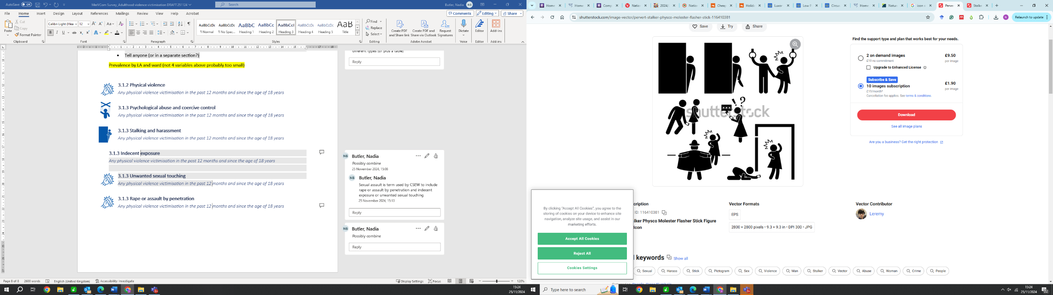



Physical violence
Psychological abuse and coercive control
Unwanted sexual touching
Since age 18 years 23.9%
Male
28.3%
Female
19.9%
Since age 18 years 9.4%
Male
5.3%
Female
13.3%
Since age 18 years 8.1%
Male
2.3%
Female
13.5%
Relationship to the perpetrator¹
Relationship to the perpetrator¹
Boyfriend/
girlfriend
Relationship to the perpetrator¹
Friend/ acquaintance
Stranger 51.5%
22.8%
23.4%
Location of victimisation¹
At home 35.0%
Location of victimisation¹
At home 83.5%
Location of victimisation¹
Night-time economy
35.0%
Reporting of victimisation¹
Family/
friend
42.8%
Reporting of victimisation¹
Family/
friend
45.1%
Reporting of victimisation¹
Family/
friend
38.8%
Stalking and harassment
Rape or assault by penetration
Indecent exposure
Since age 18 years 9.1%
Male
5.0%
Female
12.8%
Since age 18 years 5.4%
Male
1.3%
Female
9.2%
Since age 18 years 3.0%
Male
0.6%
Female
5.2%
Relationship to the perpetrator¹
Boyfriend/girlfriend
20.2%
Relationship to the perpetrator¹
Stranger 7.4%
Relationship to the perpetrator¹
Friend/ acquaintance
26.3%
Location of victimisation¹
Location of victimisation¹
Public space
Location of victimisation¹
At home 50.6%
64.7%
At home 54.5%
Reporting of victimisation¹
Family/
friend
52.1%
Reporting of victimisation¹
Family/
friend
42.0%
Reporting of victimisation¹
Family/
friend
28.2%

Slide 14
Associations with poor health & wellbeing & health risk behaviours
Adulthood violence victimisation & health risk behaviours
Adulthood violence victimisation & health & wellbeing
Adulthood violence victimisation & criminal justice exposure

Slide 15
Associations with perceptions of safety/violence, neighbourhood cohesion, bystander behaviours, & relationship closeness
Personal safety from violence/ prevalence of violence
Bystander behaviours
Neighbourhood cohesion
Relationship closeness

Slide 16
Associations with ACEs, school exclusion & trusted relationships
ACE counts
School exclusion
Trusted adult in childhood
No trusted adult support

Slide 17





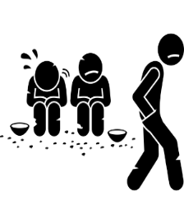







Adverse Childhood Experiences (ACEs) across Merseyside
Prevalence of thirteen individual ACEs, adults in Merseyside
Abuse: Verbal
Abuse: Physical Neglect
Household: Parental Separation
Household: Witnessing Domestic Violence
Household: Mental Illness
Community: Bullying
Community: Witnessing Violence
3.5%
20.7%
15.6%
15.9%
25.4%
20.4%
23.9%
Abuse: Physical
Abuse: Sexual
Household: Alcohol Harm
Household: Drug Harm
Household: Gambling Harm
Household: Incarceration
22.5%
6.5%
13.2%
4.2%
3.2%
2.8%

Slide 18




Adverse Childhood Experiences (ACEs) across Merseyside
Prevalence of ACEs (9) across Merseyside
50.1%
18.9%
18.8%
12.2%
Participants who reported 4+ ACEs across local authorities
Wirral
St. Helens
Sefton
Liverpool
Knowsley
11.9%
7.9%
12.6%
14.0%
11.6%

Slide 19
Associations with poor health & wellbeing & health risk behaviours
Increased risk in adults experiencing 4+ ACEs vs 0 ACEs
Controlling for sex, age, ethnicity and deprivation
Health
Increased risk in adults experiencing 4+ ACEs vs 0 ACEs
Controlling for sex, age, ethnicity and deprivation
Education & employment
Health risk behaviour
Violence
Criminal justice exposure

Slide 20
Increased risk in adults experiencing 4+ ACEs vs 0 ACEs
Controlling for sex, age, ethnicity and deprivation
Personal safety from violence/ prevalence of violence
Associations with perceptions of safety/violence, neighborhood cohesion, & bystander behaviours
Neighbourhood cohesion
Bystander behaviours

Slide 21
Increased risk in adults experiencing 4+ ACEs vs 0 ACEs
Controlling for sex, age, ethnicity and deprivation
Adult relationship closeness
Associations with relationship closeness & activities
Childhood relationships & activities

Slide 22
Summary
Violence & community safety are cross-cutting issues related to a wide range of public health harms
  Health & wellbeing; health risk behaviours; criminal justice exposure
Multi-agency approach with policies/interventions that focus on cross-cutting issues & underlying root causes
What happens in childhood can influence outcomes across the lifecourse
Prevention focused on early intervention
Promote & embed evidence-informed practice
Unique resource to support MVRP partners to understand local issues & develop & target policy & interventions to communities most in need
Advocate for increased targeted investment

Slide 23
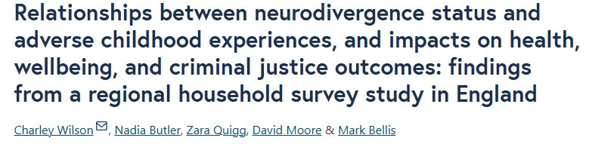
Next Steps
Dissemination of findings across local & regional multi-agency partnership meetings (Jan-Mar)
Inclusion of data in the MVRP data hub (Apr/May)
Public release of reports (Apr-May)
  Overarching summary & methodology
  Community safety, Violence, ACEs
  5 * local authority reports
Further analyses & output production

Slide 24


Thank you
Prof Zara Quigg
z.a.quigg@ljmu.ac.uk
@zaraquigg

