Slide 1
Unlocking the Labour Market
How the MVRP has improved access to jobs and training for prison leavers, ex-offenders and young people at risk of criminality on Merseyside
Lance Grundy MBE
DWP Lead Merseyside Violence Reduction Partnership

Slide 2
Background
The Merseyside Violence Reduction Partnership was the first VRU in the country to have a DWP staff member seconded to the team.
This was in recognition of the role that high-quality employment and training opportunities play in reducing offending, re-offending and diverting young people at risk of criminality away from crime

Slide 3
What we have achieved
Through our partnership approach we have implemented closer working between the Department for Work and Pensions [DWP] and His Majesty’s Prison & Probation Service [HMPPS]
DWP staff are now working in five NPPS offices across the Liverpool City Region to maximise ex-offenders and prison leavers access to work, training opportunities and the wider DWP Jobcentre Plus offer
DWP staff also work alongside police-led Integrated Offender Management Teams in either HMPPS offices or police stations delivering a similar service to more high-risk offenders

Slide 4
We have expanded this delivery model to include the provider of the Merseyside Police-funded Deferred Prosecution Scheme for 18-25-year-olds
We are also working with the HMPPS Creating Future Opportunities Activity Hub where Disability Employment Advisers provide on-site support to more complex cases such as those with mental or physical health conditions which affect their ability to work
We have driven forward improved communication and joint-working between DWP Multi-Agency Public Protection Arrangements [MAPPA] co-ordinators and their counterparts in HMPPS to ensure that those individuals subject to MAPPA supervision are managed safely when accessing job or training opportunities in the City Region

Slide 5
DWP Support for Prisoners and Ex-offenders
There are DWP Prison Work Coaches in most prisons in England, Scotland & Wales.
They work with prisoners on arrival, during their sentence and before they are released
Notes:
There are 122 prisons in England and Wales and 15 prisons in Scotland
Here in Merseyside, we have prison work coaches based in both HMP Liverpool and HMP Altcourse
We also have the role for Mappa Co Ordinator on our team
We now have a little video that explains the Prison work coach role then we will discuss it in more detail *

Slide 6
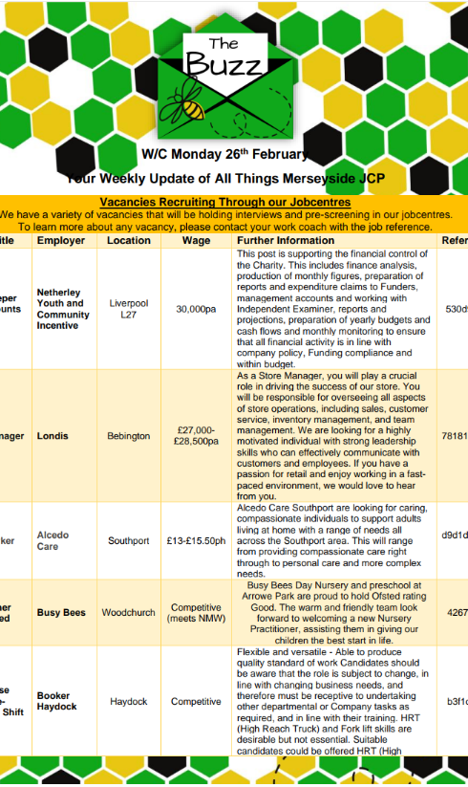
Through The Gate Support
PWCs are located in NPPS offices across the City Region where they:
Offer tailored support to help prison leavers and ex-offenders move closer to the labour market
Advertise upcoming job and training opportunities, check eligibility and refer where appropriate
Signpost to non-DWP support e.g. CFO Activity Hubs
Notes:
*As mentioned earlier on – in Merseyside we offer a through the gate support having our PWCs based in probation offices across the city region.

Slide 7
Connect with the wider DWP offer
50 Plus
Youth Hubs
Care Leaver
Supporting Families
DEAs
Specialist Ex-Offender WCs

Slide 8
Any Questions???

