Slide 1

Rebecca Bates Chloe Booth
Child to Parent/ Caregiver Violence and Abuse Research study and PhD Study
Notes:
A general definition is that it can involve any act of violence, abuse, coercion, or criminal damage in the home (or other environment) by a child/adolescent towards a parent, often following a continued pattern of multiple behaviours.
Globally there are many inconsistencies in the definitions of CAPVA which can be attributed to the way it is perceived, operationalised and measured
CAPVA is becoming more widely recognised in the UK and internationally as a serious, emerging public health issue, with immense impacts on children, parents, other family members and the wider community.
As part of Chloe’s PhD she conducted an extensive literature review so I’m going to pass over to her to talk about some of the key findings.

Slide 2


Background and Literature review
Notes:
Chloe conducted an extensive literature review including topics such as demographics of those involved, risk factors, key theories and policies. It also includes gaps and recommendations for future research. Chloe's full literature review can be found if you follow this QR code.
In terms of the research project.... a bit of background about the research study: MVRP hosted a workshop for practitioner across a number of different field to attend CAPAV came up as a significant and prevalent issue they were facing in their service. This resulted in the MVRP commissioning LJMU to complete a mapping of support services and to get a better understanding of the offer available to families across Merseyside.
Little caveat about the study whilst we recognize the needs of children and young people as a priority, in order to help those children and young people we must also explore the experiences and support needs of parents/caregivers (and other siblings in the household). Our report focuses on practitioners and parents/caregivers.

Slide 3



Research study Methodology
Engagement with stakeholders’
Interviews were conducted with key partners (n~24); and an online practitioner survey (n~33).
Engagement with parents
Interviews were conducted with parents/caregivers (n~9) who have experienced CAPVA; and an online parent/caregiver survey (n~18).
Advisory group and stakeholder workshop
An advisory group was established, and stakeholder (Jan 23 n~26 & Dec 23 ~ n16) workshop held to support this study.
Notes:
We implemented a number of methodologies
Semi-structured interviews either over the phone or online were conducted with key partners (n~24); and an online practitioner survey ran simultaneously across relevant services and organisations (n~33).
Similarly, we engaged with parents and caregivers who had experienced CAPVA through interviews (n~9); and we also ran an online parent/caregiver survey which was shared by services and across social media (n~18).
We also set up an advisory group made up of key experts run by them any intended survey or interview questions to assess for relevance and appropriateness.
Finally, we hosted a workshop with key stakeholders which many of you attended. Where we collected key information to support the research study. We also had some follow up workshops to disseminate some of the research findings and also to begin implementing some of the recommendations.

Slide 4







KEY Findings
Extent of abuse
64.7%
84.8%
65.5%
Demographics of those involved
76.5%
58.8%
52.9%
Mothers
Son’s
9 years old or less
Notes:
Extent of abuse- 65% of parents and 85% of practitioners agreed/strongly agreed that they believed CAPVA is a problem in Merseyside. Again about 65% of practitioners felt the number of CAPVA incidences they have encountered has increased in the last 12 months compared with the previous year. Some practitioners linked this to covid-19 felt this offered a kind of perfect storm situation for violence to get much worse. Perhaps it would have always been there but without the relief from things like schools, spending time outside the household it creating an environment where CAPVA could thrive undetected.
Consistent with previous research that mother (76.5%) surveyed were still currently experiencing CAPVA. Most reported the child committing CAPVA was their son, and the majority reported the behaviours began when the child was 9 years old or less, they reported that the behaviour was at its worst when the child was between 13-15 years old.

Slide 5
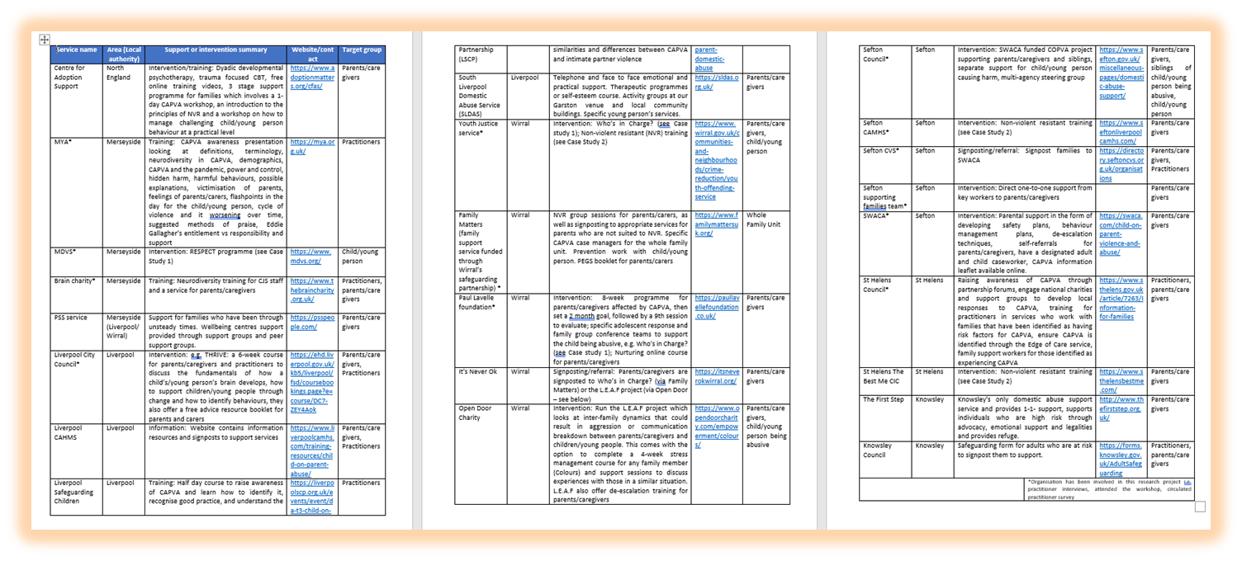

Mapping of services across Merseyside that offer CAPVA support
Notes:
Hard to see sorry but we compiled a list of services across Merseyside that were offering capva support to families.
Split by across Merseyside and LA specific services.

Slide 6




CAPVA specific interventions across Merseyside
Respect Young People’s Programme (RYPP)
Who’s in charge
Non-violent Resistance training
CAPA First Response
Notes:
There were several CAPVA specific interventions identified across Merseyside including Respect Young Peoples Programme, Who’s in Charge, CAPA first response and Non violent resistance training. The report has individual case studies on each of these and goes into more detail on what each one entails.

Slide 7

System wide recommendations
Establish a Merseyside CAPVA multi-agency steering group
Enhance CAPVA data collection and sharing within and across organisations
Training for practitioners
Public awareness campaign
Notes:
As part of the report, we noted a number of recommendations
Establishing a Merseyside CAPVA multi-agency steering group
Service data, in particular police data was particularly difficult to obtain. Data collection and sharing within and across organisations needs to be enhances and improved.
More training for practitioners particularly in organisations with high turn over of staff.
A public awareness campaign to reduce stigma and improve knowledge.

Slide 8
Intervention specific recommendations
Support website and helpline
Increase police awareness of support services:
Parent/caregivers support groups
Engage schools in prevention
Tailor interventions to ensure they are person/family centred, considering neurodiversity
Research and evaluation
Notes:
This study also identified several approaches and interventions
Which included:
Having one websites or hub which included support for families and information on where they can go for help as well as a helpline that families could call for support.
More often than not the police are the the first point of contact in times of crisis therefore an Increase police awareness of available support available.
More parent/caregiver support groups
Engage schools in early prevention
More tailored interventions particularly for families with children with neurodivergence
More research/evaluation.

Slide 9

Recommendations currently being actioned
Multiagency steering group (workshop event with key organisations and practitioners across Merseyside Jan 2024)
Answered the Home Office’s call for consultation
Driving forward a multiagency steering group
CAPVA specific roles.
Integrating CAPVA into LJMU Public Health course curriculum.
Academic paper
Notes:
So far, we have hosted 2 events since publishing our report. Attended by roughly 30 practitioners and experts across different sectors to decide as a collective however to progress a multiagency steering group and who would site on it. These meeting have been very productive with some outcomes including having two separate groups one more general strategic group and another for more operational purposes.
As part of one of those events the group answered the home offices call for consultation to help decide how child to parent violence is defined as a collective Merseyside response.
The multiagency steering group recommendation has begun to gain traction. Myself and Roger Tompson the Education lead for the VRP presented the findings to the Merseyside Strategic Policing and Partnership Board with the hope that it will continue to build traction with the PCC pushing it forward.
Respect has employed a Merseyside wide CAPVA lead Helen Last whos role is to identify and improve pathway and training amongst many other thing.
Further work includes incorporating CAPVA into LJMU youth violence module for our Public Health course.
Disseminating the research findings via conferences and meetings
Writing academic papers
And a Phd funded by the MVRP on CAPVA CB who will speak on this now.

Slide 10
PhD
This PhD programme aims to tackle the inconsistencies around CAPVA by exploring the evidence on CAPVA across Merseyside and identifying what an effective model for preventing and responding to CAPVA looks like.
Last 2 years
      Literature Review
      Systematic Policy Review
      Mixed Methods Youth Justice Service Data Study
      Interview Stage for Qualitative Study
Notes:
Hi, I'm Chloe and I am the PhD researcher for this project. This PhD aims to change the inconsistent approach to CAPVA across services by exploring the evidence on CAPVA across Merseyside and identifying what an effective model for preventing and responding to CAPVA looks like.
Since starting, I have completed the literature review mentioned earlier, a systematic policy review, a mixed methods study, both of which I will talk about, and I am in the interview stages of a qualitative study to capture the voicers of parents/carers, siblings and young people with lived experience of CAPVA.

Slide 11

PHd aims and objectives
The overarching research question of the entire PhD is:
What does an effective model of preventing and responding to CAPVA look like?
In order to answer this, a number of research questions have been devised:
•What is the nature and extent of CAPVA across Merseyside?
•What are the risk factors for CAPVA?
•What is the evidence for preventing and responding to CAPVA?

Slide 12

Policy Review Findings
18 UK policy and international guidance documents for CAPVA were analysed
61% were guidance documents rather than official policy
61% were produced by a charity, support service or independent source
Definitions varied greatly
Approaches to CAPVA were mostly responsive rather than preventative
None of the policies or guidance were underpinned by a theoretical framework
Notes:
The systematic policy review was intended to summarise UK policy and international guidance for practitioners in order to provide an evidence base for a better approach to addressing CAPVA globally
The aims were to explore
How CAPVA is defined through policy, legislation and guidance for practitioners
What approaches to preventing and responding to CAPVA are recommended
Who is developing CAPVA policy, legislation and guidance, and what evidence, theoretical framework or legislation underpins them
18 UK policy and international guidance documents for CAPVA were analysed
61% were guidance documents and were produced by a charity, support service or independent source, highlighting the work frontline services are doing to supplement support with guidance in light of the lack of official statutory CAPVA Policy.
Definitions varied greatly throughout. There were some consistencies through the documents, in terms of nature and types of abuse, as well as several differences such as age and type of perpetrator.
Despite evidence suggesting that prevention is key to CAPVA, the majority of the documents were responsive in nature
None of the policies or guidance were underpinned by a theoretical framework and only 2 were based on legislation

Slide 13

Youth Justice Service Data Findings
Originally a quantitative study to look at anyone within the Youth Justice Service (past 6 months)and compare variables between those who had displayed CAPVA and those who hadn't
Data from two local authority Youth Justice Services were analysed and 5 different types of abuse were reported (Emotional= 2.4%, Financial= 2.4%, Verbal= 31%, Physical= 45.2%, Multiple forms of abuse= 19%)
100% of those were CAPVA was reported were 16+ (16-17=88.1%, 18=11.9%)
83.3% of perpetrators were male
83.3% of perpetrators had reported experiencing at least one ACE (4+ ACEs=42.9%)
Practitioners from both Local Authorities stated that more consistent and standardised recording of CAPVA would result in data that more accurately reflects CAPVA within their Local Authority
'trying to standardise it as well as you know, pushing for (management) to give us that flag either on the offence tab or in the event characteristics region'
Practitioner 1
'it probably would be easier if you just had a little specific box in the family section'
Practitioner 2
Notes:
Originally a quantitative study to look at anyone within the Youth Justice Service within the 6 months prior to data collection and compare variables between those who had displayed CAPVA and those who hadn't however data was so inconsistent, that the decision was made to only look at CAPVA cases and supplement the data with qualitative interviews with service practitioners.
Data from two local authority Youth Justice Services were analysed and 5 different types of abuse were reported, with the most frequent being physical abuse at 45.2%. however this may be a reflection on only the most severe cases of CAPVA being reported.
100% of those were CAPVA was reported were 16+, and again this could likely be reflection of the minimum age of domestic violence and no standardised procedure for reporting CAPVA from those under 16
83.3% of perpatrators were male
83.3% of perpetrators had reported experiencing at least one ACE with 42.9% experiencing 4 or more
Practitioners from both Local Authorities stated that standardised recording of CAPVA would result in data that more accurately reflects CAPVA within their region

Slide 14

What Next?
Continue to recruit for, and interview, those with lived experience of CAPVA (specific focus on fathers and young people due to gaps in the research) and complete qualitative study next year
Review all evidence so far, alongside key stakeholders, and assess the appropriateness of a Delphi study to devise a model of best practice to preventing and responding to CAPVA across Merseyside

Slide 15


Thank you r.bates@ljmu.ac.uk
C.J.Booth@2018.ljmu.ac.uk
Literature review
Research study report

