Slide 1
Notes:
As I’m sure you’ve guessed, we need a picture

Slide 2
6 week program for Primary School years 5-6
Education through Exercise
Key deliverable message for Young People to walk away with
Message to spread through the school, at home with families, friends and across their communities.
Who Are we?
What do we do?
Merseyside Fire and Rescue
Merseyside Police
NWAS & St John’s Ambulance
HISTORY
Community Focused approach beginning from World Fire Fighter Games 2008 Leading on to London Olympics 2012 Legacy and Inspire Program Establish Grass Roots Sport, Cultural and Healthy Eating Activities
Develop Partnerships to Promote Sport, Health and Well-Being
Thus, Fire Fit was born!
Notes:
I don’t think we have a team photo but it’d be nice I like the theme of this one but can’t replicate it, so I’ve tried some others…

Slide 3
Statistics
In 2022 27% of children aged 2-15 were overweight or obese (NHS England)
Knowsley, currently has the highest rate of obese and overweight 10-11 yr olds (45.6%) in the UK
Child attitudes towards police are determined by their interactions, but more so through their parent’s views. Its estimated confidence falls in policing by 20% for each annual age increment (Sindall et al., 2016)
Home office figures show Merseyside police recorded 298 assaults on emergency workers between March 2020 and the end of 2022, not including attacks on Police.
Notes:
Young people and the formation of attitudes towards the police (Sindall, McCarthy, Smith, 2016) published in the European Journal of Criminology

Slide 4
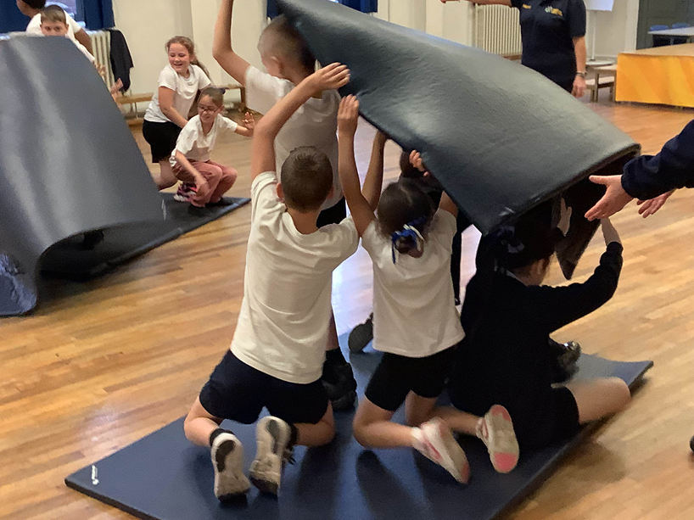
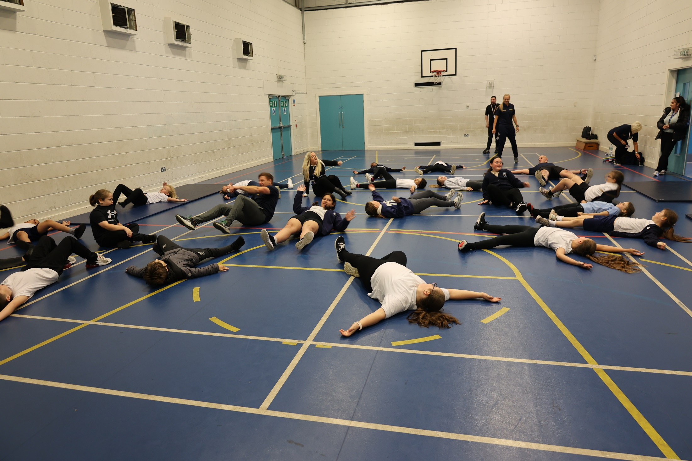
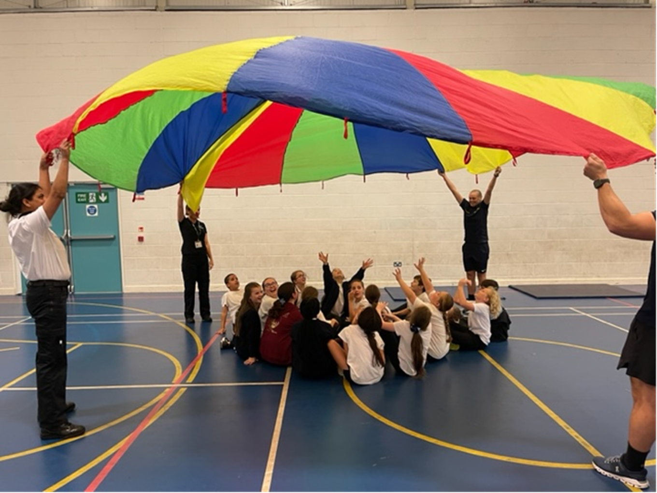
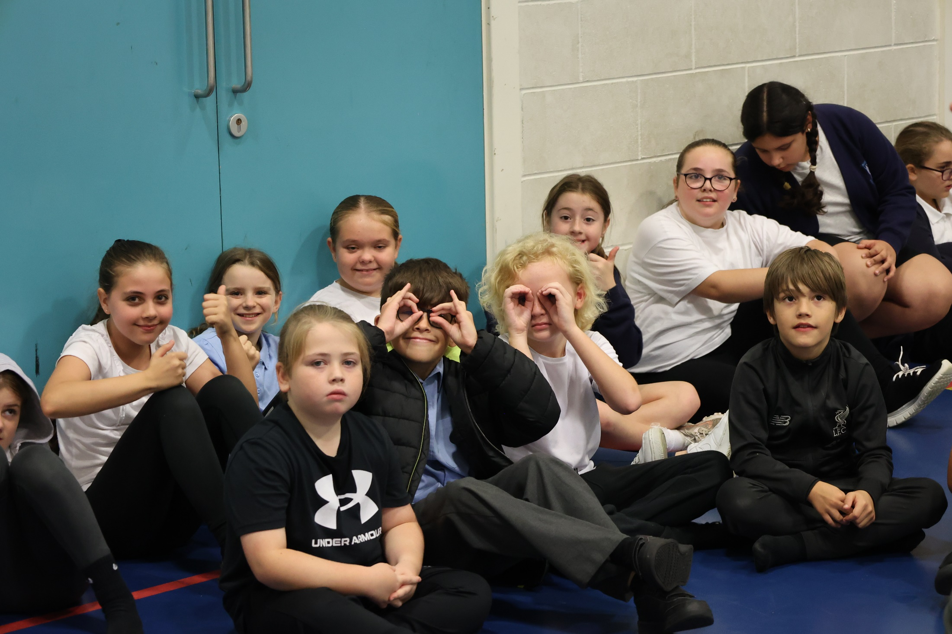
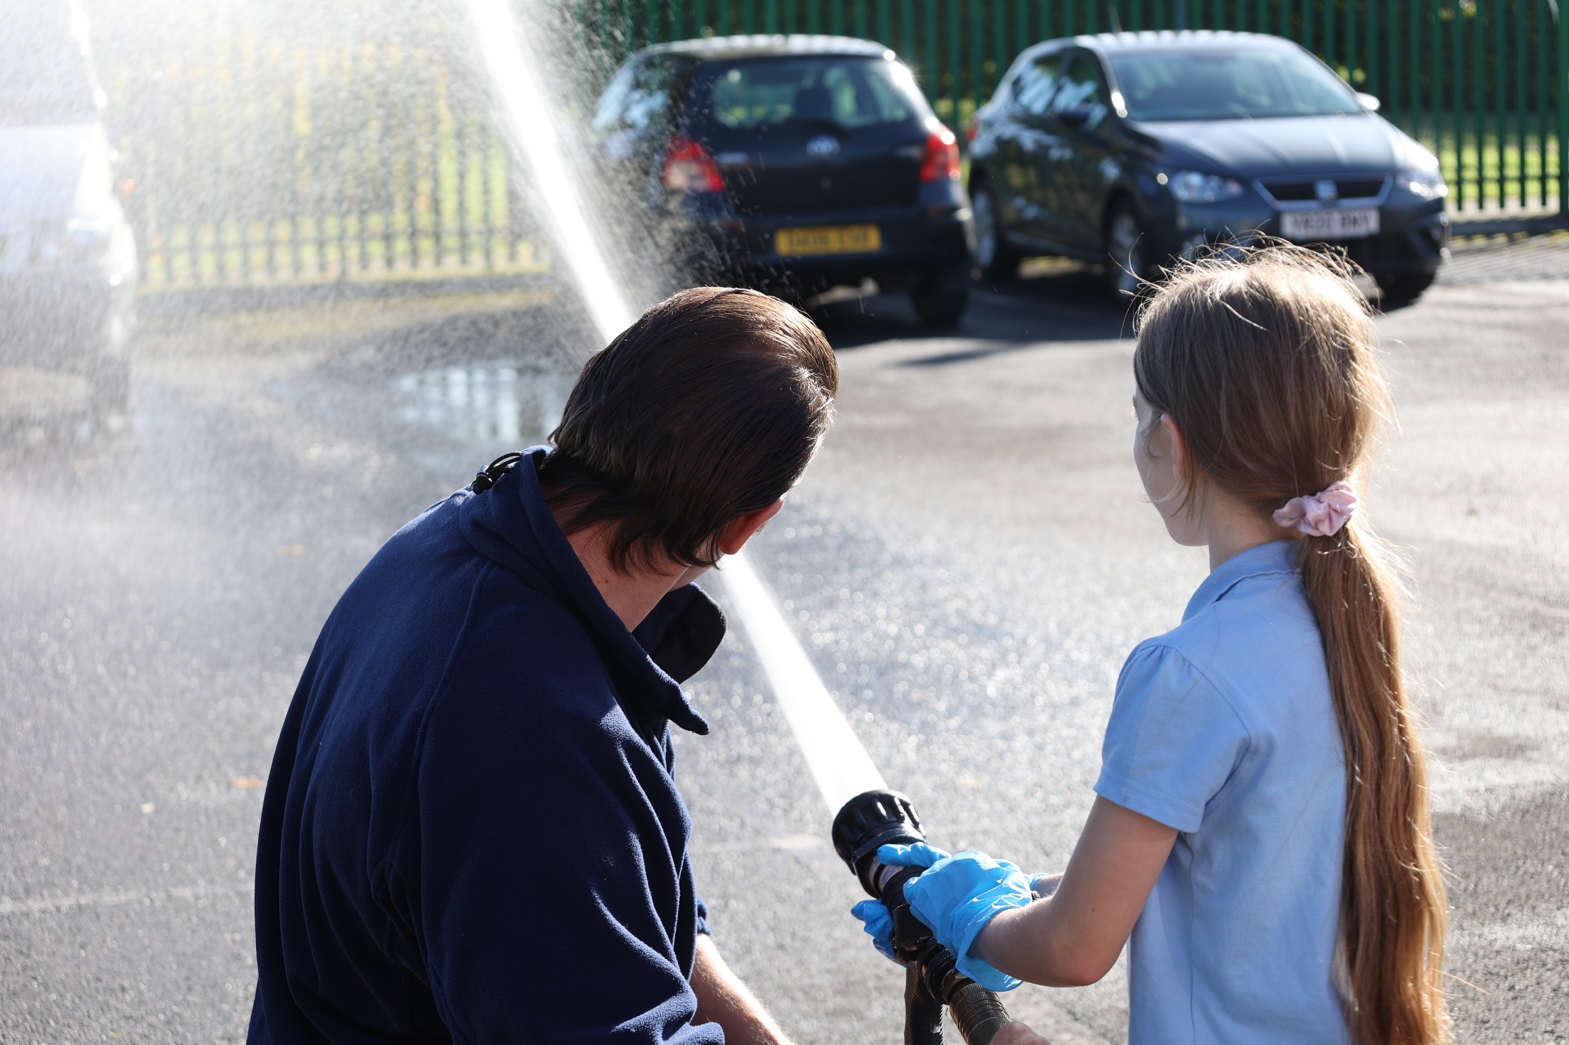
6 Week Programme
90 Minute sessions
1 topic per week, 3 safety messages
Notes:
Since starting in June 2023 we have targeted 491 children over 15 schools to date.
Strengthening their protection factors, building self-esteem, self –confidence and self-control
Deliver Key Messages identified by VRP using a Trauma informed approach to coaching
Visits from Fire engines and police cars
Contributing to the mitigation of post Covid health and wellbeing inequalities
Raising of aspiration levels, reductions in school exclusion and persistent absence
Bridging relationships between Children and Blue Light Services

Slide 5
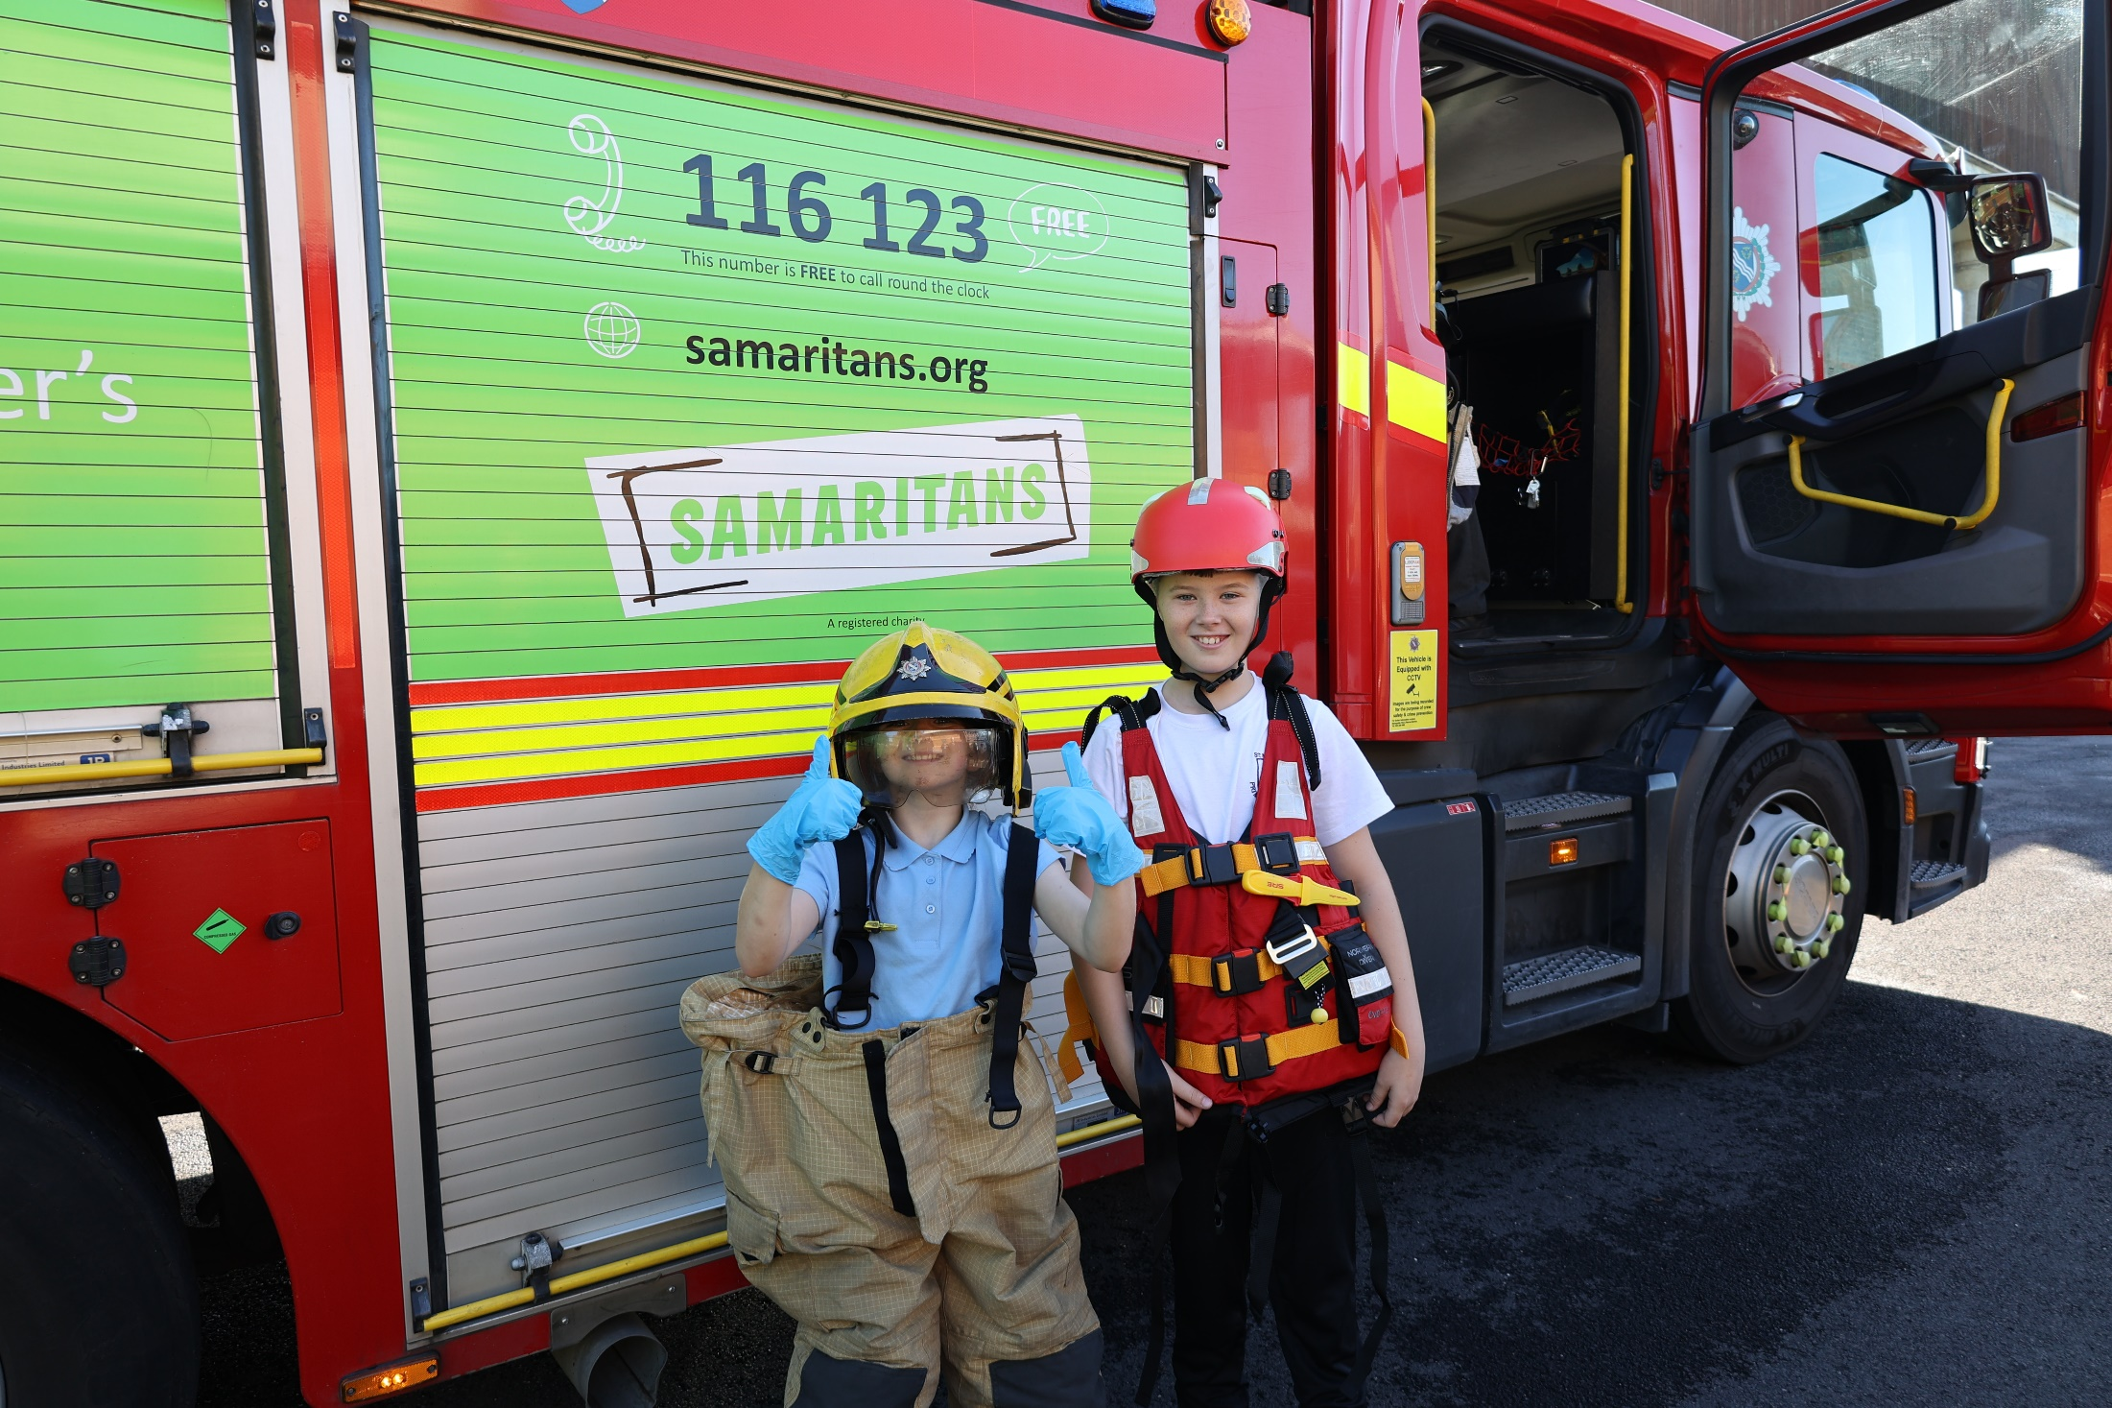
Key Messages

Slide 6
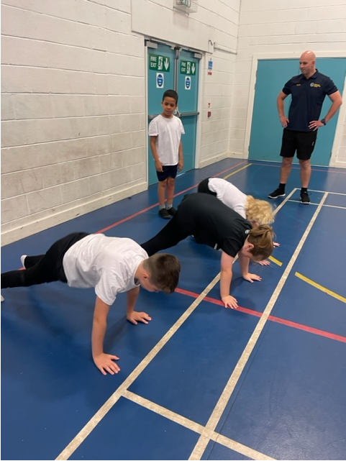
FIRE SAFETY
1 – Check Smoke Alarms
2 – Shut Doors
3 – Call 999
ROAD SAFETY
1 – Cross on green
2 – Fasten
3 – Don’t get distracted
WATER SAFETY
1 – Call 999
2 – Lay Like a star
3 – Throw a line

Slide 7
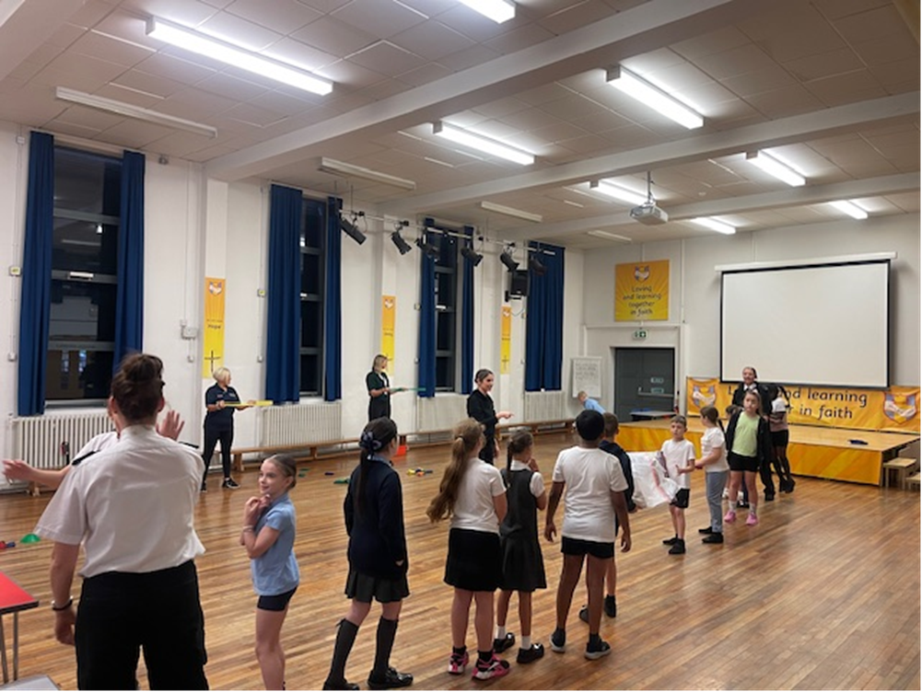
Key Messages

Slide 8
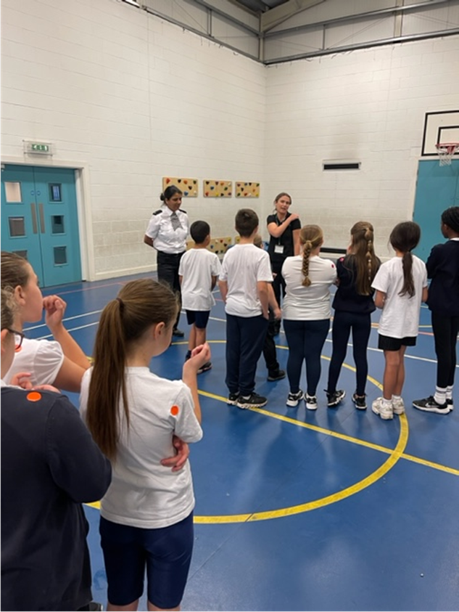
GANG EXPLOITATION
1 – Don’t accept gifts
2 – Tell someone you trust
3 – Don’t follow the crowd
ANTI SOCIAL BEHAVIOUR
1 – Arson is a crime
2 – Hoax Calls cost lives
3 – Don’t Trespass
HATE CRIME
1 – Don’t discriminate
2 – What makes us different?
3 – Hate crime is a crime!
CYBER SAFETY
1 – Don’t Share Details
2 – Bullying is Bullying
3 – Might Not Be Who You Think

Slide 9
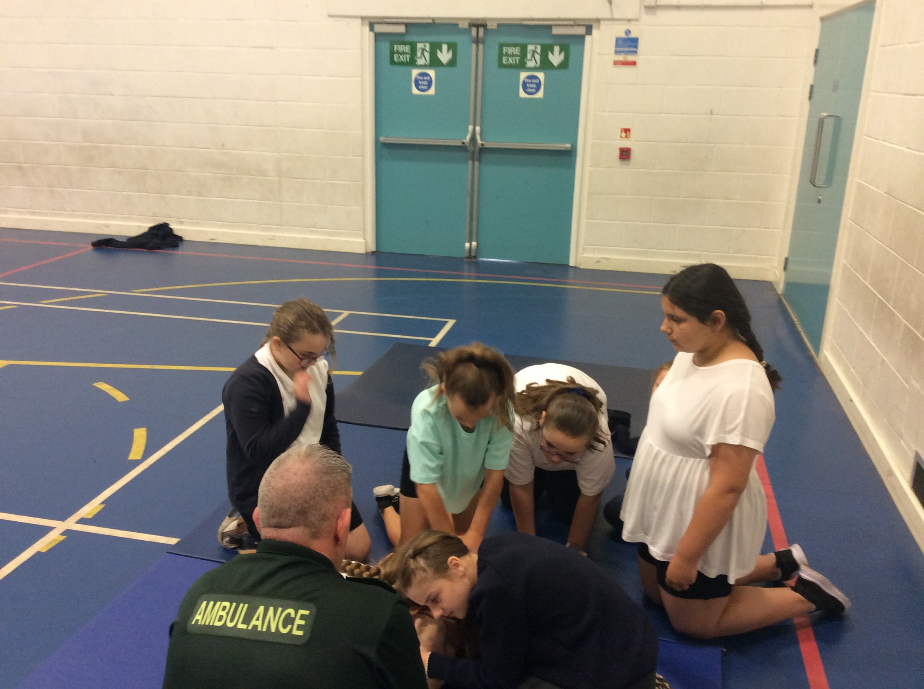
Key Messages

Slide 10
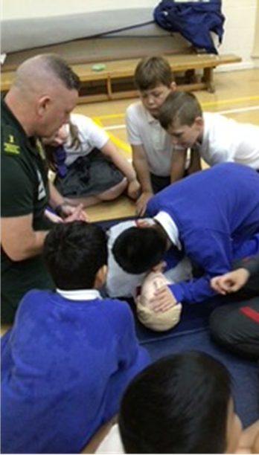
Casualty Care
1 – CPR
2 – Recovery Position
3 – Bandages
4 – Call for help
5 – Check for danger

Slide 11
What did they learn

Slide 12
Our Impact
Build positive relationships with children
Improve safety knowledge
Promote confidence in potential lifesaving scenarios
Empowering the children to pass on the message
Encourage healthy lifestyle choices through exercise and nutrition
Notes:
Relationships with children will hopefully translate to their families, breaking down barriers that exist and helping us to create safer communities.
Every session is designed with key safety messages that are reiterated constantly through games so that every child can remember each point at the end of the six-week programme
Each game is specific to one of the messages to provide a practical element to the learning so if a situation does arise the children will have the confidence and the knowledge to deal with it
We encourage all of the children to share the messages that they have learned during the fire champions programme with their family and friends and contact the emergency services if they have any questions.
In its simplest form we get the children to exercise and highlight the importance of making healthy lifestyle choices and the benefits of exercise and good nutrition.

Slide 13
Comments from Teachers
The Fire Champions programme has been fantastic. It has left a positive impact on all of the children, who have thoroughly enjoyed working with the different emergency services and learning key skills.
The incorporation of games not only made the programme enjoyable but also taught the children some important life skills.
The blindfold exercise, simulating a smoke-filled house, proved to be a particularly engaging and educational session for the children.
Additionally, the inclusion of a CPR session and first aid with bandages was another highlight.
The children wanted to thank the fire champions for all of their work during the programme. We couldn’t recommend the sessions highly enough to other schools and would love to work with you again!
Comments from Children
“It was fun because the games were exciting but we also learnt a lot”
“Brilliant and I get excited each Thursday morning. I enjoyed the games and learnt lots of new information”
“ We learnt about fire safety and how to test smoke alarms.”
“I enjoyed it because it was fun. My favourite part was seeing the Fire Engine and meeting more fire fighters ”
“We learnt not to take bribes from strangers”
“After every lesson im so excited for the next one”
“I didn’t know what the fire service was , I didn’t know what they did”
Games were great they teach us how to save people and how to help people out water safely”
“Very unique”
“My mum is going to be so proud of me because I done CPR”

Slide 14
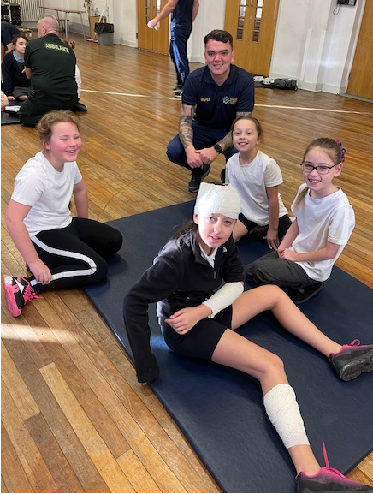
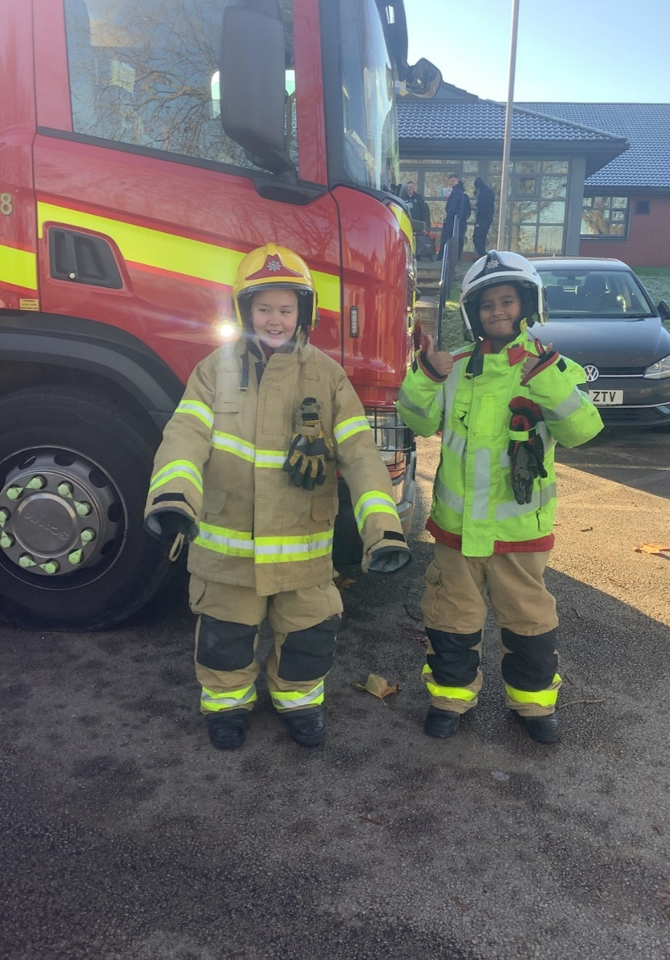

Slide 15
Any Questions?

