Slide 1
Be the change
Francine McKeown
Service Manager
Crime and Communities

Slide 2
“Keep Your mind open to change,
Welcome it.
It is only by examining and re-examining our opinions and ideas that we can progress”
Notes:
What is this all about?
Well today I have to take you back before I can take you forwards. Some of the things I am about to talk about are quite radical, but what do they say? Nothing changes if nothing changes. All I ask is that you stick with me and keep an open mind.

Slide 3
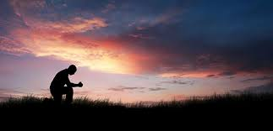
Who has heard (or believes in) the following?
Manifestation
Laws of Attraction
Praying for Something
Visualization
Wishing / Hoping
Notes:
Now can I have an agreement that when you adopt any of these practices you are asking for what you WANT rather than what you don’t. Some of you may start doing things that will help you move ever closer towards what you are hoping for. You imagine how you will feel when you get what it is that you want.
KEEP THIS IN MIND WHEN I TALK

Slide 4
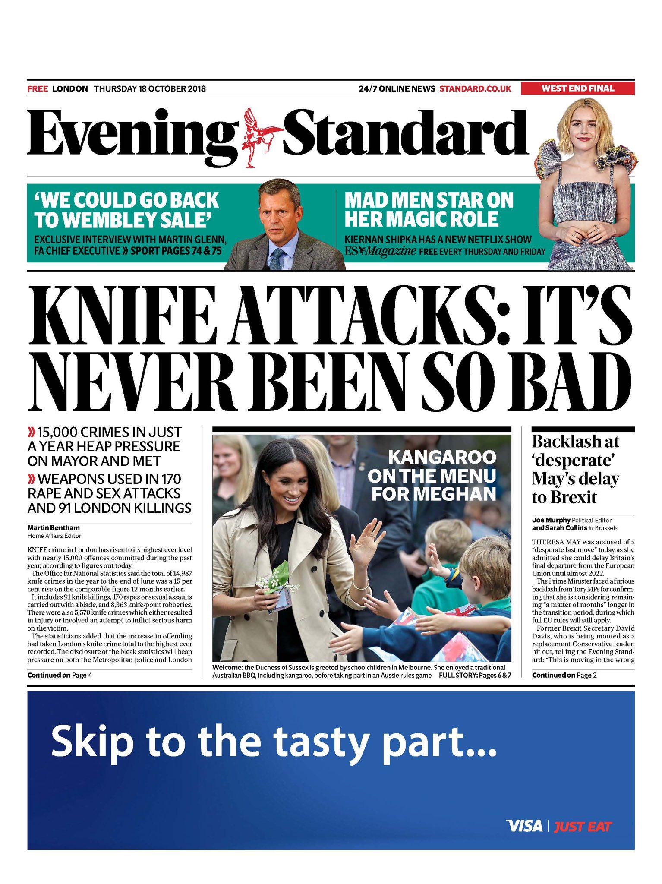
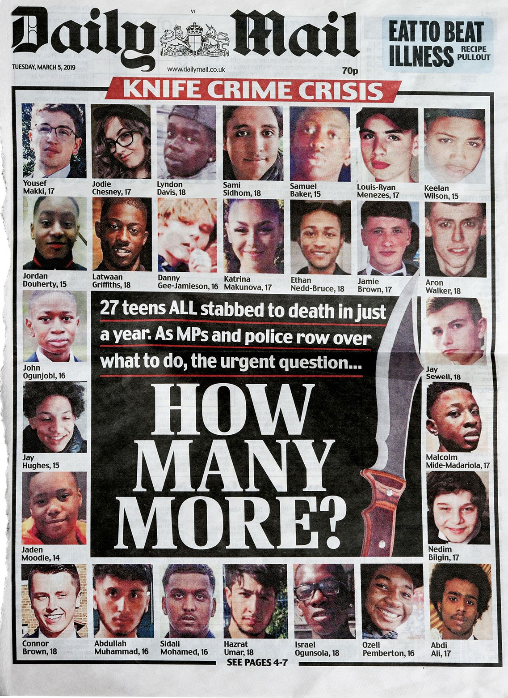
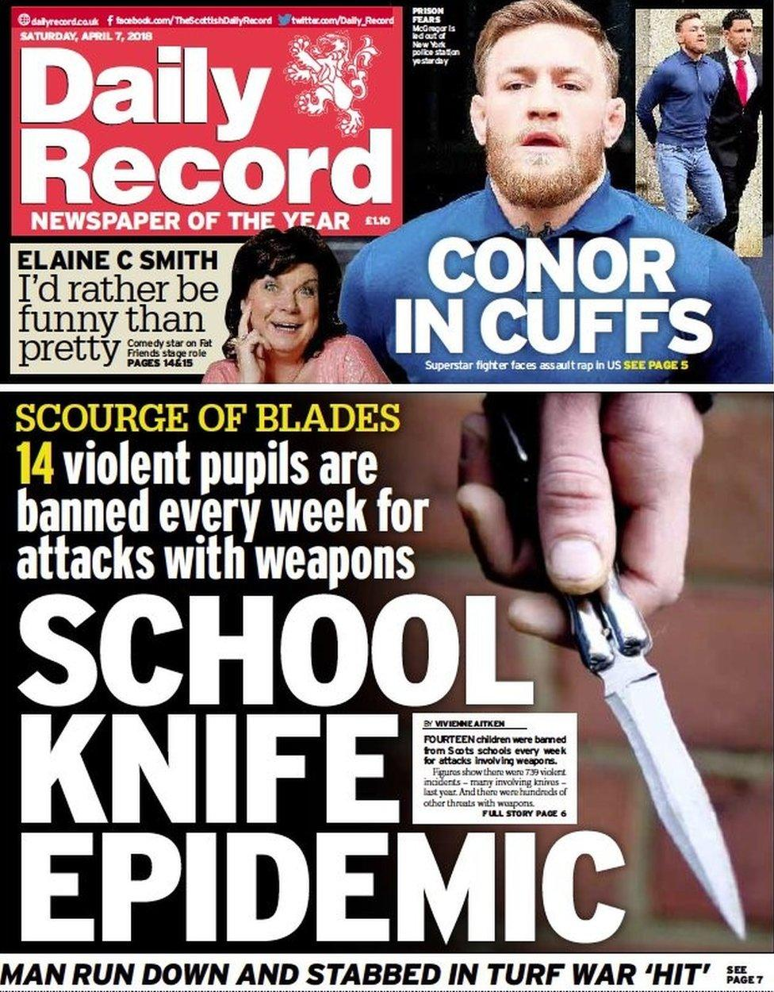
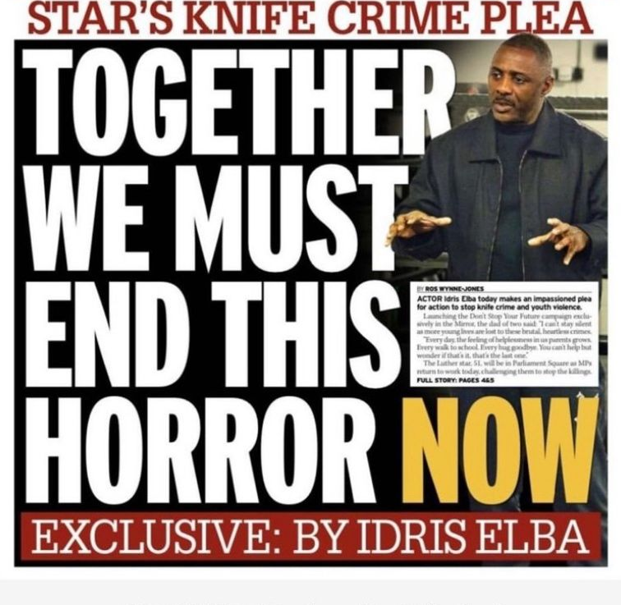
Notes:
When I was preparing for today I was looking for evidence to support the point that I wanted to make. I wanted to tell you that it is safer than ever, that because of the work that we all do people are safer in general. Violent crime is at its lowest level in a decade. That’s what I really wanted to say. So I looked for stats to back that up. Some data told me that over the last decade violent crime has reduced, some data told me that actually it has increased. Some said that it was both up and down. I concluded that violent crime IS reducing. You wouldn’t think so though would you?

Slide 5
Attitudes towards knives
Attitudes towards knives
Base: 14-17 year olds in Knowsley; Question added in 2023
Average base: 2023 = 242
This data is taken from the Trading Standards North West Survey carried out for Knowsley Council
Notes:
The thing is though it really doesn’t matter. I mean to us as community safety reps, political leaders and Violence reduction partners data matters but what really matters what matters most (or at least it should) is how people feel…….. and people do not FEEL safe. Take a walk out of here today up into Liverpool, stop people as you go and ask them do you feel safe? And they will tell you no, ask them if knife crime is an issue, they will reply that yes it is worse than ever.
Look at this survey? Look what young people tell us about Knives
Why do our young people feel like that? Why do they not feel safe? Some wonderful work has been done to reduce serious violence and improve community safety, the sole purpose of this very function is to reduce violence. Hotspot Policing has been hugely successful and of course we have had the EVOLVE areas, so in answer to my own question. I don’t really know why people don’t feel safe…….but I can take an educated guess.

Slide 6
A paradox
We have entered a paradox. We are making things safer whilst simultaneously telling people they are not safe, its US, WE are doing that and I am here today to tell you that we need to stop, we need to reframe and rethink the way that we deliver interventions to reduce serious violence.
We have been delivering interventions that lack an evidence base or even worse have a negative impact as a universal offer in our school and communities and it needs to stop. Even worse. We have been doing this in the most deprived communities and to some of our most vulnerable and susceptible children. In December our schools spend the best part of a month convincing children that a guy in a red suit will deliver presents to them if they behave, we tell those very same children that they need to run with a baton of hope to reduce knife crime and that if they do they might raise enough money to have their own bleed kit in case their friends get stabbed.
Notes:
We have entered a paradox. We are making things safer whilst simultaneously telling people they are not safe, its US, WE are doing that and I am here today to tell you that we need to stop, we need to reframe and rethink the way that we deliver interventions to reduce serious violence.
We have been delivering interventions that lack an evidence base or even worse have a negative impact as a universal offer in our school and communities and it needs to stop. Even worse. We have been doing this in the most deprived communities and to some of our most vulnerable and susceptible children. In December our schools spend the best part of a month convincing children that a guy in a red suit will deliver presents to them if they behave, we tell those very same children that they need to run with a baton of hope to reduce knife crime and that if they do they might raise enough money to have their own bleed kit in case their friends get stabbed.

Slide 7
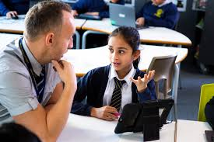
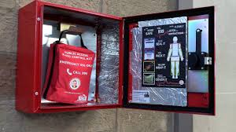
Targeted
Interventions
Bleed Kit Locations
Local Messaging

Slide 8
Serious Violent Crime in Knowsley
Down 36% since 2020
Serious Violence with Knife in Knowsley
Down 36% since 2020
All Knife Crime in Knowsley
Down 27% since 2020
Notes:
Most people are good, most people want to live peacefully, happily and free from violence. They deserve a chance, they deserve for us to believe in them. So instead of us trying to read the futures of 1000’s of people in our communities based on where they live geographically we should be supporting people to be ambitious to be aspirational and to reach their full potential. To open our minds, to open their.
The Mother of Ashley Dale, Julie said to me Francine, there has to be another way, a different way for women and girls. She planted the seed and the seed has grown and so well it should.

Slide 9
Be. The. Change.
Notes:
If we want people to Be The Change that means our universal offer MUST focus on what people can be and do as opposed to what they shouldn’t. it is without question. It is the basics, it is what I spoke to you about at the start. Its what we all want and its what we all hope for. Its our purpose.
Its proper organic EARLY HELP, its acknowledging that you may not be from an affluent area, you may have had ACES or trauma but you have services behind you that are going to build you up, believe in you, level that playing field for you, people like us, who are going to expect for our communities the same as we expect for ourselves and for our own children, to deliver programmes that will help you to reach your full potential.
In this model of delivery there is room for TARGETED interventions, those directed towards members of our community who do veer off piste.
I believe that if we all co-ordinate our approach and adopt this model people will begin to feel safer and when people feel safer we all win.
So I am asking you to BELIEVE, BELIEVE that your communities can do more and be more because they can, because it is the very least that they deserve.
Be the Change

Slide 10
Thank you
Francine McKeown
Francine.McKeown@knowsley.gov.uk

