Slide 1
Be an Active Bystander: The development of the MVP Programme
Damian Hart – Project Development Manager
Rhiann Barrett – Programme Coordinator

Slide 2
What is MVP?

Slide 3
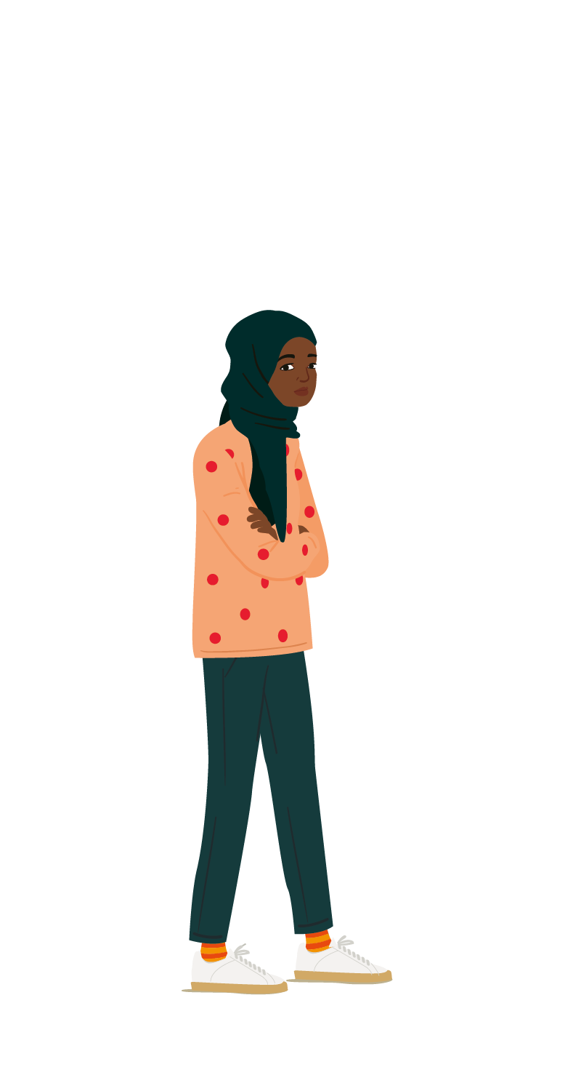
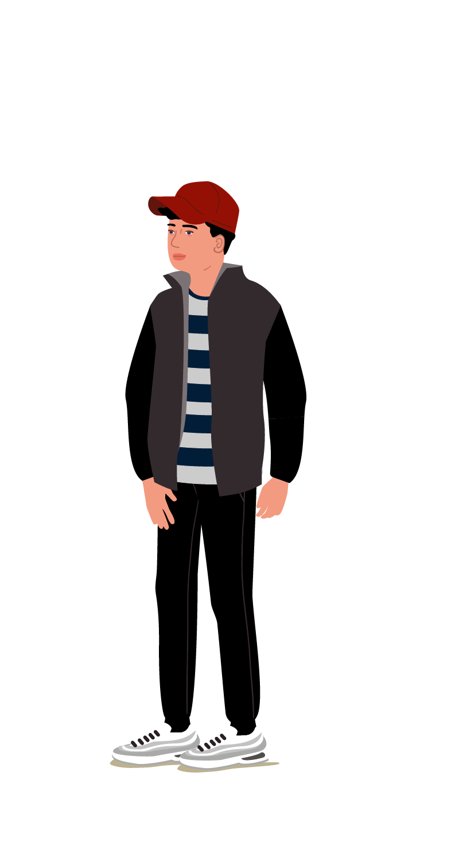
How does it work?
MVP also known as the Mentors in Violence Prevention Programme is peer education programme that provides young people with the language and framework to explore and challenge the attitudes, beliefs and cultural norms that underpin gender-based violence, bullying and other forms of abuse, while building resilience and promoting positive mental health.
The programme empowers pupils in schools to identify and communicate concerns with other peers and school staff by supporting schools to take a ‘whole school’ approach to early intervention and prevention of bullying, harassment, and risky behaviours.
Notes:
As mentioned by some our MVP Mentors …
MVP is a school-based violence prevention programme, with a particular emphasis on gender-based violence, which aims to increase non-violent bystander intervention through a peer education approach to inform and empower individuals to become proactive bystanders in the face of violence.

Slide 4
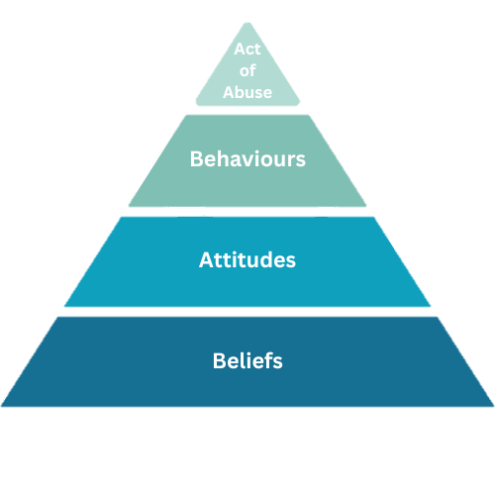
5 Core Components
MVP is based on five core components:
Exploring violence through a gendered lens;
Developing leadership;
Adopting a bystander approach;
Recognising the scope of violent behaviour; and
Challenge victim-blaming.
The programme consists of interactive scenarios and group discussions and a key concept of the programme is that it is delivered by trained student peers under the supervision of trained staff.
The student mentors lead their peers (typically from a younger year group) in discussions of realistic scenarios covering a range of abusive behaviour they might witness as a bystander.
A list of several actions which a bystander might consider taking in the situation are then presented and discussed as a group to teach participants about appropriate actions they could take and empower them to be proactive bystanders.
Notes:
Violence pyramid underpins everything we talk about in MVP that the act of abuse is at the top of the pyramid and usually relates to what we see happening.
We need to recognise what underpins the act of abuse is a set of behaviours, attitudes and beliefs.
And how as a bystander – these may be the parts where we intervene and do something!

Slide 5
School Commitments
There is a need for the ethos and principles of the programme to complement and meet priorities identified in a school’s improvement plan, recognise the sensitive topics that the programme may cover and ensure appropriate support will be in place for all involved.
A school would need to agree to:
Identify two staff members with dedicated time allowance to implement and support the programme - one pastoral, one SLT, with a gender balance preferable, to comprise an MVP school team
One and a half days training of the MVP school team delivered at MYA Headquarters
Provide anonymous information regarding school-level demographics to support diversity recommendations
Delivery of Recruitment, Confirmation and Awareness raising assemblies and workshops
Two-day training to a selected group of Mentors
5 x 1 hour delivery of the programme (along with sessional support)
Mentor and Mentee participation in Evaluations

Slide 6
Whole-School Approach
Workforce:
Within MVP we promote a whole-school approach to the programme by encouraging schools to access:
1 and a half days Staff Training
Awareness Assemblies
CPD Sessions
Parent/Carers:
We also provide information to parents/carers about the programme including:
Information letters
Dedicated website channel
Direct contact details to the MVP Team

Slide 7
Links to…
Notes:
VAWG agenda
MVP believes that violence is gendered and through the programme we facilitate and encourage lively debates that centre on traditional and current social understanding of masculinity, femininity, sex and gender.
By exploring how these norms can play a role in supporting or condoning bullying and gender-based violence the sessions look at the objectification of women in the media, including pornography.
The question is posed as to whether this objectification contributes to harassment and abuse.
Sessions promote open and honest dialogue about how stereotypes of masculinity and femininity might affect young people’s willingness to intervene and interrupt abusive behaviour.
Serious Violence Duty
- Intervention to prevent and reduce serious violence whilst promoting a bystander approach

Slide 8
Our Reach

Slide 9
What’s happened so far?
We gained commission in 2020 to deliver MVP in 10 schools.
This has grown each year and now we cover 1/3 of schools in Liverpool City Region!
Although we target Secondary Schools – we have also delivered in Special Schools.
36 Schools
1,153 Mentors
10,100 Mentees
Notes:
17 Liverpool Schools
2 Knowsley Schools
10 Sefton Schools
4 Wirral Schools
3 St Helen’s Schools

Slide 10
Impact

Slide 11
Mentor Voices

Slide 12
Mentor Voices
“MVP teaches you life skills on mental health and violence.
It enlightens you on the effects that cause and prevent violence.
For example, gender lenses, victim blaming, bystanding, abuse, violence and leadership.
MVP stands for Mentors in Violence Prevention, and we have learned how to show these skills during our learning.
Overall, we are confident in showing people what leads up to violent actions and what changes we can make to stop them.
We are Mentors in Violence Prevention.”

Slide 13
Headteacher voice
“On a very positive note, we are due an OFSTED any minute and as a result the SLT have asked an ex-inspector to come in and do a fake inspection to see where we can improve. Her visit was today, and she went into all the PSHE year 8 lessons and saw our lovely mentors in action. I've just seen my boss (SLT) in the corridor and she said the inspector was "blown away with the MVP mentors and programme".
Calday Grammar

Slide 14
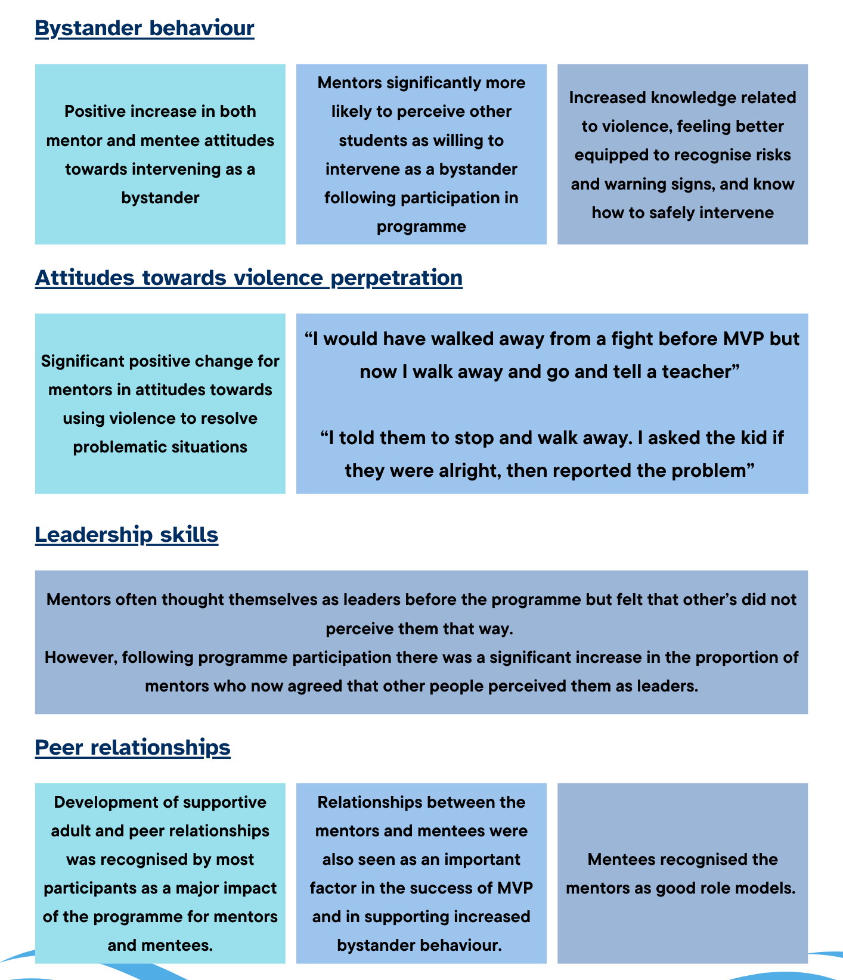
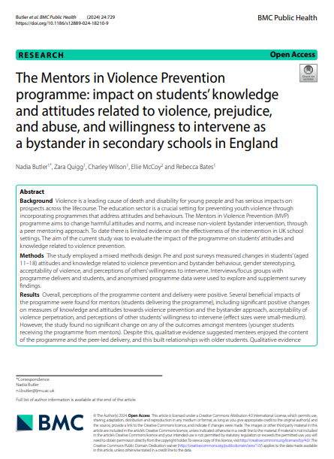
LJMU Evaluation
Notes:
Left image shows the impact of MVP that was highlighted in the journal on the right which was published in the BMC

Slide 15
Curriculum

Slide 16
Lessons and Learning Outcomes
Gender Stereotypes and The Bystander Approach To enhance mentees understanding of the MVP programme and why preventing violence is important To explore what we mean by gender stereotypes and the impact these can have on people’s behaviours To explore the relationship between gender stereotypes and violence To increase mentees understanding of what a bystander is and the role they can play in preventing violence
Leadership, Recognising Violent Behaviour and Challenging Victim Blaming To increase mentees confidence in being a leader when it comes to violence prevention and ways in which they can lead To understand the different types of violence and the forms it comes in (violence pyramid) To understand how we can better respect other’s and what does ‘respect’ look like To explore what victim blaming is and enhance mentee understanding of the impact of language
Weapons / Hate Crime / Relationships To explore what we mean by weapons in various form, hate crime, and behaviours in relationships from a violence prevention point of view To reflect on the judgements we make as bystanders to an incident involving ‘weapons’/ ‘hate crime’ / ‘behaviours in relationships’ To be able to recognise the red flags in a situation To feel more confident to know what to do as a bystander in these situations

Slide 17
MVP Website

Slide 18
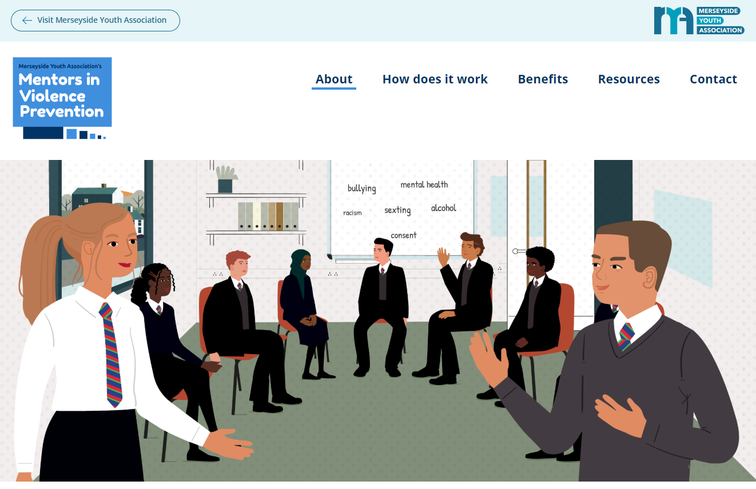
Website
Notes:
The MVP website hosts information about:
The origin of MVP and its background
How the programme works in schools including key information about the core components
The benefits of the programme including impact reports and graduation films
Resources for schools to use in their delivery

Slide 19
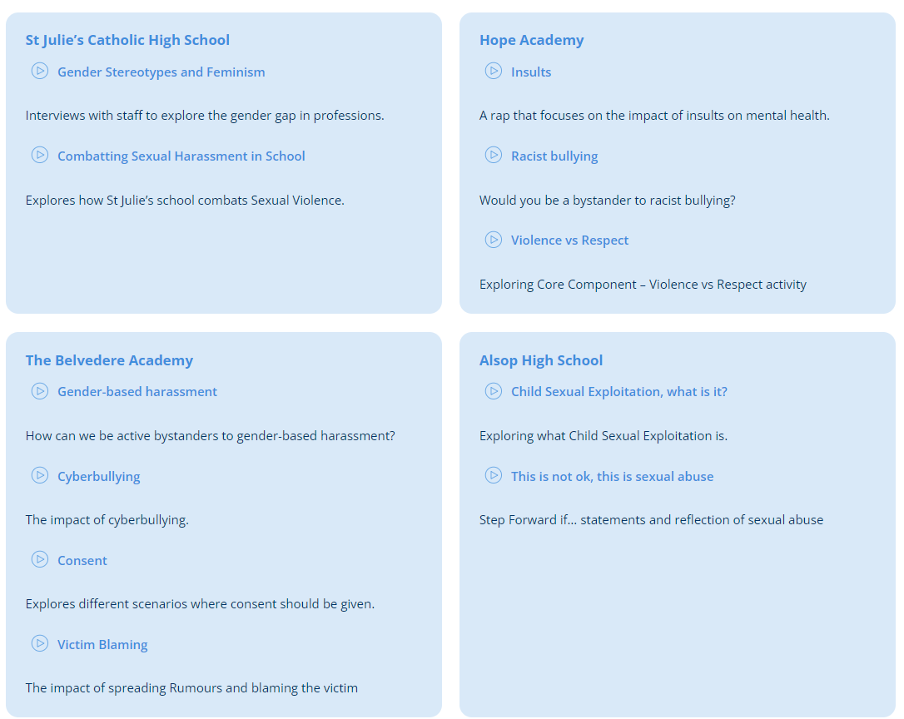
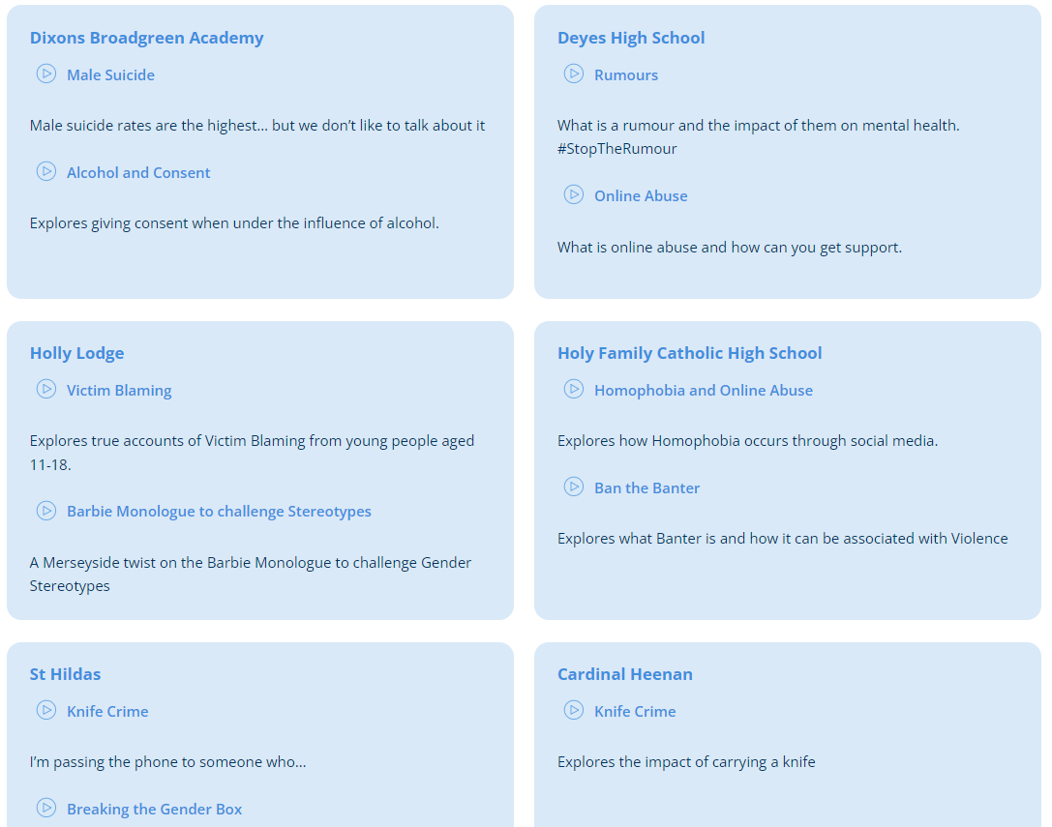
MVP Films
Notes:
As part of the programme – we have also been able to offer Mentors the opportunity to create and produce a film about key MVP topics that they have learnt about throughout their training and journey as a Mentor
These are also hosted on the website as well as used in social media campaigns, and embedded into the MVP sessions to make the programme relatable and inclusive of the Merseyside community
Examples on slide

Slide 20
Youth Endowment Fund
Randomised Control Trial
Will further cover 1/3 of schools across Merseyside and Cheshire
Delivery in 41 schools
41 schools will be a control group
Both will be measured via SDQ and Pro-Social skills questionnaires

Slide 21
Thank You

