Slide 1


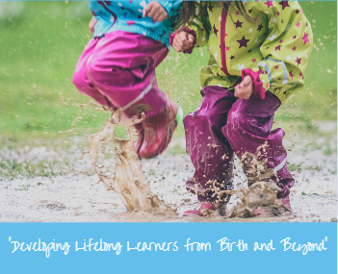

Discover, Collaborate and Evolve.
Sefton Place Based Early Years Project

Slide 2
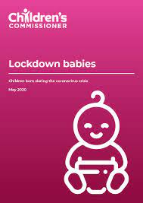
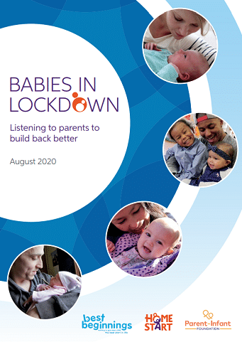


Discover-Research
Babies in Lockdown
Best Start for Life
Family Hubs
BABS – PIMHS – ‘Rare Jewel’
1001 critical days

Slide 3
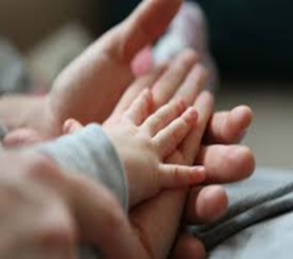
Discover-Local Intelligence
Ward data analysis MVRP evidence hub
8 wards – Cambridge, Church,
Derby, Ford, Linacre, Litherland,
Netherton and Orrell and St. Oswalds
Cambridge added due to local knowledge of E.H

Slide 4

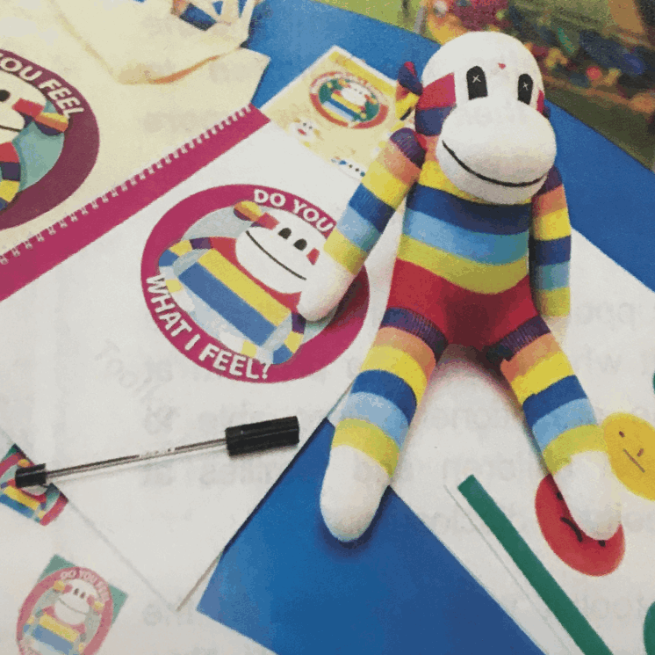
Discover Evidence Based Programmes
Read to Bump
Evaluated by Liverpool John Moores
Based prenatal and postnatal development research.
Looks at Literacy deprivation across Sefton Wards
Monkey Bob
Emotional Literacy Programme
Specifically designed for children who have experienced trauma
Linked to Operation Encompass.
Ferre Laevers-Scales of Involvement and Wellbeing
Recognises the child's Involvement and Wellbeing as essential for effective learning.
Scales allow practitioners to observe a child and reflect on any barriers to involvement and wellbeing.

Slide 5
Collaborate
Early Years Settings
Early Help
Children's Social Care
Community Midwives and Health Visitors
Virtual School
Talking Therapies
Domestic Abuse Services

Slide 6
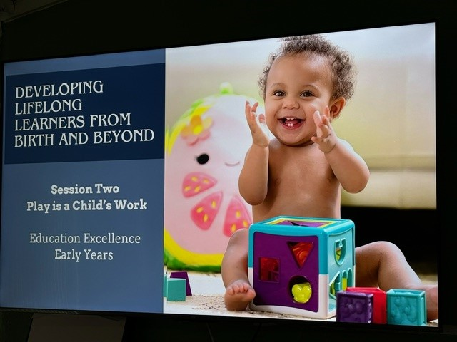
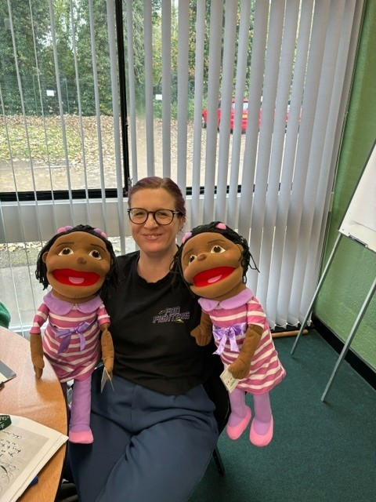
Evolve-Working together to meet the needs of the 'Child of Today'
Life-long Learners project

Slide 7
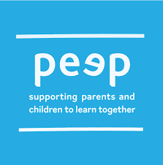
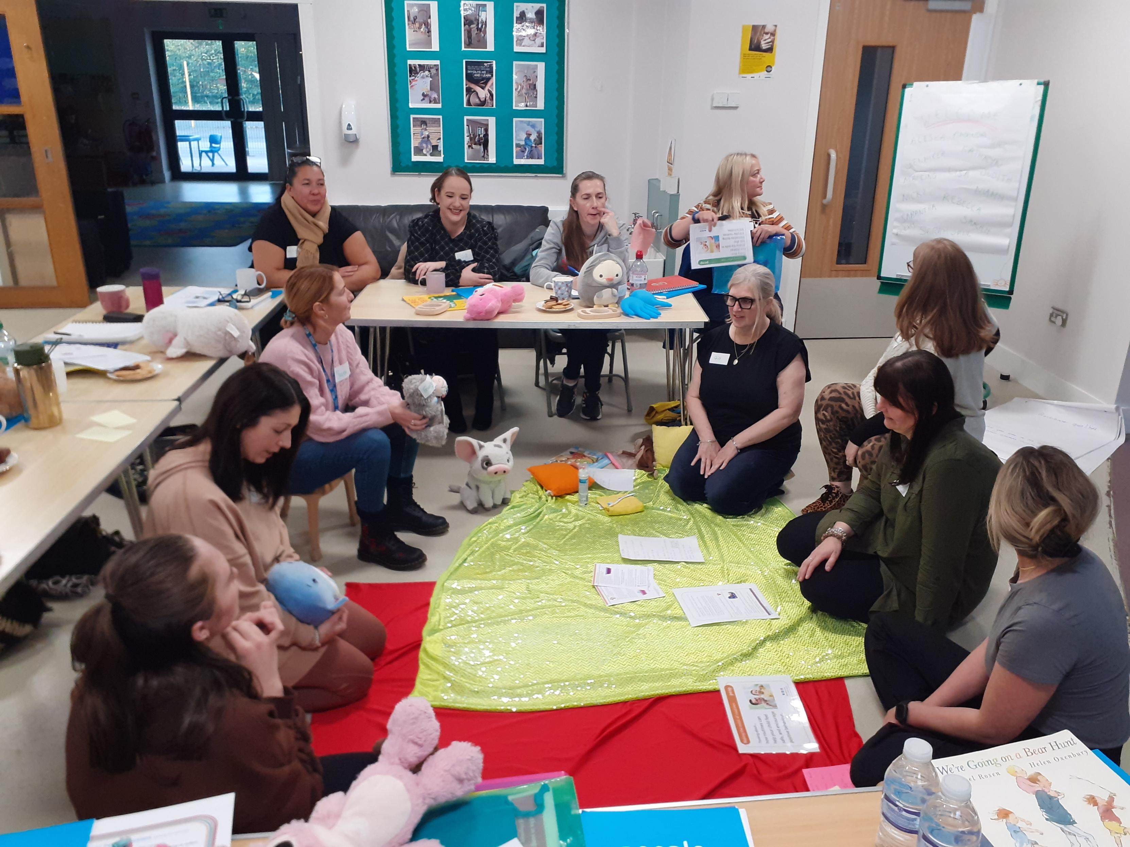
Evolve-Supporting parents and carers as their child's first educator.
Train the Trainer model adopted.
21 participants now trained
What is PEEP?
Peep Learning Together Programme Training is for practitioners who work, or plan to work, with mums, dads, carers and babies or young children, to contribute to:
strong parent-child relationships
increased parental knowledge and confidence in how to support their child's learning and play in day-to-day life, from birth to school
children’s personal, social and emotional development, communication and language, early literacy, early maths, and health and physical development.

Slide 8
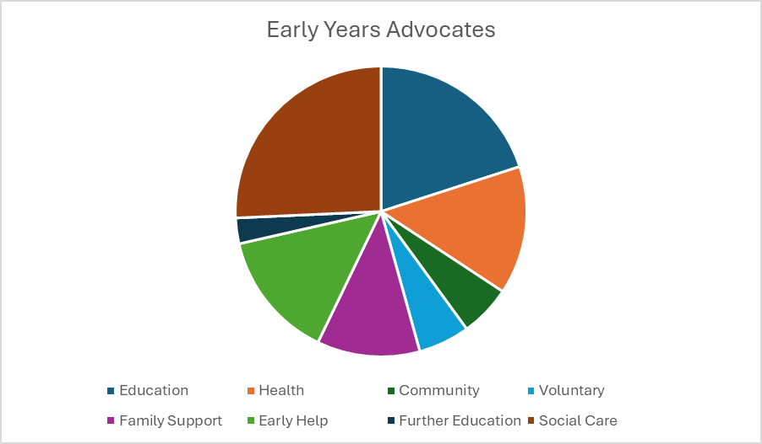
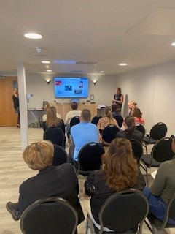
Evolve: Early Years Advocates

Slide 9
Evolve: Sustainability and Next Steps
Continue to use the Early Years Advocate Model to deliver consistent key messages to families.
Engage with families through existing provision such as parent and toddler sessions and family Hub interventions.
Family hub remodel and progression.
Continue to roll out PEEP learning together programme across Sefton.
Second cohort of Lifelong Learners in progress
Scales of well-being and involvement utilised in schools/settings and Early Help assessments.

