Slide 1
The Story Behind the Statistics

Slide 2
The Statistics
St Helens is the 26th most deprived town from 317 in the country. (ONS 2019)
Some postcodes are in the bottom 1%.
25% Wards are in the most deprived 10% of wards in the country

Slide 3
St Helens Children's and Young People’s Needs Assessment 2024
Identifies high levels of childhood mental health inequalities.

Slide 4
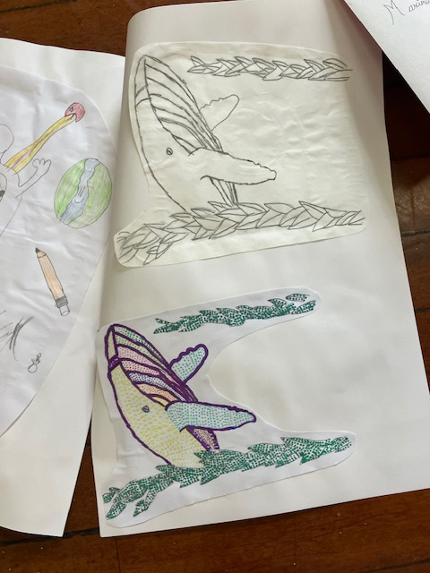
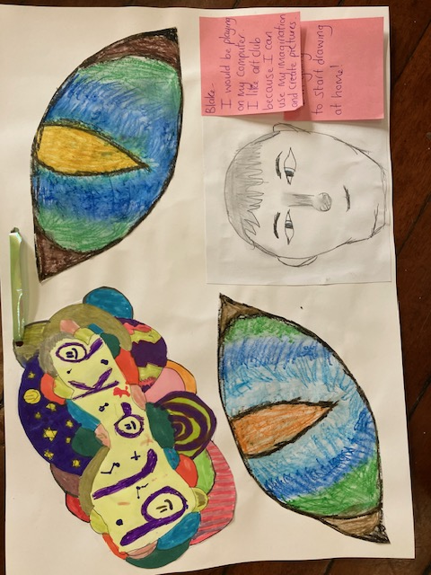
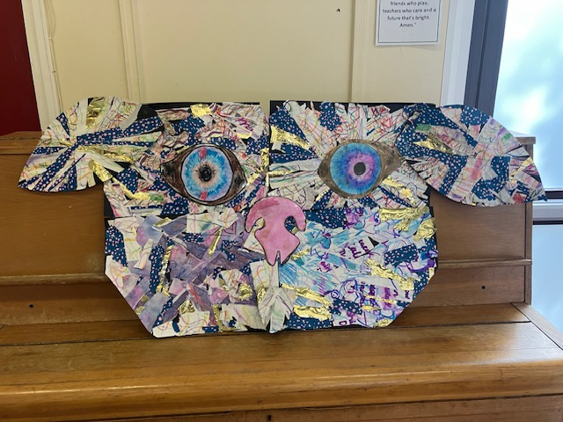
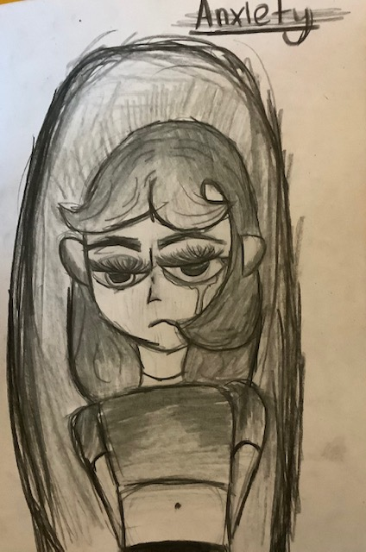
Sport & Art Diversions

Slide 5
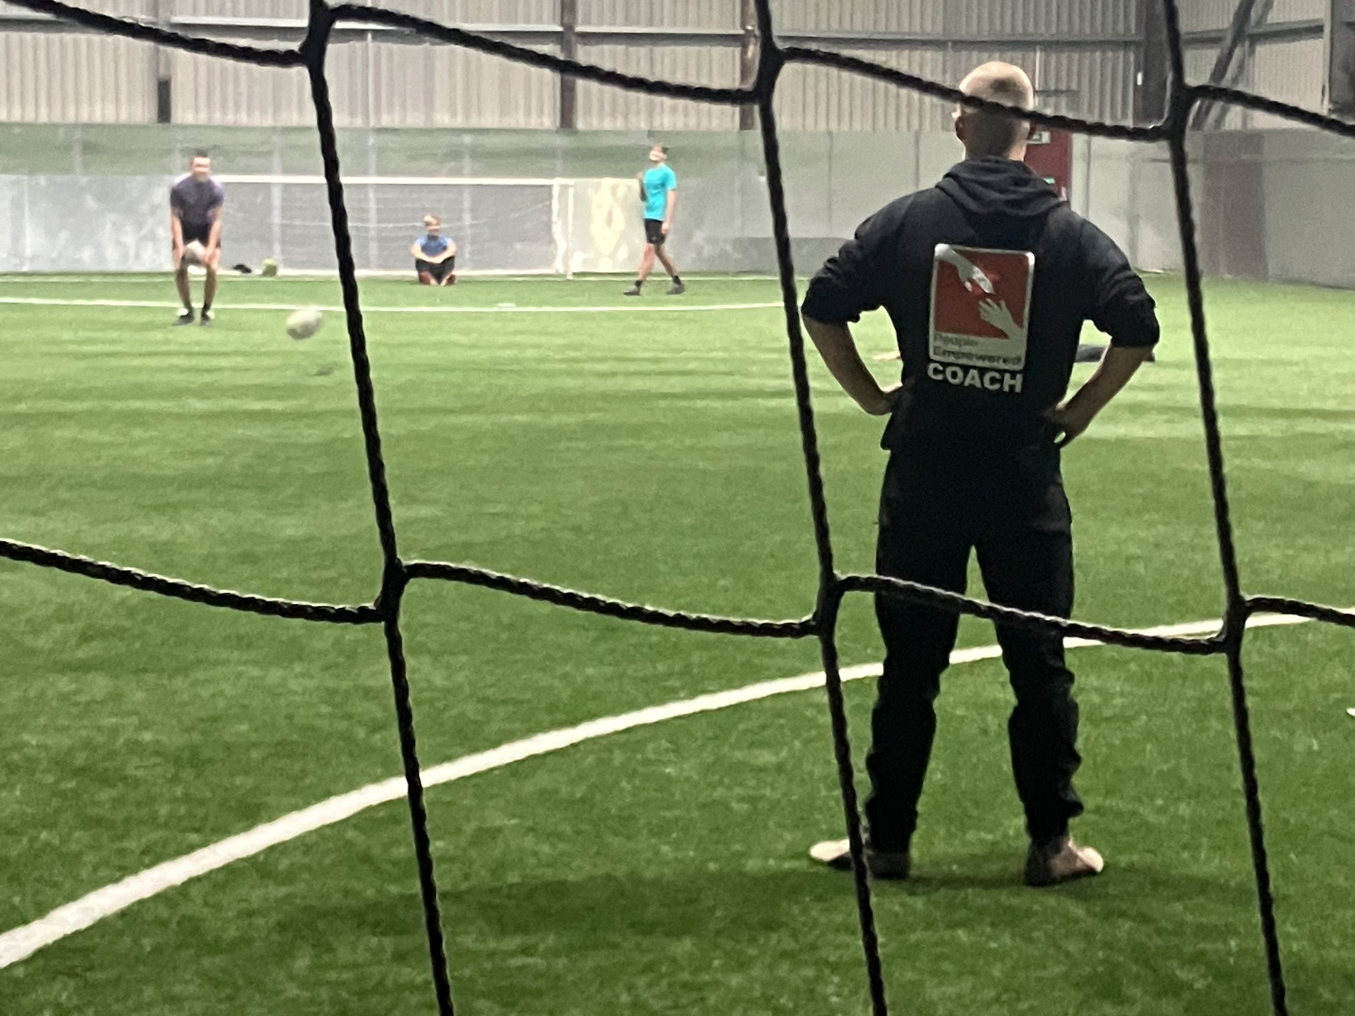
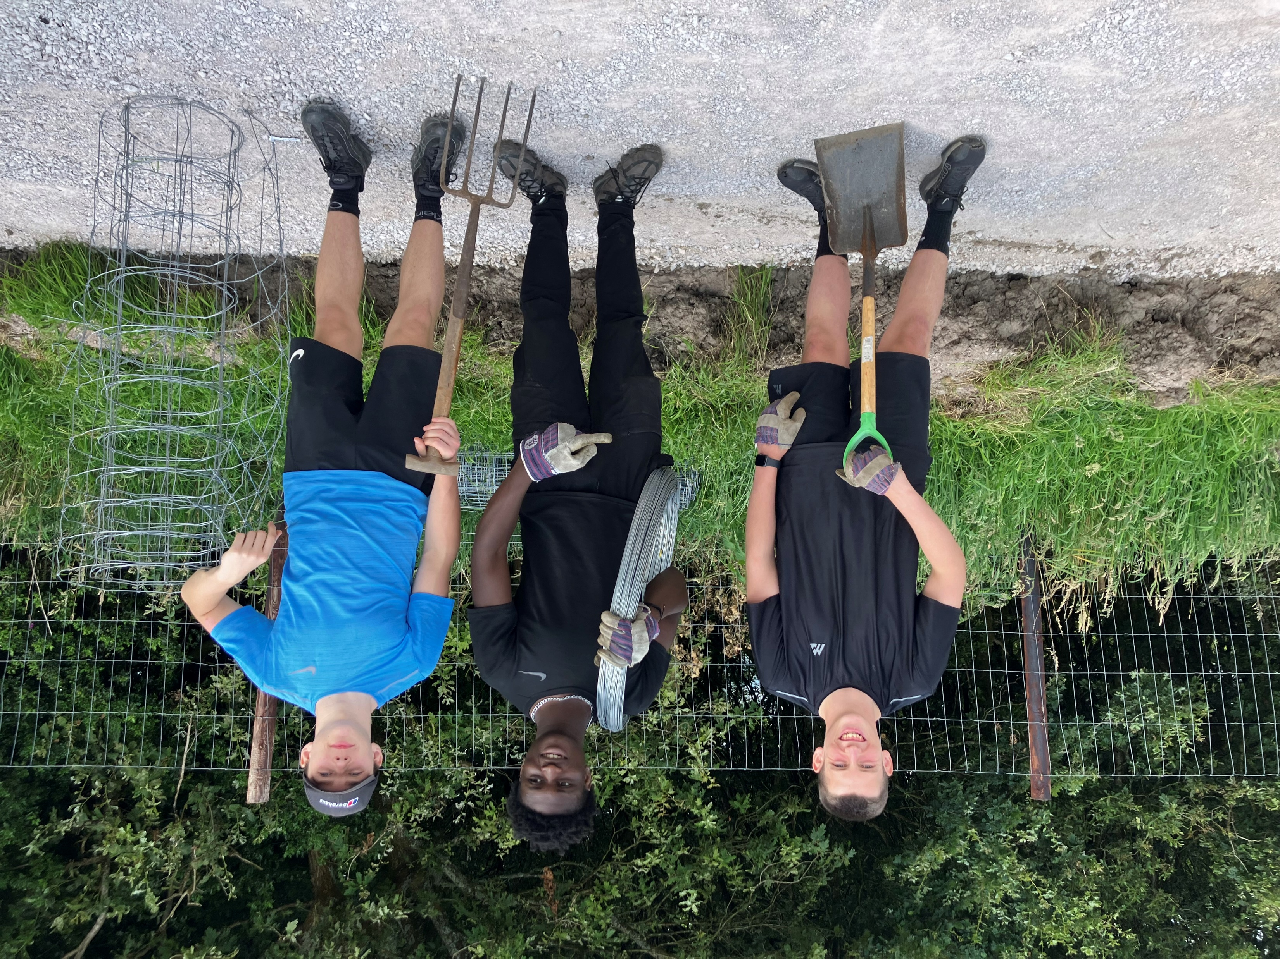

Slide 6
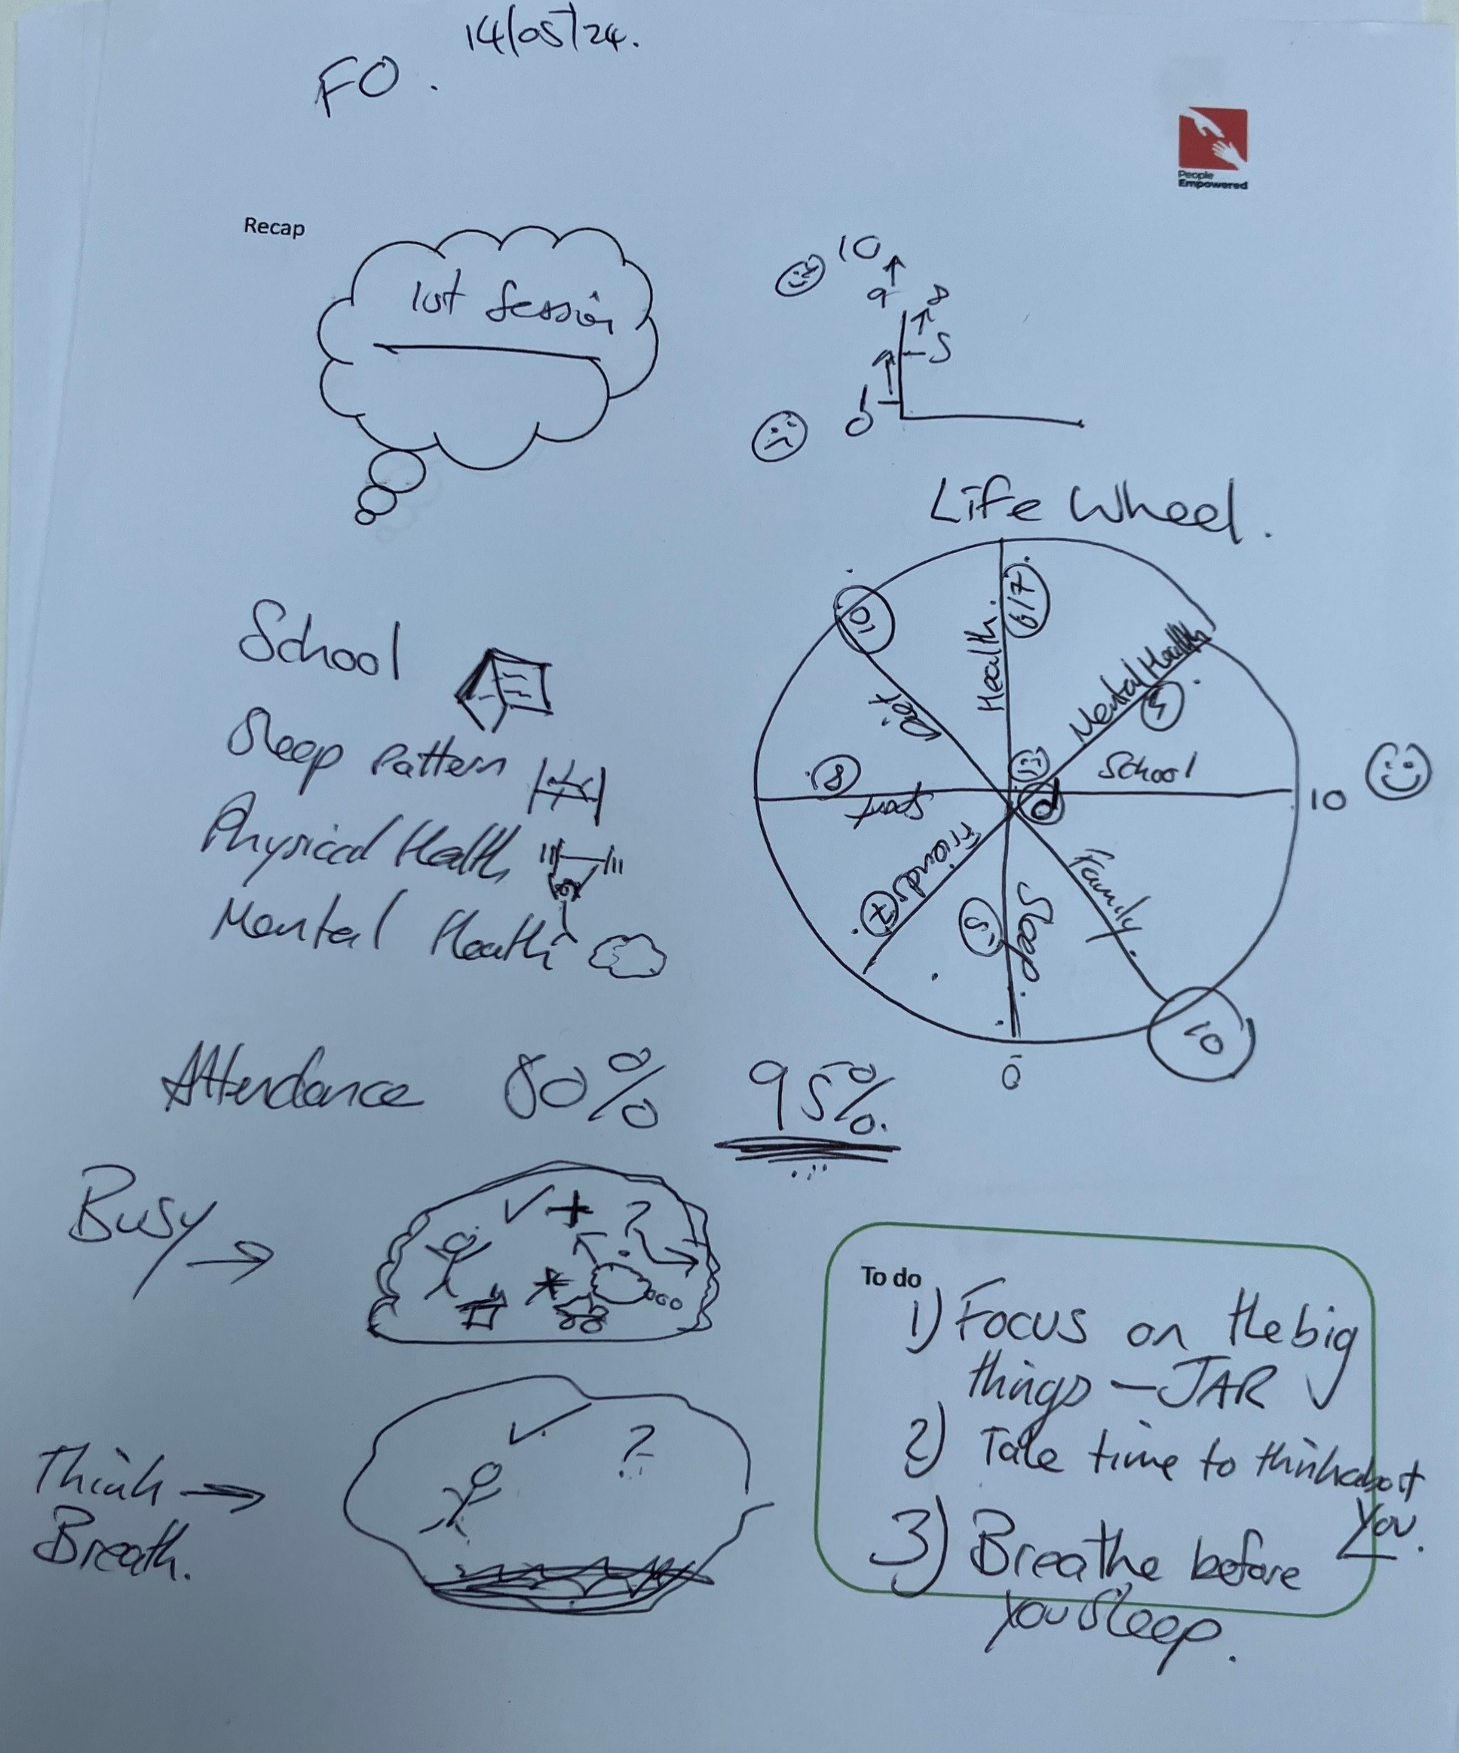
Workshops & 1-2-1’s

Slide 7
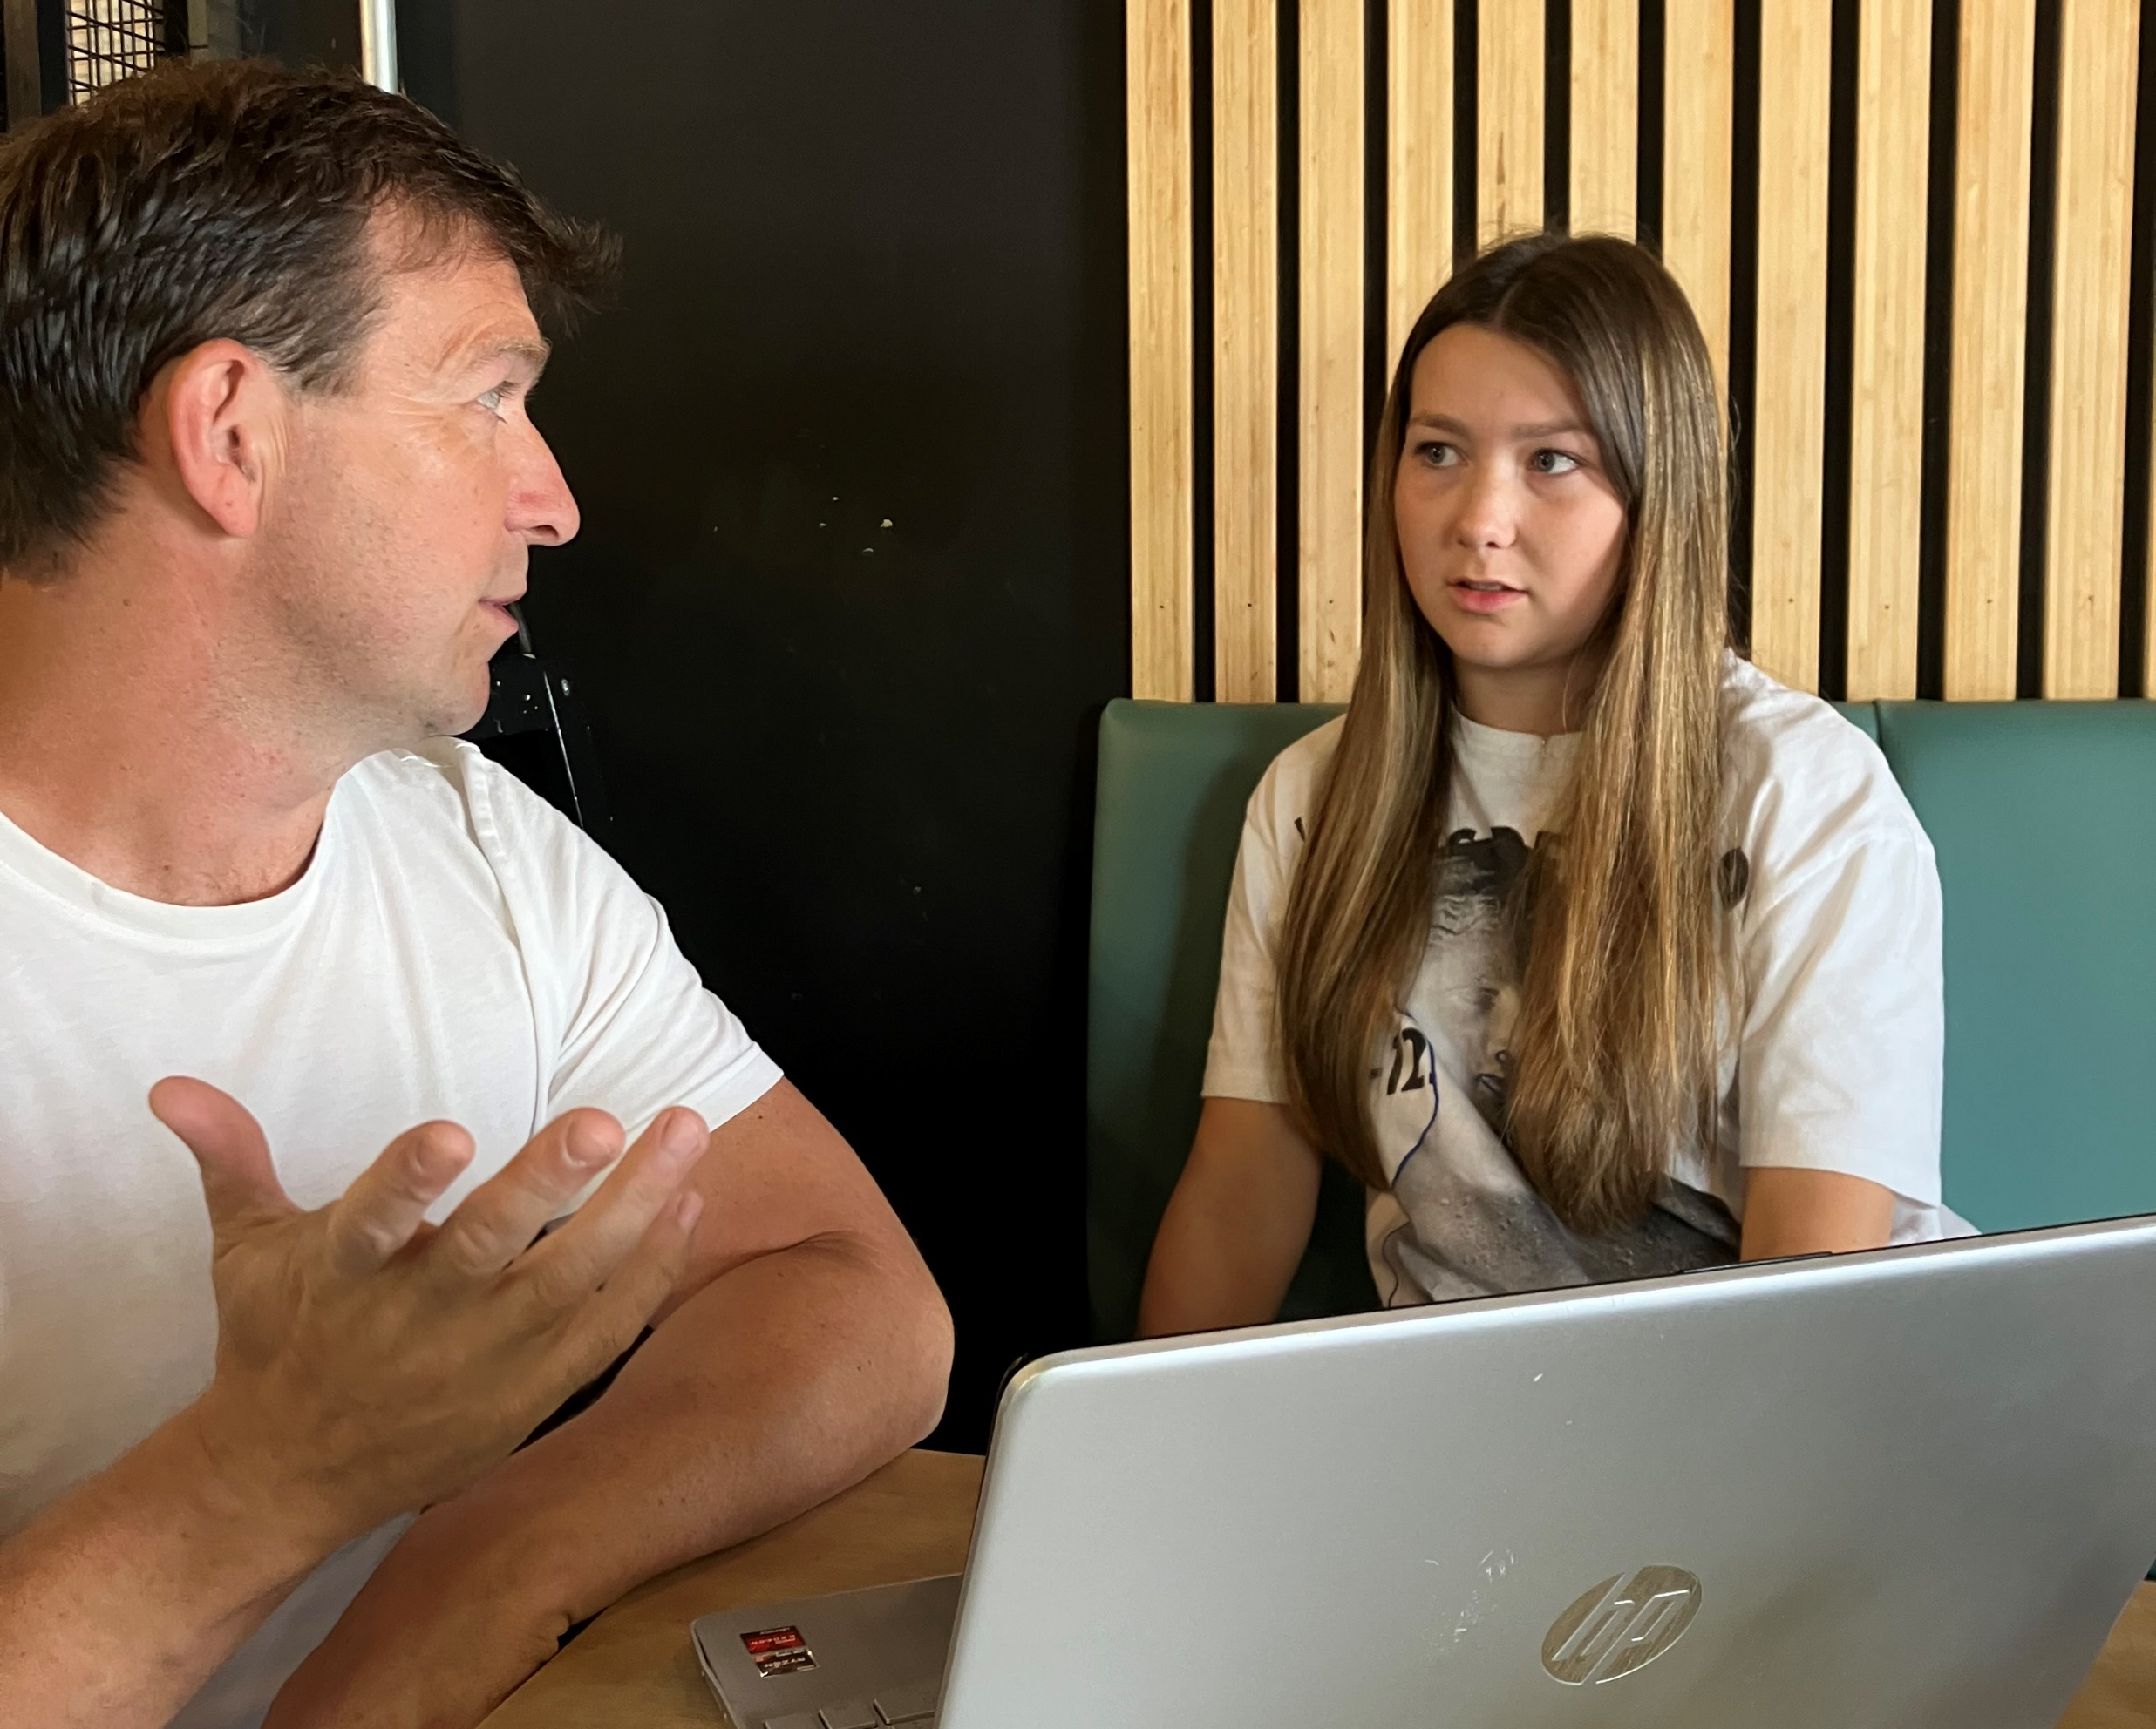
Our Statistics
100% of our mentoring participants have said the sessions help to improve their feelings of wellbeing, help to reduce negative thoughts and symptoms of anxiety/poor mental health.
Only 2, from over 80 mentees who engaged with us beyond 8 weeks, fell back into negative outcomes over the last 3 years.
Only 10 young people/families have disengaged with us before their 3rd session in the last 3 years.

Slide 8
The Life-belt Model
Some people will grab the life-belt and kick for safety.
Some will cling on to the life-belt until they are rescued.
Some can’t reach the life-belt and the current takes it away from them.
Some they grab the life-belt, but the sharks get them anyway.

Slide 9
Callum & Kate’s Story, Behind the Statistics

Slide 10
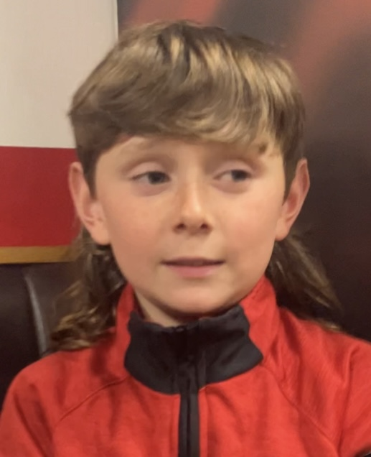
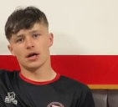
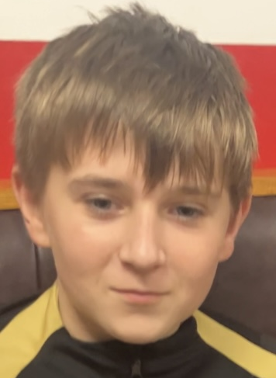
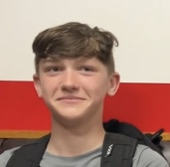
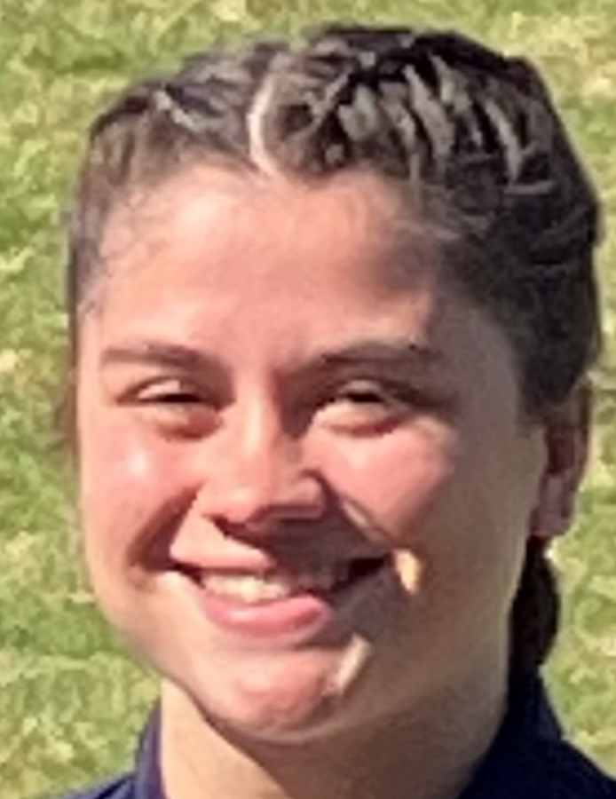
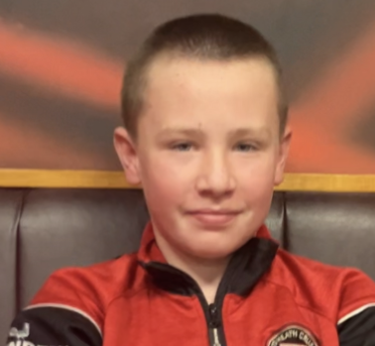
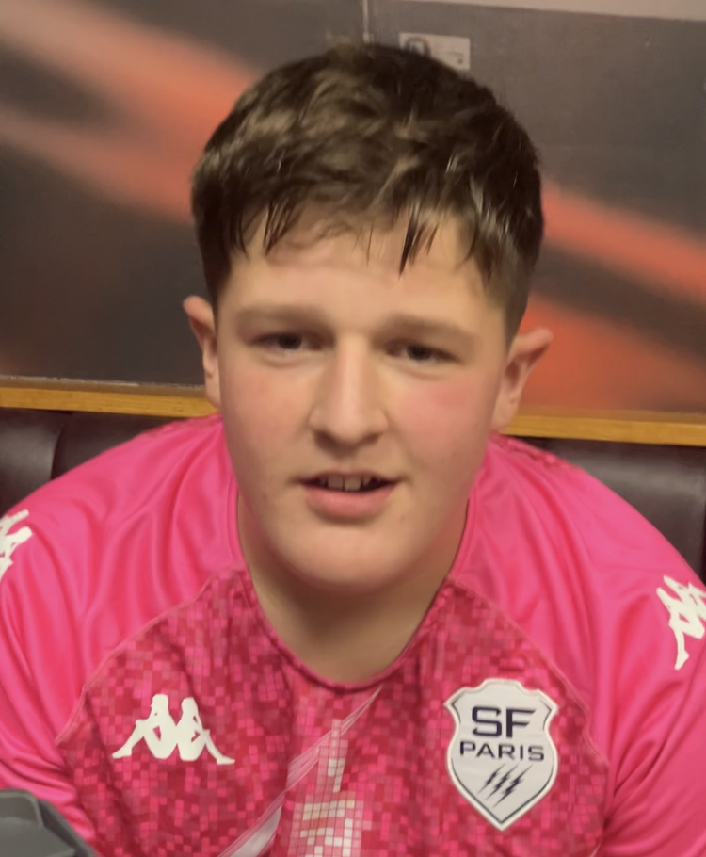
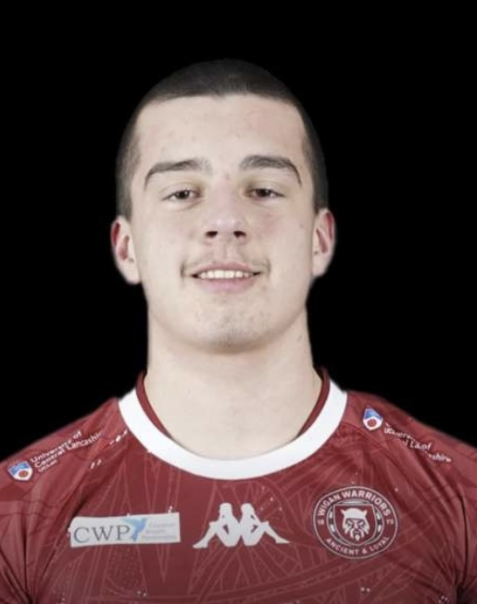
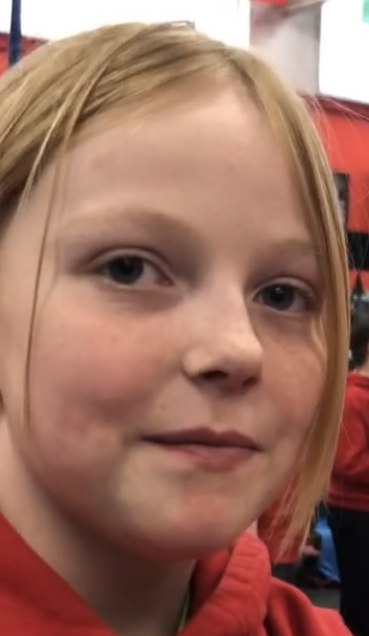
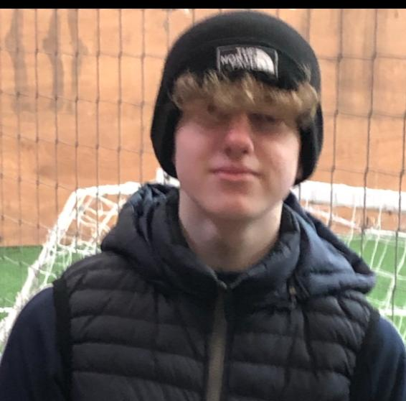
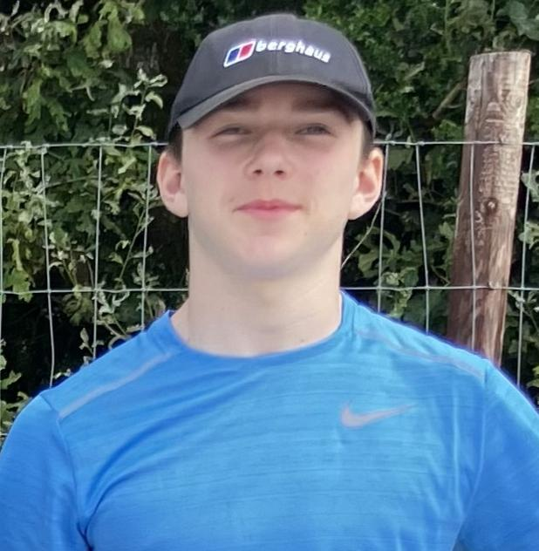
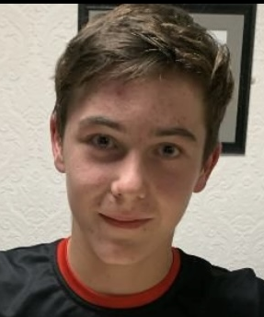
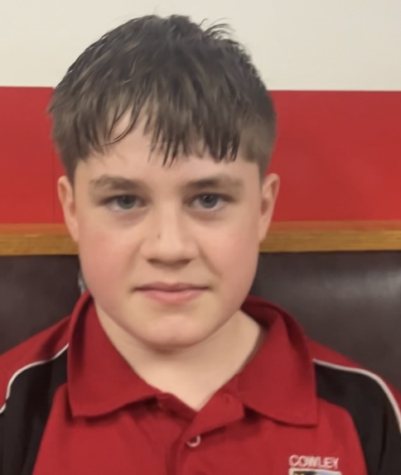
Untold Stories!

Slide 11
Not all stories have happy endings. In memory of Leon Prescott. 2005-2024

