Slide 1

Nadine Bogan
Education Lead MVRP nadine.bogan@merseyside.police.uk
Merseyside Violence Reduction Partnership
https://www.youtube.com/watch?v=epB0woHDnu4

Slide 2


Slide 3

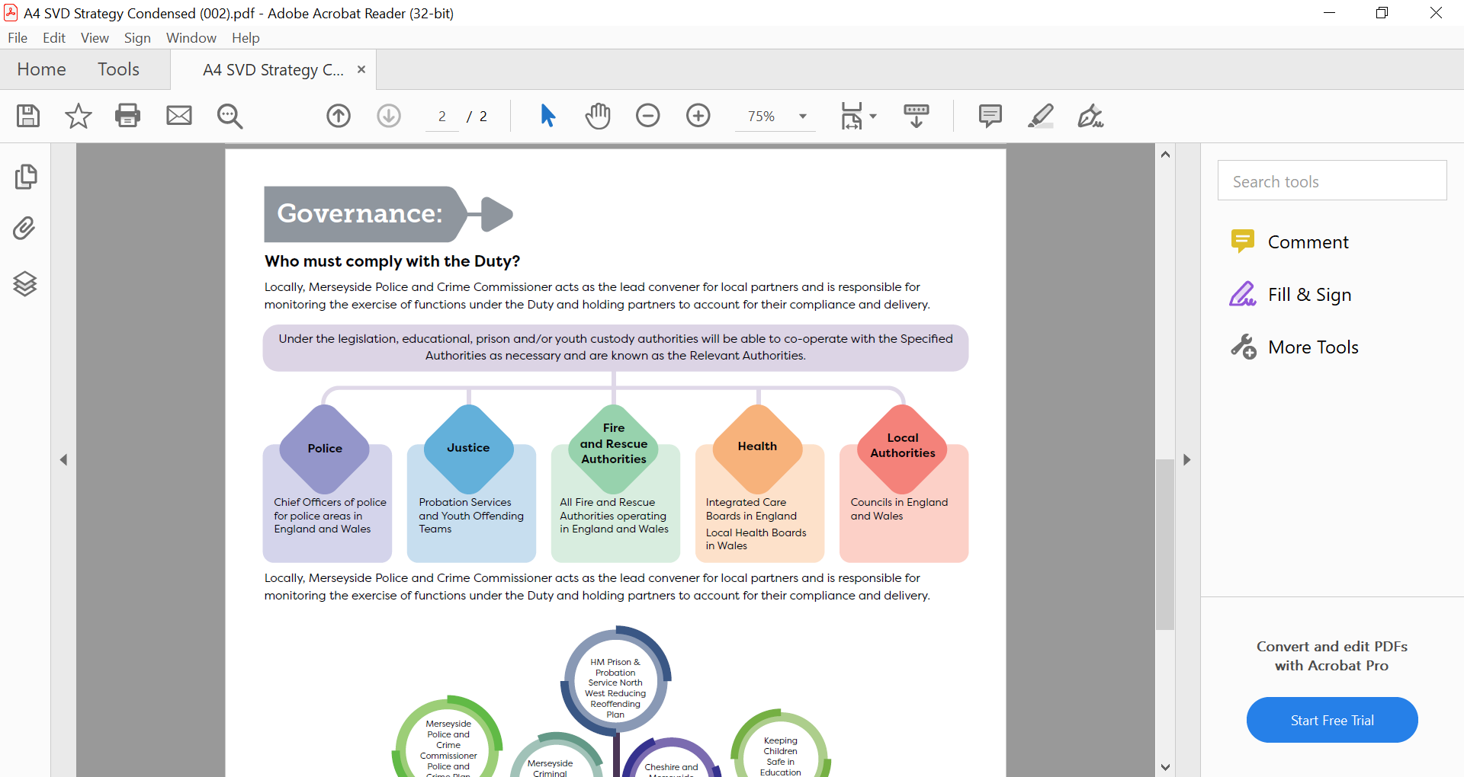
Serious Violence Duty
The Duty is intended to ensure relevant services work together to share information and collaborate on interventions to prevent and reduce serious crimes within their local communities. Schools are in a vital position to safeguard children and young people and may collaborate with other agencies to deliver the strategy to prevent and reduce serious violence in their area.
Schools and organisations can engage with the SVD by:
Providing qualitative insight into the impact of SV on the education sector
Provide insight into risk factors and vulnerabilities experienced by the CYP
Support the development and implementation of the strategy to address local factors that puts a child at risk of being a witness, victim or perpetrator.
(NASUWT – The Teachers Union)

Slide 4
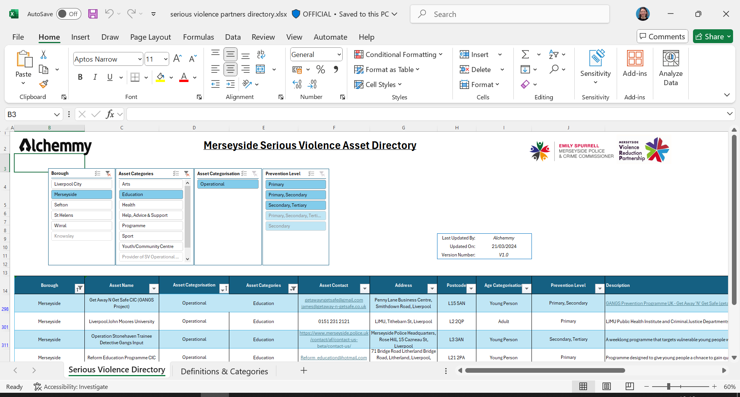
Serious Violence Asset Directory: Merseyside Police and Crime Commissioner
Georgia Probert SVD Program Manager
Georgia.Probert@merseysidepcc.info

Slide 5

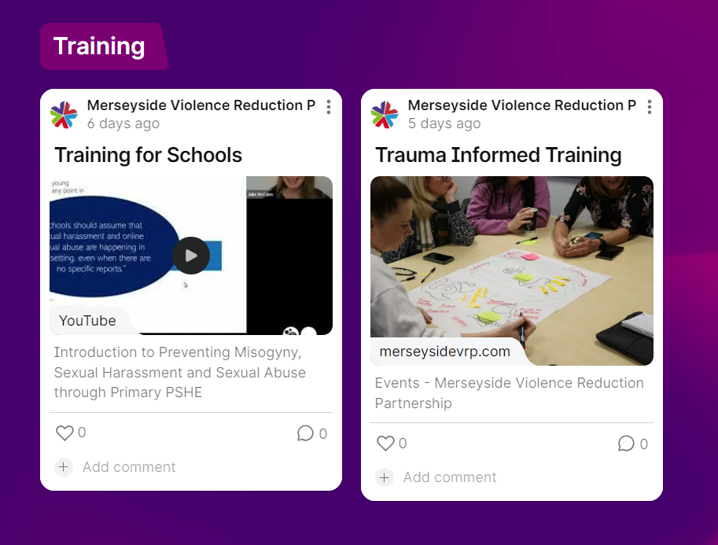
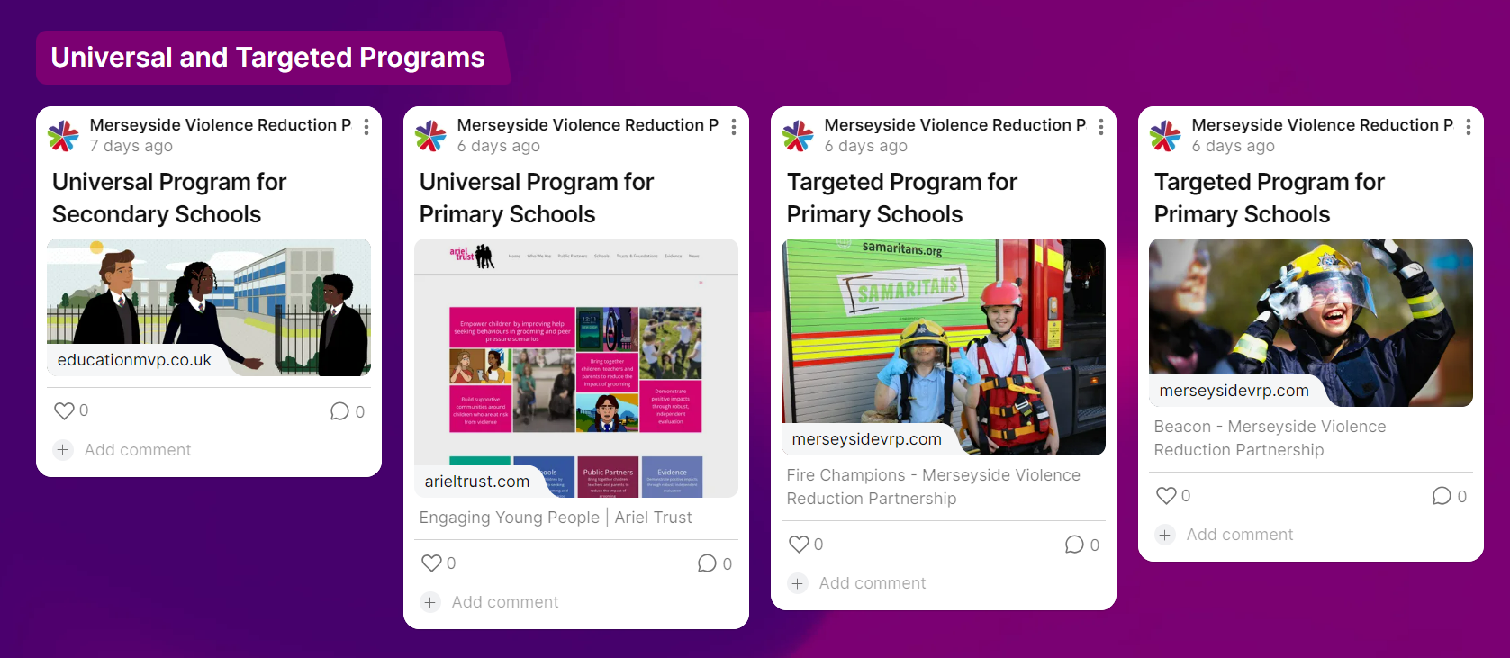

Slide 6

Network 1: Outcomes
An enhanced understanding of how to engage with the work of the MVRP.
To provide a tool for educational settings that enables young people to influence and inform violence prevention strategies across our region.
To develop a collective understanding of evidence-based approaches.
A commitment to engage with EPIC (Education Practice Insight Creator) to drive the networks practice, discussion around prevention across Merseyside.

Slide 7
Part 1
To provide a tool for educational settings that enables young people to influence and inform violence prevention strategies across our region.

Slide 8







Merseyside children and young people and university students’ feelings of safety, experience of violence, and wellbeing survey

Slide 9


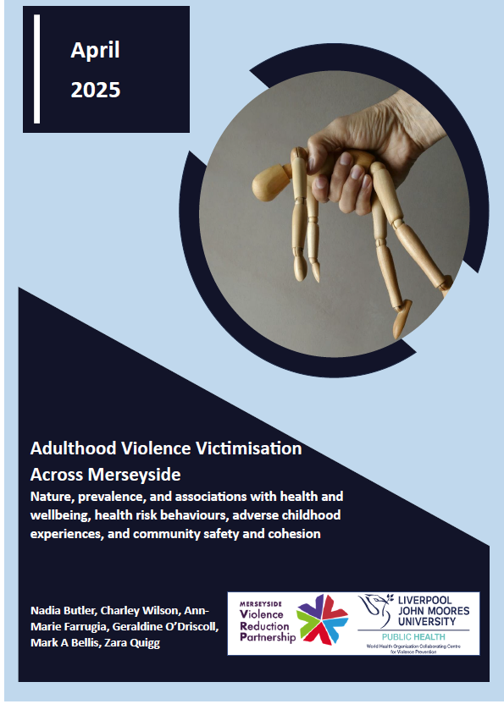

Merseyside Violence & Community Safety Survey
A population-level representative household survey of adults who are residents in Merseyside
Community safety and neighbourhood cohesion
Violence Victimisation in Adulthood
Adverse Childhood Experiences (ACEs)
Sociodemographics, health & wellbeing, health risk behaviours, exposure to criminal justice system
Themed & local authority specific reports

Slide 10






Perceptions of Violence in Merseyside
86.3% thought that violence is common in Merseyside generally
34.8% of participants thought that violence is common in their neighbourhood
13.9% felt personally unsafe from violence in Merseyside generally
6.4% felt personally unsafe from violence in their neighbourhood
42.7% felt that children aged 10-17 years are unsafe from violence in Merseyside generally
25.9% felt that children aged 10-17 years are unsafe from violence in their neighbourhood
37.7% felt that young people aged 18-25 years are unsafe from violence in Merseyside generally
23.3% felt that young people aged 18-25 years are unsafe from violence in their neighbourhood

Slide 11













Adverse Childhood Experiences (ACEs) across Merseyside
Prevalence of thirteen individual ACEs, adults in Merseyside
Abuse: Verbal
Abuse: Physical Neglect
Household: Parental Separation
Household: Witnessing Domestic Violence
Household: Mental Illness
Community: Bullying
Community: Witnessing Violence
3.5%
20.7%
15.6%
15.9%
25.4%
20.4%
23.9%
Abuse: Physical
Abuse: Sexual
Household: Alcohol Harm
Household: Drug Harm
Household: Gambling Harm
Household: Incarceration
22.5%
6.5%
13.2%
4.2%
3.2%
2.8%

Slide 12




Adverse Childhood Experiences (ACEs) across Merseyside
Prevalence of ACEs (9) across Merseyside
50.1%
18.9%
18.8%
12.2%
Participants who reported 4+ ACEs across local authorities
Wirral
St. Helens
Sefton
Liverpool
Knowsley
11.9%
7.9%
12.6%
14.0%
11.6%

Slide 13
Associations with poor health & wellbeing & health risk behaviours
Increased risk in adults experiencing 4+ ACEs vs 0 ACEs
Controlling for sex, age, ethnicity and deprivation
Health
Increased risk in adults experiencing 4+ ACEs vs 0 ACEs
Controlling for sex, age, ethnicity and deprivation
Education & employment
Health risk behaviour
Violence
Criminal justice exposure

Slide 14
Associations with ACEs, school exclusion & trusted relationships
ACE counts
School exclusion
Trusted adult in childhood
No trusted adult support

Slide 15



The children and young people survey
Background: Following the completion of an adult household survey on violence in Merseyside, LJMU was commissioned by the MVRP to conduct a youth-focused survey in schools and universities.
Purpose: To build a robust evidence base on young people's experiences of violence.
Key Aims:
Understand the extent and nature of violence victimisation among young people.
Identify at-risk socio-demographic groups.
Examine links between violence and risk/protective factors.
Explore impacts on mental wellbeing, resilience, help-seeking, and educational outcomes.
Younger school children survey
Years 6- Year 8
Opt-in consent from parents will need to be obtained
Older school children survey
Years 9 onward (including sixth form)
Students under 16 years old parental opt- in will need to be obtained
University student survey

Slide 16
Next steps
Participation Process
You will soon receive an email from the MVRP on behalf of LJMU.
If your school is interested in taking part:
  Read and sign the gatekeeper consent, and contact the LJMU research team (details in the email).
      They will provide all the necessary study materials to you to implement the survey with your students
Survey Participation
Primary schools – survey is only suitable for Year 6 students
Secondary schools can choose which/how many year groups take part.
Two separate surveys:
  Younger pupils: Years 6–8
          Older pupils: Year 9 onwards including 6th form
Surveys are ideally completed online. Paper copies can be provided if needed
Consent Requirements
Children under 16: Require parental opt-in consent.
  LJMU will supply the relevant consent forms and information sheets.
Children 16 and over: Can provide their own consent.
To inform parents:
  Schools are encouraged to share survey details via their newsletter or a dedicated email.

Slide 17
Why your participation is important
Providing critical locally specific evidence on the extent and nature of children and young people’s experience of violence, feelings of safety, supportive adults in their lives and wellbeing
Informing commissioning of local prevention and support services targeted at children and young people
Providing you with an insight to your student’s perceptions of safety, wellbeing, and experience of violence

Slide 18
Part 2
To develop a collective understanding of evidence-based approaches.
A commitment to engage with EPIC (Education Practice Insight Creator) to drive the networks practice, discussion around prevention across Merseyside.

Slide 19
Introduction
Agenda
Ben Araya Larrain
Senior Change Manager
Ben.larrain@youthendowmentfund.org.uk
Introduce Youth Endowment Fund (YEF) and our approach to preventing violence
YEF and the Education Practice Guidance
Our new EPIC self-assessment tool
Notes:
Thank you for joining us.
We are going to be talking about how leaders of education settings such as schools, colleges and Alternative Provision can self-assess their violence prevention practice.
If you are here and you aren’t a leader of a setting, thank you for joining, we very much hope that this will be an interesting session and that you’ll be able to go away and share this with education leaders within your networks.

Slide 20
Our vision
A world where no child becomes involved in violence.​
Our mission
To find what works and build a movement to put this knowledge into practice.​

Slide 22
Violence impacts children’s lives
In 2024 we surveyed 10,000 teenage children aged 13-17:
20% of teenage children report being victims of violence;
  61% of incidents led to physical injury
Those not being victims – 67% are concerned about being a victim
Of teenage children who were victims of violence, 65% experienced it multiple times within the year, with nearly a third (31%) – or 5% of all teenage children – reporting that it occurred more than five times
½ of all teenage children in romantic relationships have experienced violent or controlling behaviours

Slide 23

Setting the scene – Education
22% report that the fear of violence has taken a toll on their mental health, disrupting sleep, suppressing appetite and making it harder to focus in school
10% of children across England and Wales skipped school due to fears of violence, increasing to 26% for children who had been victims of violence

Slide 24
Trends in violence
64%
Increase in homicides between 2013/14 and 2023/24 for 13-19 year olds
141%
Increase in number of 13-19-year-olds who lost their lives to knives or other sharp objects since 2013/14.
Source: Beyond the Headlines 2025 | Youth Endowment Fund

Slide 25

In England, 51% of headteachers/ principals report that they are ‘not confident’ or ‘not confident at all’ in identifying and delivering evidence-based interventions for preventing children’s involvement in violence.
Education settings are uniquely positioned to help keep children safe from violence
Education settings provide safe, trusted spaces for children.
Education settings can offer evidence-based support that reduces children’s involvement in violence.
Education settings safeguard children, spotting problems and signposting to specialist help.
82% of teachers and 72% of DSLs reported receiving no training on serious violence in the past 2 years.

Slide 26

YEF Education Practice Guidance
Critical reflection from education leaders and academics
YEF Toolkit (over 2000 studies)
Independent reviews of policy and practice
Survey of 10,000 teenage children and 9500 teachers
YEF intervention evaluations

Slide 27
YEF Education Practice Guidance
1
Keep children and young people in education
Deliver evidence-informed attendance-improvement strategies (such as meetings with parents/carers and breakfast clubs).
Implement whole-school and targeted behaviour support to reduce the need for exclusion.
Provide appropriate support for temporarily suspended and permanently excluded children.
2
Provide trusted adults
• Provide one-to-one mentoring by trained adults to support vulnerable children.
• Engage vulnerable children in sports with coaches who can support them.

Slide 28
YEF Education Practice Guidance
3
Develop social and emotional skills
Develop children’s social and emotional skills with a universal curriculum, targeted support and whole-school strategies.
Provide relationship violence reduction sessions to secondary-age children.
Implement an anti-bullying strategy.
Support access to therapy for those children who require additional support.
4
Target efforts at the places and times where violence occurs
• Survey children and talk to staff to determine where to focus your efforts.
• Meet with partners to understand the local context and coordinate your safeguarding response
5
Cautiously consider unproven strategies and avoid harmful approaches

Slide 29
Reflections
What surprised you/ intrigued you about the 5 key recommendations?
Do any of the recommendations make you think about practice in your local context?

Slide 30

Education Practice Insight Creator (EPIC)
Free digital self-assessment tool that allows schools to understand how well their practice aligns with the evidence in preventing youth violence.
Takes on average less than 30 minutes to complete.
Provides a tailored downloadable insights report
https://insights.youthendowmentfund.org.uk/

Slide 31

Recommendation 1: Keep children in education
Evidence-informed attendance improvement strategies
Universal and targeted behaviour support
Reflective of data until 13/10/2025

Slide 32
Recommendation 1: Keep children in education
Support for suspended and permanently excluded children
Reflective of data until 13/10/2025

Slide 33
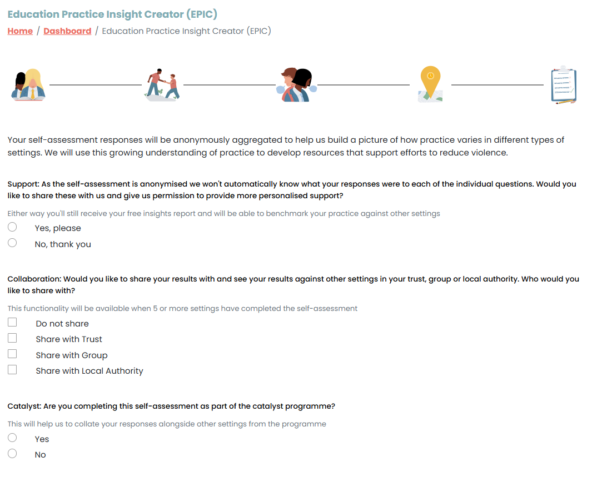
Select if you are happy for your individual responses to be accessible by YEF and a group/ VRU

Slide 34
Sign up to our education newsletter
Complete an EPIC self assessment: https://insights.youthendowmentfund.org.uk/epic
Check out our Education Practice Guidance report: https://youthendowmentfund.org.uk/reports/education-guidance/
Ben.larrain@youthendowmentfund.org.uk
Notes:
Welcome and intro 5 mins
Introduction and context 5 mins
Guidance 5
Demo 12 mins
Q&A 5 mins

Slide 35
Part 3
An enhanced understanding of how to engage with the work of the MVRP.

Slide 36


MYA RAISE Team’s Violence Prevention Offer
Mentors in Violence Prevention Programme
A peer-education programme that equips older students (Mentors) with the understanding and knowledge around violence prevention – who then go on to deliver these messages to younger students (Mentees).
Focusing on the 5 Core Components of Violence Prevention, MVP has a strong focus on eradicating gender-based violence and encourages young people to become active bystanders against serious violence.
Violence Prevention Workshop / Assembly Offer
Delivered by MVP Staff – chose from 2 sessions:
- Active Bystander Approaches
Violence Against Woman and Girls & Misogyny
The chosen session can be delivered as a workshop to 1 class, or as an assembly to a whole year group.
Sessions will last 45-50 mins.
For more information or to enquire about accessing these violence prevention offers:
RhiannB@mya.org.uk
(Mainstream Secondary)
Notes:
https://educationmvp.co.uk/

Slide 37


MYA RAISE Team’s Violence Prevention Offer
Empowering Youth Voices: Film Guidance
A collation of films created by Mentors from the MVP Programme.
Each film is summarised, age-rated an accompanied with conversation starters to encourage discussions with young people around serious violence.
Resource Roundups
Each month we will be sharing our Resource Roundup to explore current themes, view relevant resources including youth voice and identify key support services.
For more information or to enquire about accessing these violence prevention offers:
RhiannB@mya.org.uk
Notes:
Film Guidance - https://educationmvp.co.uk/wp-content/uploads/2025/09/MVP-Film-Guidance.pdf
Resource Roundups - https://educationmvp.co.uk/resources/resource-roundups/

Slide 38

Evidence based resources for primary schools
KS1 New Resource – Telling Tales or Asking for Help, online training dates available:
Wednesday 14th January 2026 3.30-4.30pm
Tuesday 20th January 2026 3.30-4.30pm
Thursday 5th February 2026, 3.30-4.30pm
KS2 New Resource – Knock at the Door, online training dates:
Monday 24th November 2025 3.30-4.30pm
Knock at the Door Parental Engagement (New), online training date:
Monday 3rd November 2025 3.30-4.30pm
KS2 Send Me A Selfie (Skills for Healthy Relationships)
Monday 17th November 2025 3.30-4:45pm
KS2 Skills to Resist Radicalisation
Wednesday 26th November 3.30-4.45pm
KS2 Grassing or Grooming
Monday 17th November 2025 3.30-4:45pm
Engaging Young People | Ariel Trust
trish@arieltrust.com

Slide 39

Primary PSHE Teaching to Prevent Weapons and Gangs
· Gain a deeper understanding of the context, causes, and impact of knife crime and gang activity on young people.
· Learn practical strategies to teach the skills and knowledge that support children in making safer choices.
· Understand the vital role of schools in safeguarding children and young people from gang involvement.
· Develop confidence in delivering sensitive topics within a safe, inclusive classroom environment.
Book your place free of charge at: https://sil-ltd.co.uk/training-details/3478
Further details of SIL’s PSHE offer can be found at: https://sil-ltd.co.uk/personal-development
39

Slide 40
Network 1: Actions
Sign up for youth survey and any relevant training.
Read and Share “Education, Children and Violence Guidance for school, college and alternative provision leaders to help prevent children’s involvement in violence”
3. Complete Education Practice Insight Creator (EPIC)
4. 22nd January 4-5, Network 2 (Dashboard discussion).

Slide 41
Thank you
Nadine Bogan
Education Lead MVRP
nadine.bogan@merseyside.police.uk

