Slide 1

Nadine Bogan Education Lead MVRP nadine.bogan@merseyside.police.uk

Slide 2
Network 2: Outcomes
Strengthen understanding of the Youth Endowment Fund’s guidance, show how it aligns with the EPIC framework, and equip schools to use these tools to initiate meaningful conversations around prevention and violence reduction.
Provide insight into the SAFE Taskforce, a regional programme funded by the Department for Education.
Practical perspectives on violence prevention with KnifeSavers.
Build a clearer understanding of how to engage effectively with the work of the MVRP.

Slide 3
Part 1
Strengthen understanding of the Youth Endowment Fund’s guidance, show how it aligns with the EPIC framework, and equip schools to use these tools to initiate meaningful conversations around prevention and violence reduction.

Slide 4
Our vision A world where no child becomes involved in violence.​
Our mission To find what works and build a movement to put this knowledge into practice.​
Ben.larrain@youthendowmentfund.org.uk

Slide 5

YEF Education Practice Guidance
1
Keep children and young people in education
2
Provide trusted adults
3
Develop social and emotional skills
4
Target efforts at the places and times where violence occurs
5
Cautiously consider unproven strategies and avoid harmful approaches
Notes:
Dennis

Slide 6


Ofsted Inspection
Every school and FE provider in England will now be inspected on whether they protect children from involvement in violence and use an evidence-based approach to do so.
There is now a new section within the Safeguarding chapter of the school inspection toolkit focused on child-on-child violence.
Inspectors will evaluate the extent to which leaders ensure that staff are aware of the signs that pupils may be at risk of becoming involved in violence and understand that early, evidence-based intervention can be key to preventing them from going on to commit violence.
Notes:
Jo

Slide 7


Education Practice Insight Creator (EPIC)
Free digital self-assessment tool that allows schools to understand how well their practice aligns with the evidence in preventing youth violence.
Takes on average less than 30 minutes to complete.
Provides a tailored downloadable insights report
https://insights.youthendowmentfund.org.uk/

Slide 8
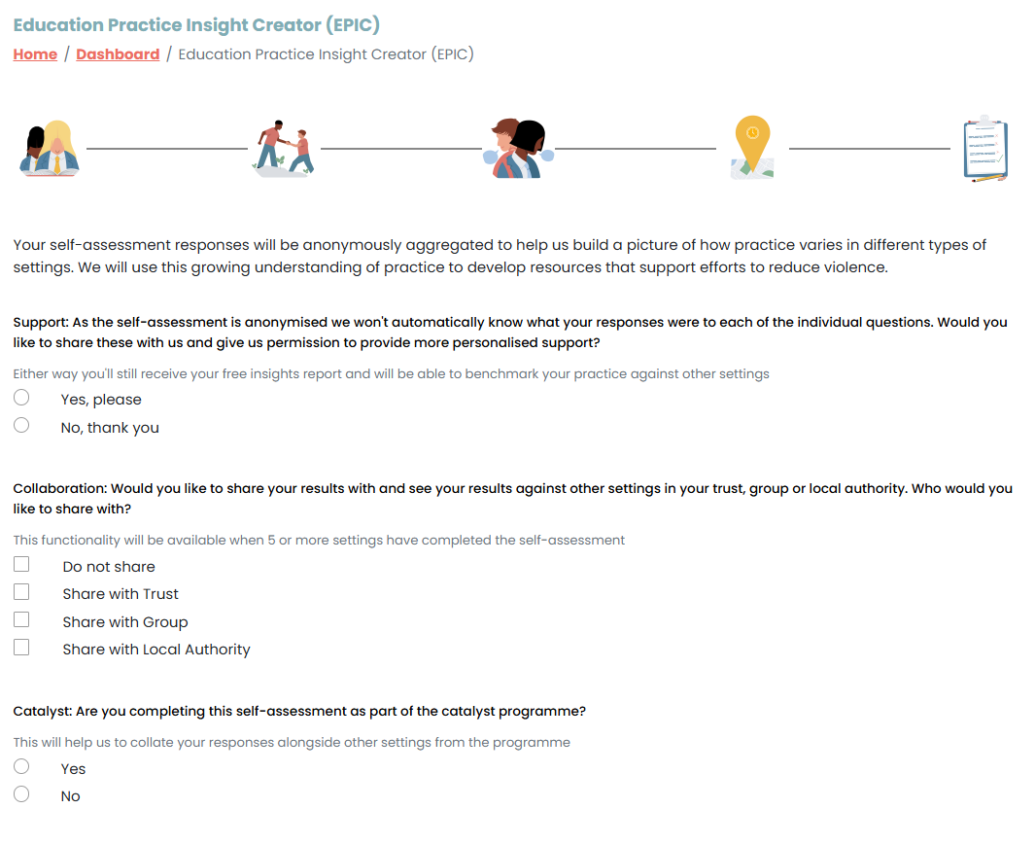
Select if you are happy for your individual responses to be accessible by YEF and Merseyside VRU

Slide 9

EPIC Report
Recommendation 1: Keep children in education
Evidence-informed attendance improvement strategies
Universal and targeted behaviour support
Reflective of data until 16/01/2026

Slide 10
EPIC Report
Recommendation 1: Keep children in education
Support for suspended and permanently excluded children
Reflective of data until 16/01/2026

Slide 11

EPIC Report
Recommendation 2 – Provide children with trusted adults
Reflective of data until 16/01/2026

Slide 12

EPIC Report
Recommendation 3 - Develop children's social and emotional skills
Reflective of data until 16/01/2026

Slide 13

EPIC Report
Recommendation 4 - Target efforts at the places and times where violence occurs
Reflective of data until 16/01/2026

Slide 14

Upcoming YEF webinars
Session 3 – Social and emotional skills development
25th February 2026
Registration link: Social and emotional skills development
Session 4 – Violent times and places and unproven approaches
15th April 2026
Registration link: Violent times and places and unproven approaches
Notes:
Dominic

Slide 15
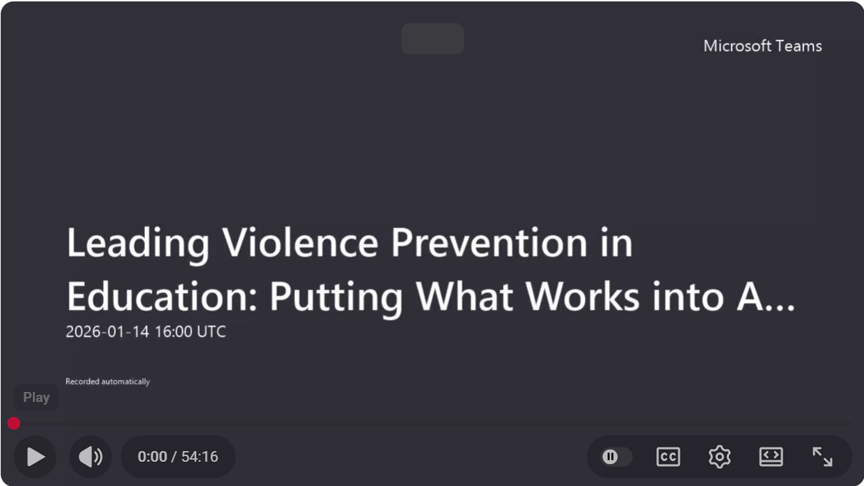
Webinar series
Leading Violence Prevention in Education: Putting What Works into Action
Session 3 – 26/02/26: Social and emotional skills development
Register here
Session 4 – 15/03/26: Targeting efforts at the times and places where violence occurs & unproven strategies
Session 1 – 19/11/25: Putting What Works into Action
Session 2 – 14/01/26: Attendance, suspensions, permanent exclusions and trusted adults
Register here

Slide 16
Sign up to our education newsletter Complete an EPIC self assessment: https://insights.youthendowmentfund.org.uk/epic Check out our Education Practice Guidance report: https://youthendowmentfund.org.uk/reports/education-guidance/
Ben.larrain@youthendowmentfund.org.uk
Notes:
Welcome and intro 5 mins
Introduction and context 5 mins
Guidance 5
Demo 12 mins
Q&A 5 mins

Slide 17
Part 2
Provide insight into the SAFE Taskforce, a regional programme funded by the Department for Education.

Slide 18
SAFE Project – Liverpool
Project Lead – Helen Aldridge

Slide 19
SAFE brings together mainstream schools to commission evidence based interventions to SUPPORT young people with challenging behaviour, enabling them to ATTEND school regularly so they can FULFIL their potential and prevent costly poor life outcomes by inspiring them to EXCEED their expectations.
High quality, evidence based interventions, in & around school, delivered the right way for maximum impact.
Getting upstream of the educational indicators of serious violence – attendance, behaviour & exclusions.

Slide 20
SAFE Project Overview
DfE (Education Engagement & Serious Violence Unit)
KS3- addressing educational indicators of serious youth violence
10 areas in England – Liverpool, Manchester, Bradford, Leeds, Sheffield, Birmingham, 4 London boroughs.
£3.2m for Liverpool to March 2025
Strategic Needs Assessment
SNA informs priority, targeted cohorts with well evidenced interventions
Evidence informed – knowledge base of the Youth Endowment Fund (YEF) and Early Intervention Foundation (EIF) – mentoring, social skills & CBT
YEF funded RAND evaluation years 1-3
Developed local impact tool using LCC outside of the RAND evaluation
Notes:
Published in July 2021, the cross-government Beating Crime Plan announced investment of over £45m in specialist support in both mainstream and Alternative Provision (AP) schools in areas where serious youth violence is most prevalent, to support young people at risk of involvement in violence to re-engage with education.
The majority of this funding is focussed on investment for mainstream schools through the SAFE Taskforces programme, with £30m of funding over a 3-year period.
10 areas include Manchester, Sheffield, Leeds, Bradford, Birmingham and London boroughs
The aim of the taskforce is to get upstream of serious violence by tackling the education indicators that are also associated with a young person being more at risk of involvement in serious violence. ​

Slide 21
Strategic Needs Assessment
Youth violence by arrest location
Violent youth offender profile:
53% SEN (33% with an EHCP)
27% known to social care (majority CIN or CP)
52% Persistently absent from school
27% at least one fixed term exclusion
67% Free School Meals
Further analysis on weapon possession, victims of youth knife crime
School analysis on PA, FTEs, perm ex, SEN, FSM, EWO, CIN/CP/CLA, risk of child exploitation, supporting families criteria, DV, YOS, caregiver, worklessness, NEET
YPAS voice of the young person

Slide 22
SAFE Taskforce
11 schools serving the most vulnerable children in Liverpool
Merseyside Police, MVRP, virtual school, Liverpool City Council, TSYP
Half termly meetings with full participation
Terms of reference
Opportunity for Heads of the schools with the most at risk children to collaborate
DfE – Beacon of good practice for co-production

Slide 23
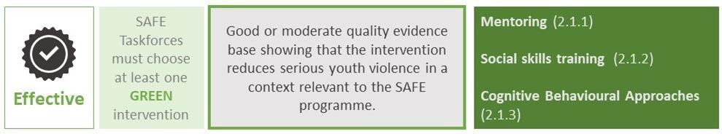
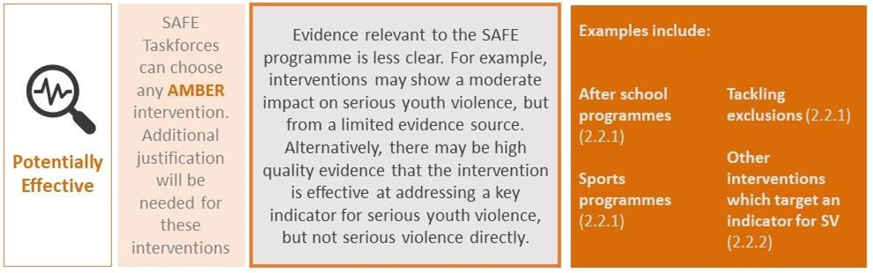

Evidence Informed Intervention Guidance

Slide 24
Intervention 1: SAFE Workers -Mentoring
​Y7-9, on the edge of persistent absence, are persistently absent or have suspensions or exclusions and have an identifying risk factor such as social care involvement, SEMH issues, and/or family involved in crime, DV and substance misuse.​
Contracted to LCC Targeted Services
11 schools with a SAFE Worker, caseload of 12-15
6 – 12 month intervention, term & non-term time
1:1 mentoring, family wraparound & referral
199 young people supported in the year to April 2024
Workers EBSA trained
Cost - £550k per annum

Slide 25
SAFE Workers (mentoring)
Evidenced Impact of Mentoring:
Reduces behavioural indicators of violence including aggression, delinquency & conduct problems
Improves engagement in education including reduced unauthorised absence, improved academic performance & academic efficacy.
Impact Monitoring:
Improved attendance
Reduction in exclusions
Increase in positive behaviours & attitudes
Impact grading across domains – education, family & friends, health, emotional wellbeing
Significant changes noted:
Relationships with fellow pupils
Enjoyment of school
Relationships with teachers
Risk taking behaviours
Emotional wellbeing

Slide 26
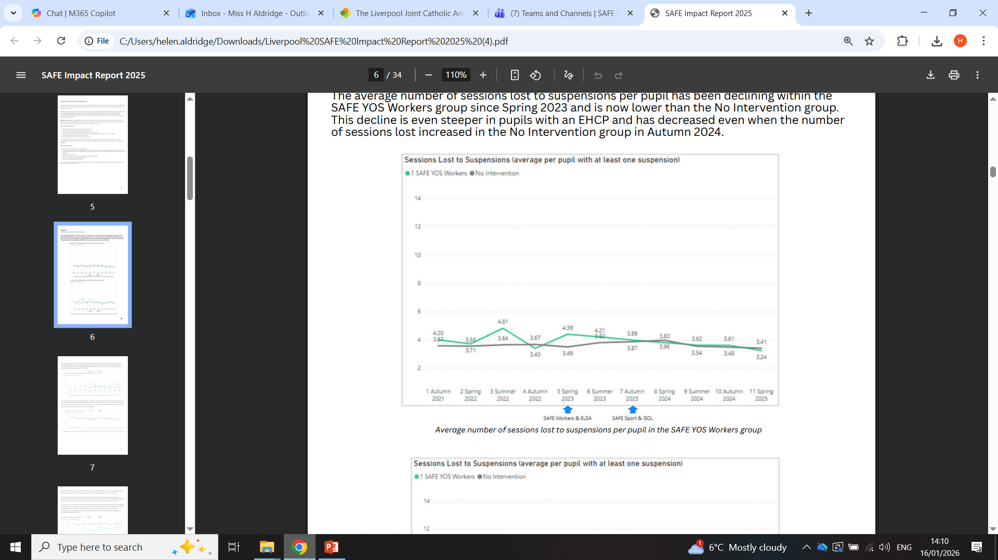
Local Impact to March 2025

Slide 27
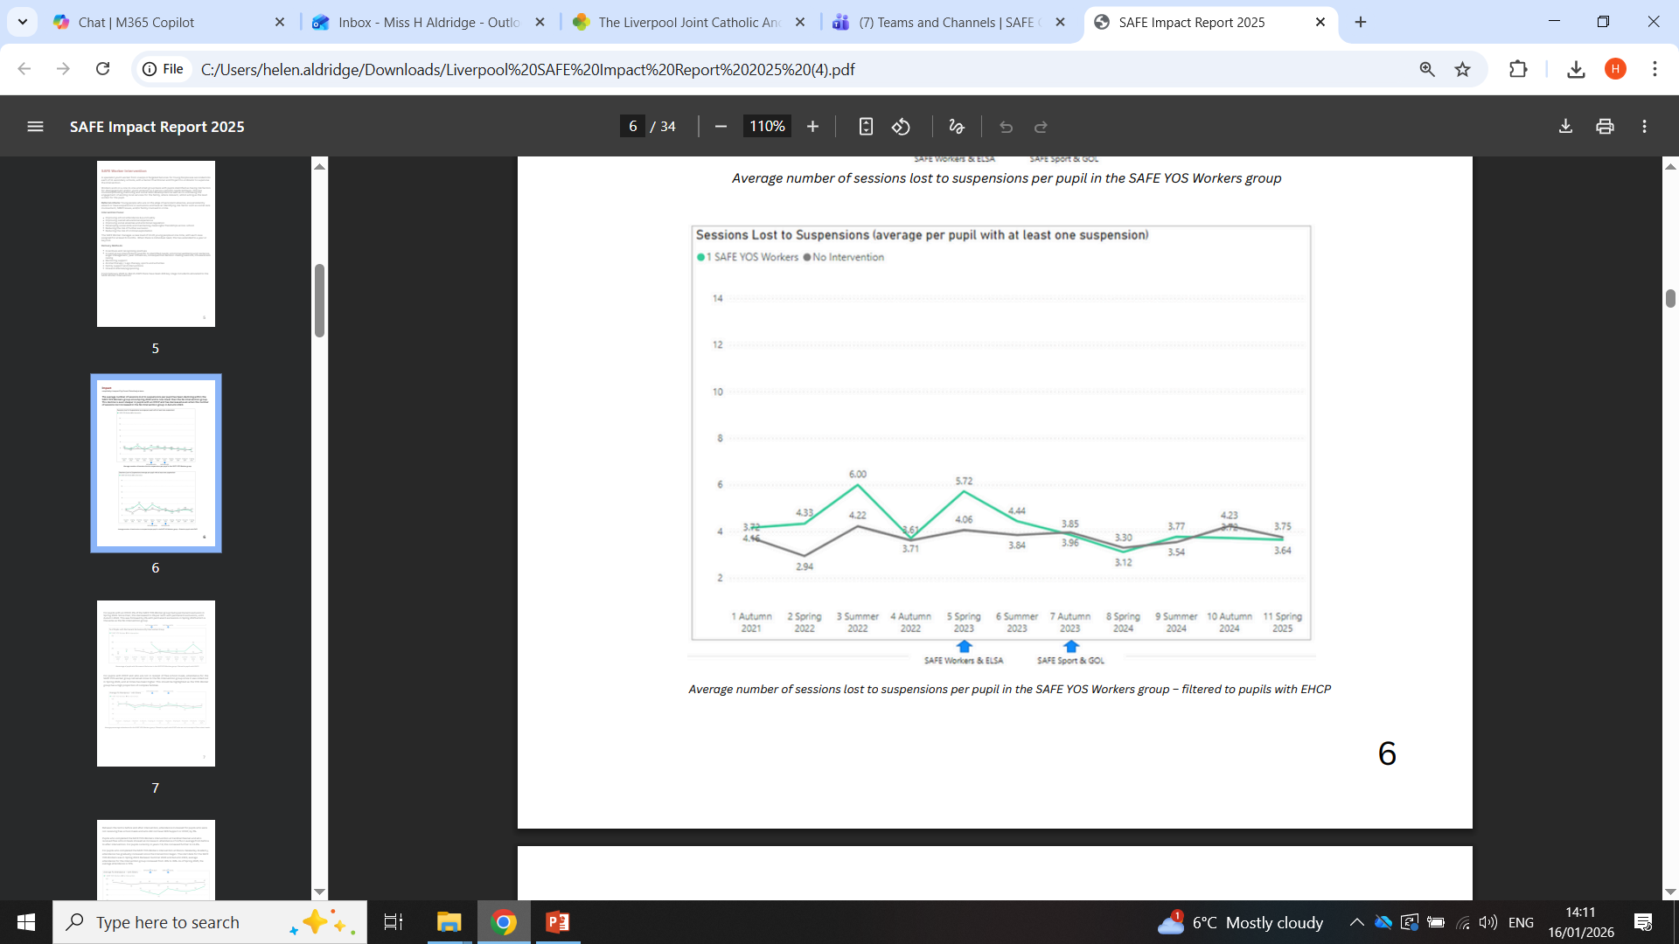
Local Impact to March 2025

Slide 28
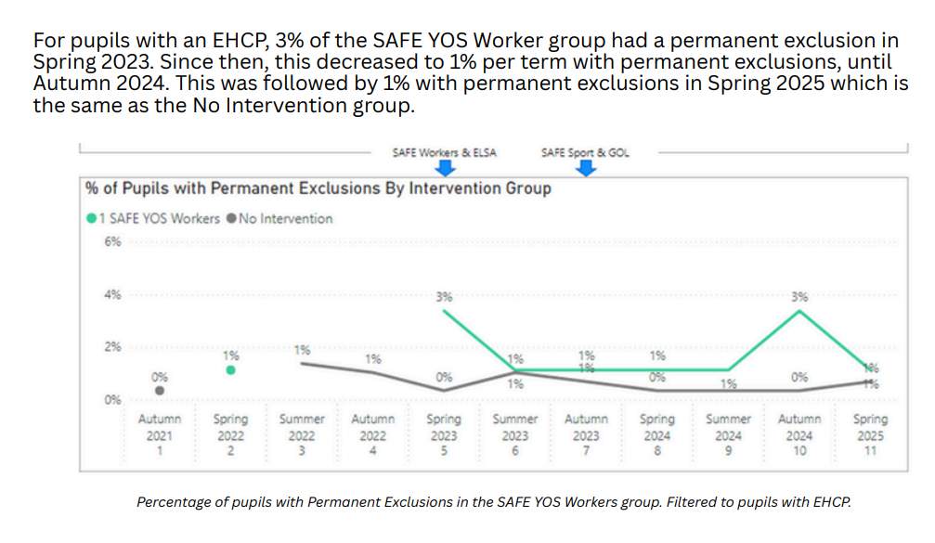
Local Impact to March 2025

Slide 29
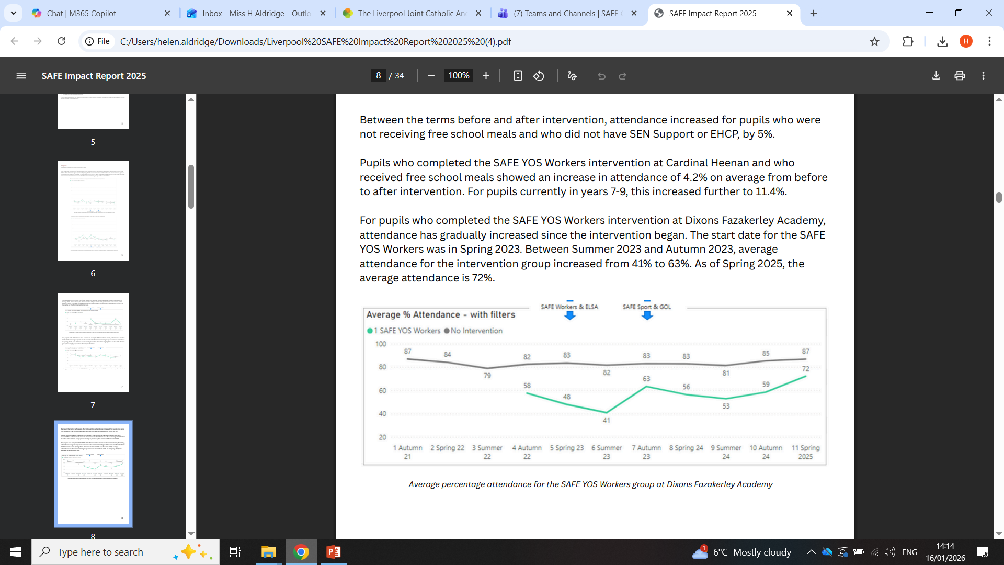
Local Impact to March 2025

Slide 30
4 Domains Explored
Across all schools the overall average increase per domain was
Education – 22.9%
Health – 12.6%
Family & Friends – 14.16%
Emotional wellbeing & Identity – 20.7%
Across all schools the overall average increase per competency was 17.36%
The biggest overall average increase was seen in the following 5 competencies
Relationships with teachers – 32.52%
Relationships with fellow pupils – 23.93%
Enjoyment of school – 28.15
Risk taking behaviours – 24.07%
Feeling supported by others – 21.16%

Slide 31
Emotional Literacy Support Assistants (ELSAs) – Social Skills
Aimed at Y7-9 pupils with emotional dysregulation, demonstrating challenging behaviour.
13 schools with an ELSA
Ongoing training & therapeutic supervision by LCC Ed Psych Team
Caseload per school of 12-15
6 - 8 week intervention, 1:1 pupil mentor
Cost c£560k per annum
585 young people supported Feb ‘23 to April ’24
Reasons for referral – disregulation, anger, conflict, anxiety, bereavement, mental health, family problems, disruptive behaviour, self-esteem, friendship issues
ELSAs trained in EBSA, LGBTQ+ & gender issues
Primary school involvement

Slide 32
ELSAs (social skills)
Evidenced Impact of Social Skills Intervention:
Encourages adoption of positive behaviours & reduces anti-social behaviour
Addresses skills that reduce aggressive or violent behaviours
Improves engagement in education
Improves social competence
Increases attendance & attainment
Reduces disruptive class behaviour, non-compliance & bullying
Impact Monitoring:
Improved attendance
Reduced suspensions
Pupil confidence levels in targeted areas, includes wellbeing

Slide 33
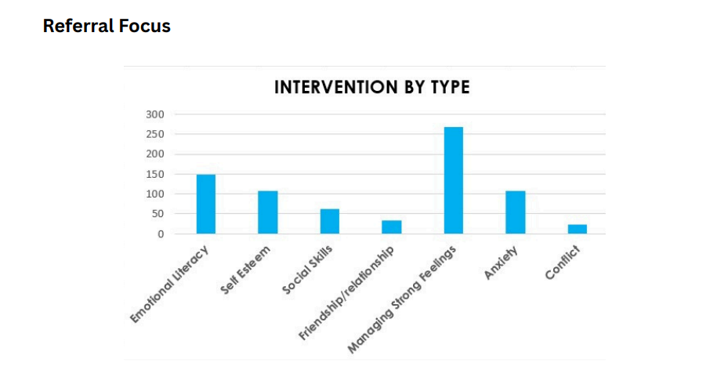
Local Impact to March 2025

Slide 34
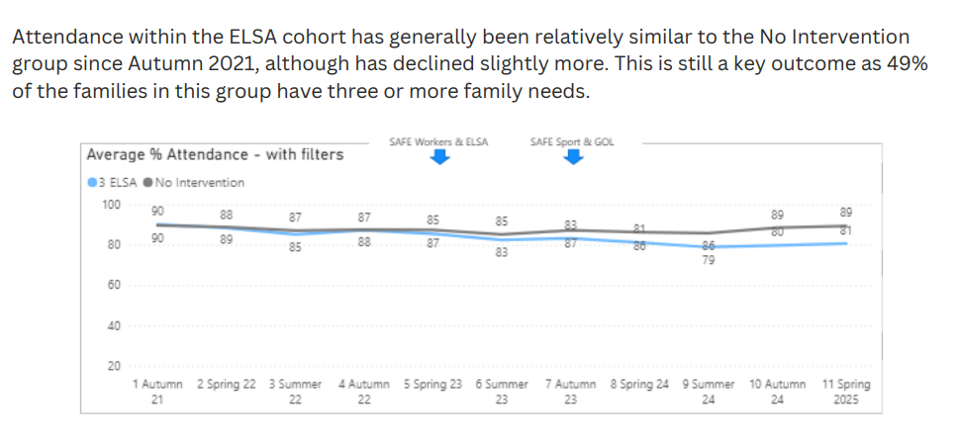
Local Impact to March 2025

Slide 35
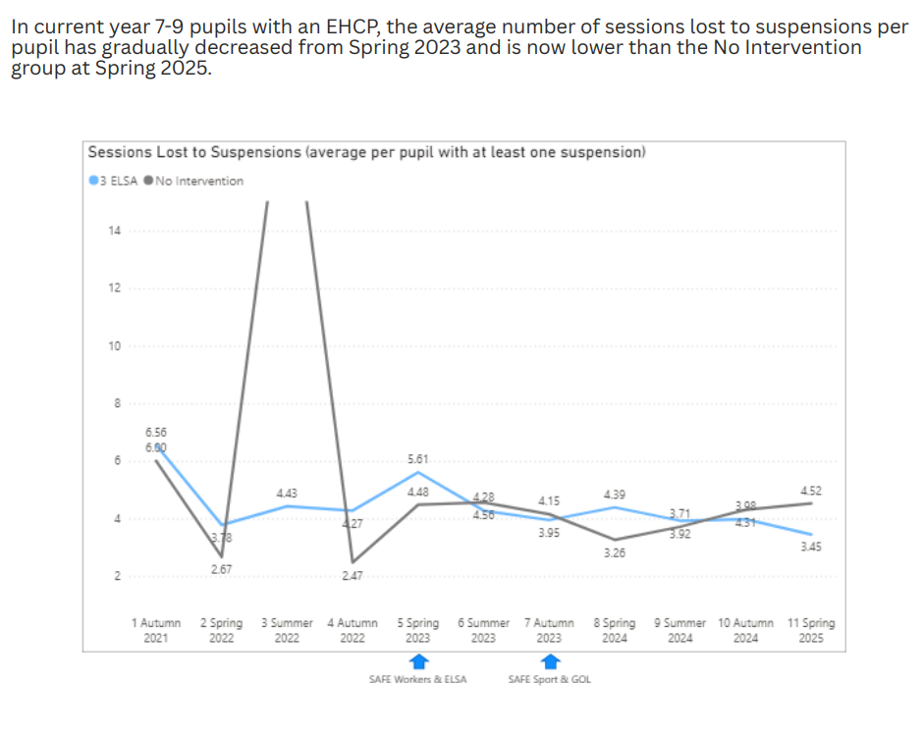
Local Impact to March 2025

Slide 36
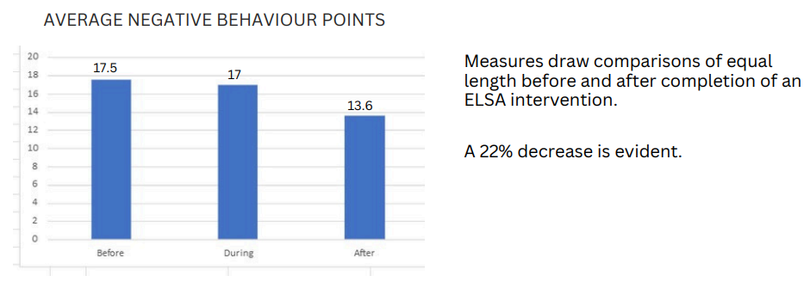
Local Impact to March 2025

Slide 37
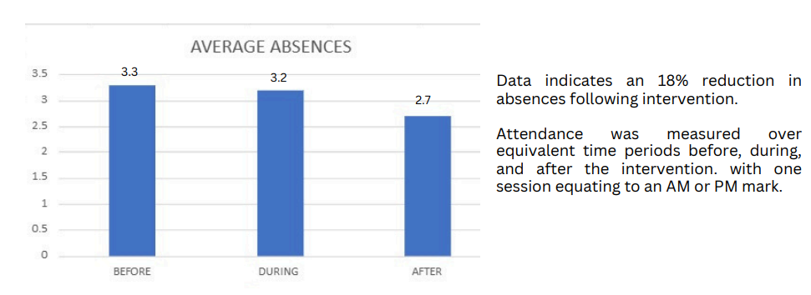
Local Impact to March 2025

Slide 38
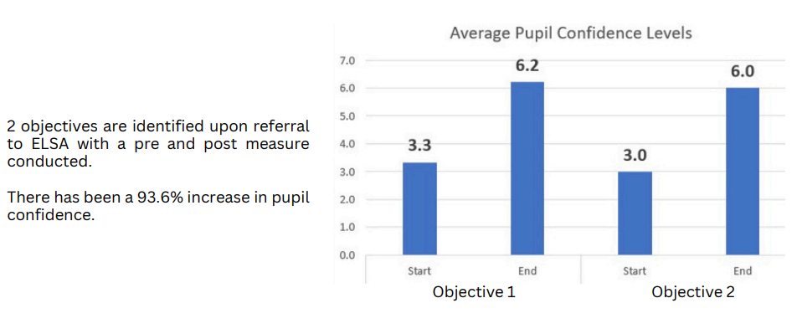

Slide 39
Data Hub
Platform to allow schools to access timely information on pupils to identify those in need of support.
Overview of services working with the family
Feeds – Child Protection, MACE & Child Exploitation, Early help, Youth Offending (Asset+, interventions, offences, prevention), schools (pupil spine data), MerPol (arrest data), Supporting Families (family complexity), Merpol (intelligence, school police officers, Probation Service (prisoner release)
Initially 11 SAFE Taskforce Schools, live September 2023
Limited access for schools – 2 logins plus school police officers
Upfront cost £100k build

Slide 40
“I am” – Sport/CBA - Mentoring
Boys identified as at risk of serious youth violence & or recording high levels of absenteeism or disengaged from education for example those known to School Police Officers, prone to anger quickly & struggle to regulate their emotions.
Contracted to LSSP Foundation
Autumn & Spring cohorts since September 2023
12 in-school engagement sessions per programme
Additional 1:1 mentoring
Extra-curricular weekly offer plus community signposting
Holiday hubs & Forrest School

Slide 41
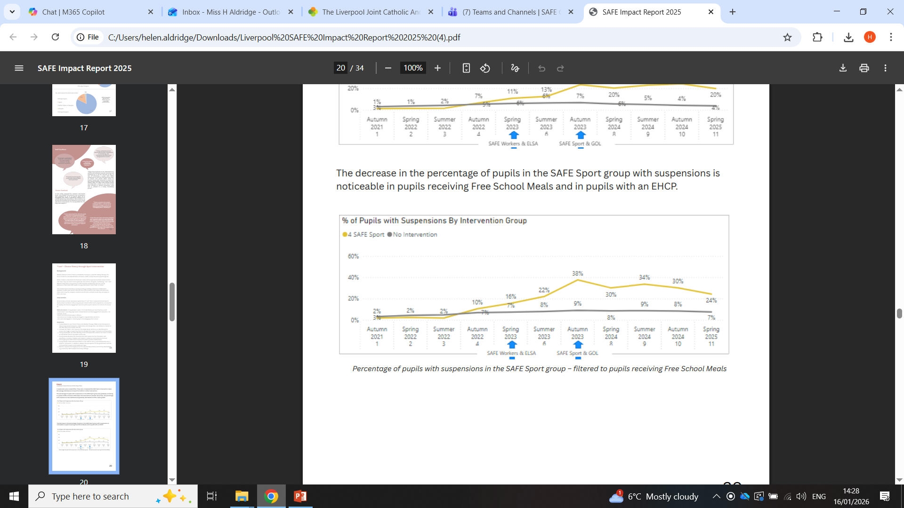
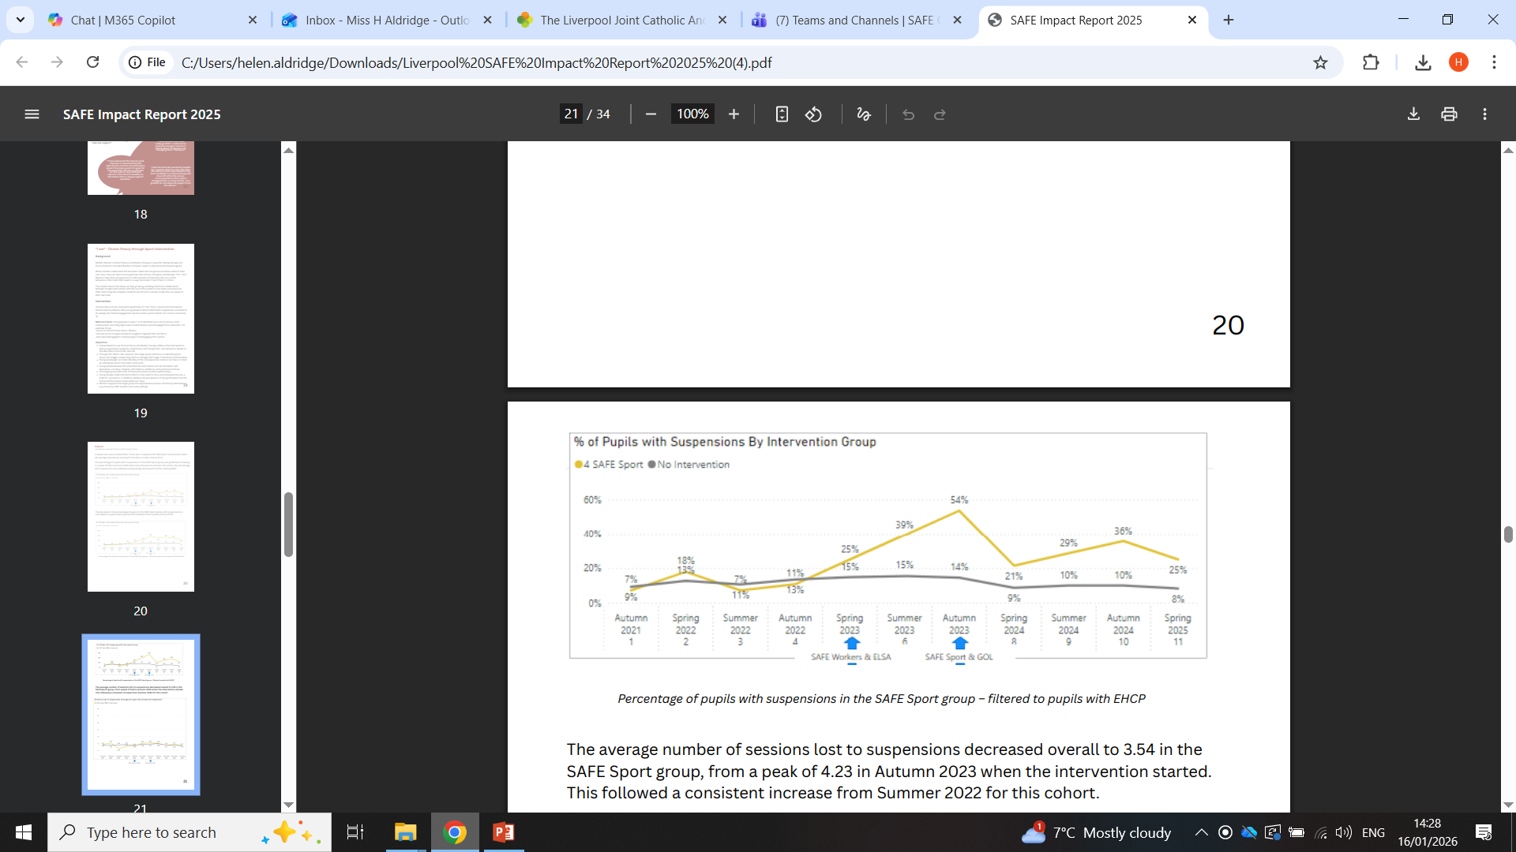
Local Impact to March 2025

Slide 42
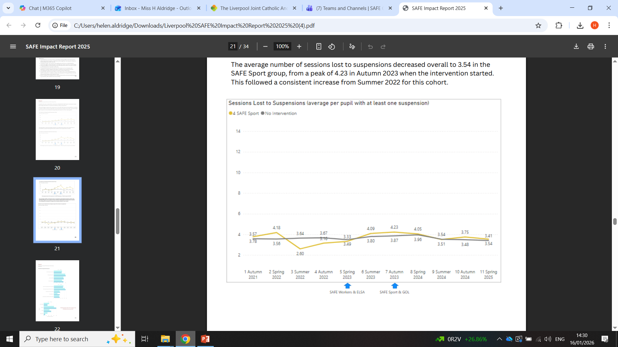
Local Impact to March 2025

Slide 43
Other SAFE Interventions
Girls Out Loud: 4 sessions focused on choices & consequences, mental health, social media and friendships. 10 schools. Cost - £60k
SALT: ELKLAN 11-16 yr old qualification for 13 school SENCos delivered by Alder Hey speech & language therapists – identifying unmet speech, language & communication needs. Cost - £16k

Slide 44
Feedback Snapshot
Pupils:
93% say the intervention has helped them – deal with emotions, be calm, improve focus, improve behaviour, attend school, improve confidence & anxiety
83% have changed something for the better about themselves – behaviour, anger, anxiety, attitude to school, choices, relationships.
Parents: cited improvements in behaviour at home, engagement with school, controlling emotions, managing friendships
Headteachers: prevented suspensions, improved relationships with parents, pupil engagement, improved behaviour, pupils value the 1:1 immensely, reduction in low level disruption, able to find out information to better support pupils & intervene early, individual attendance cases.

Slide 45
Feedback Snapshot
CYP: “I manage my anger issues better, control my emotions better”
CYP: “Teachers say I am more able to control my emotions”
CYP: ”Helps with my anxiety, I used to be scared coming into school”
CYP: “Helps me control my feelings, when I'm mad I think of what the SAFE Worker has given me - taking breaths, making right choices”
CYP: “I want to keep doing the sessions, what happens to my anger when they finish?”
Parent: “Before the SAFE Worker became involved my daughter struggled with her behaviour at school and at home. Now having him involved has enabled me to feel more supported and L feels like she has someone she can trust in school. He has helped me make contact with support services and he is always available when I call or come into school. My daughter knows she has him if she needs anything at all and this has been a big help. Her behaviour has improved at home and in school, her suspensions have reduced and she has started to engage.”
Headteacher: “D would abscond from school and steal in Sainsburys three times a week, but the work with the ELSA has helped him calm down and he hasn't been offsite once in the last 2 months. ”

Slide 46
SWOT
Strengths:
Evidence informed interventions
Targets most vulnerable & at risk CYP
Co-production at its best
Relationships with providers
Delivery at pace
Ability to involve other services
SAFE staff integrated into schools
Embedded in school systems
Knowledge of the ‘whole picture’
Weaknesses:
Temporary contracts for intervention workers
Uncertainty for schools
Opportunities
Reduce absence
Reduce exclusions
Improve mental health & anxiety
Support EBSA
County lines
Criminal exploitation
FAP strategy
Reduce future offending
Threats:
Funding ceases
Resignations of practitioners

Slide 47
Links to Ofsted Toolkit
recognising that pupils who do not attend school (children missing education) might indicate
safeguarding concerns……… or other harms both in and outside their home; these include concerns about child criminal or sexual exploitation, gangs, or online harms
engage productively with multi-agency partners to get pupils the support they need
fulfil their responsibilities in relation to child-on-child violence, which includes (but is not
limited to) bullying, physical abuse (including physical assault and harm, or the threat of
harm, with a weapon), sexual violence and harassment, and domestic abuse in pupils’ own
intimate relationships (teenage relationship abuse)
ensure that staff are aware of the signs that pupils may be at risk of becoming involved in
violence and understand that early, evidence-based intervention can be key to preventing
them from going on to commit violence

Slide 48
Part 3
Practical perspectives on violence prevention with KnifeSavers.

Slide 49
Part 4
Build a clearer understanding of how to engage effectively with the work of the MVRP.

Slide 50
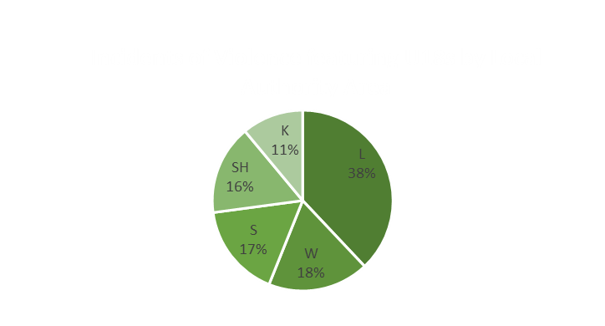
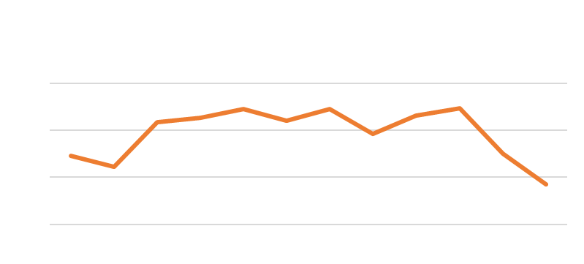


Under-18s and Violence in the Education Environment.
Between 01/09/2025 – 30/12/2025, 11.6% of U18s who were victims of crime reported it took place in an Education-linked location.
13.6% of these took place between 15:00 – 16:00
57% of violent incidents in which U18s were the victim resulted in injury.
Between 01/09/2025 – 30/12/2025, 7% of instigators of violence were aged U18. The average age of the victims were over 18. it is likely that child-parent abuse may be a contributing factor to this. (ii)
Of these, 10.6% took place in an Education-linked location.
It is highly likely that Education-linked locations and public spaces in orbit of centres of learning will continually feature as the location in which violence is instigated by Under-18s.
It is a remote possibility that measures put in place by MVRP and Education between 15:00-17:00 near centres of learning will reduce violence, further analysis is needed to identify the public spaces most violence occurs at.
Term 1 25/26 in view:
Between 01/01/2025 – 30/12/2025, 13.2% of victims of violence (i) were Under-18 (U18).
Within the same period, 10.1% of all incidents of violence were instigated by an individual under the age of 18.
7.6% of victim’s U18 reported that the event took place in an Education-linked location (this includes but is not limited to: Classrooms, Hallways, Canteens, Outdoor Areas, Changing Rooms, Offices, Kitchens, Play Areas).
The 13–17-year-old age range with the U18 cohort is simultaneously the demographic most at risk of violence and most likely to instigate. This reflects a trend seen in other VRUs.
7.8% of violent incidents instigated by U18s occurred between 15:00 and 17:00. This time frame represents the largest volume of incidents except 00:00-01:00. 6% of violent incidents between 15:00 and 17:00 took place in Education-linked locations whilst 40% were reported in Public / Open spaces. Given the time these incidents occur it is highly likely they happen outside school premises after school hours.
It is likely there are Bladed Weapons present in Merseyside schools that remain unobserved. 1% of incidents of violence instigated by U18s in Education-linked locations featured a Bladed Weapon.
23% of incidents of violence instigated by U18s in Education-linked locations was reported as Violence without Injury followed by Violence with Injury at 18%. It is almost certain that child-on-child violence is a concern in Merseyside schools. 71% of Violence with Injury incidents were committed against U18s.
Instigators of Violence by Gender
Male – 65%
Female – 35%
‘Violence’ in this respect refers to categories: Arson, Criminal Damage Excluding Arson, Homicide, Firearms, Other Sexual Offences, Possession of Weapons, Rape, Robbery Business, Robbery Personal, Violence Without Injury, Violence With Injury as recorded of TIIG data.
https://www.college.police.uk%2Farticle%2Fsupport-child-parent--abuse%23%3A~%3Atext%3DChild%2520to%2520parent%2520abuse%2520(CPA%2Ccaregivers%2520beyond%2520a%2520single%2520incident

Slide 51

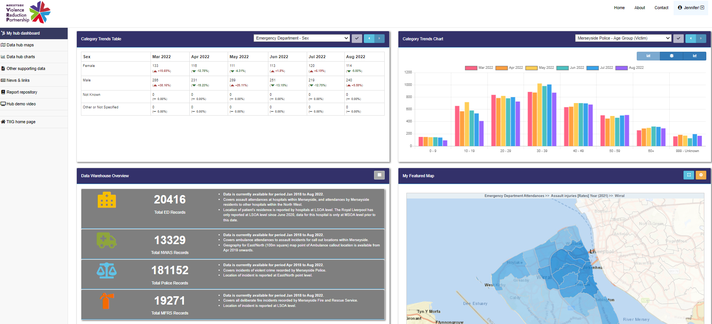

Merseyside VRP data hub
Register to access: https://tiig.ljmu.ac.uk/MerseysideVRP

Slide 52

Merseyside school student’s safety, violence, and wellbeing survey
The Merseyside Violence Reduction Partnership (MVRP), in collaboration with Liverpool John Moores University, is conducting a survey on safety, violence, and wellbeing among children and young people across Merseyside.
Capturing youth voices ensures prevention efforts reflect lived experiences and regional perspectives.

Slide 53


Recognise and Respond to CAPVA (Ask and Act)
This really makes you think - how many times you hear a parent say, "I can't get her /him in..." - what they actually mean if this was unpicked.
Some families may not even realise that CAPVA is a thing - everyone has heard of DV there’s probably so much more than we realise!
School staff are often the first point of contact for parents experiencing child and adolescent to parent violence and abuse (CAPVA). Perhaps via operation encompass, meetings with parents, discussions with children or their peers.
Respect Young People’s Service Education staff briefings aim enable staff to:
Have a better understanding of the causes, effects and risks associated with CAPVA
Be more confident to parents about CAPVA
Know what steps to take if CAPVA is identified
For more information or to book a bespoke session for your staff team, please contact:
amanda.flanagan@respect.org.uk
Young People’s Service Development Manager/Merseyside Regional CAPVA Lead

Slide 54

SIL MVRP Collaboration: Reducing Involvement with Gangs, Weapons and Violence
Teacher Training Videos
Ensuring all school staff have an understanding of the latest data, research and effective strategies to promote belonging, enable effective decision-making and risk-management and reduce violence and gangs and weapons involvement through the PSHE curriculum
Teacher Training in Alternative Provision
2 x tailored sessions for teachers working with young people most at risk of violence
https://sil-ltd.co.uk/training-details/3695
Primary PSHE Leads Training
Supporting Primary PSHE leads to understand how best to begin the preventative PSHE work as part of the universal curriculum entitlement for all children
https://sil-ltd.co.uk/training-details/3478
Legacy School Resource
PDF guide bringing together key information to support schools on an ongoing basis.
Contact: julie.mccann@sil-ltd.co.uk
54

Slide 55
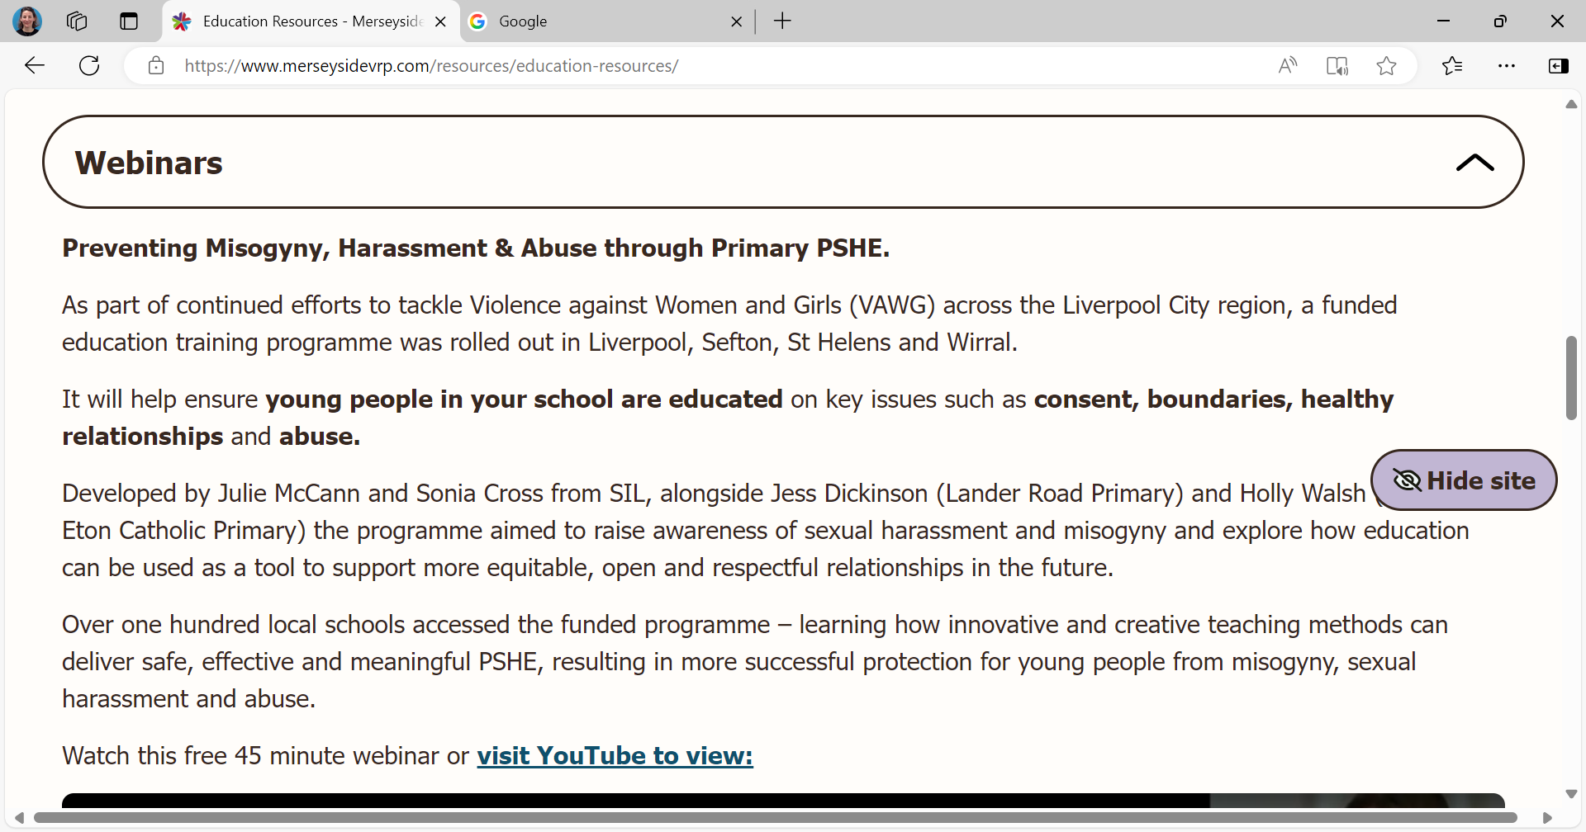

Slide 56

Ariel Trust Resources – 2026 Online Training Opportunities
Ariel Trust, in partnership with Merseyside Violence Reduction Partnership,
is offering your school FREE access to a suite of online staff training
and resources. The resources are aimed at equipping children with the
skills necessary to resist the processes associated with grooming,
radicalisation, and exploitation. These resources offer
age-appropriate materials tailored for primary aged pupils.
Schools can access the following resources:
New KS1 - Telling Tales or Asking for Help
New KS2 – A Knock at the Door
KS2 – Grassing or Grooming
KS2 – Send Me a Selfie
KS2 – Skills to Resist Radicalisation
A Knock at the Door Parental Engagement
For spring online training dates contact Trish@arieltrust.com

Slide 57

LSSP Webinar 19th March 26 : Sport as a Catalyst for Violence Prevention
LSSP invites secondary schools and alternative provision (AP) providers to a dynamic webinar exploring how sport can be used to reduce and prevent youth violence through psychologically grounded, evidence-based approaches.
Webinar Focus:
Grounded in William Glasser’s Choice Theory, which emphasizes personal responsibility, intrinsic motivation, and the power of positive relationships, the webinar will show:
How sport and physical activity can be used to engage young people in purposeful conversations and develop essential life skills such as, self-awareness and self-regulation.
Why Choice Theory?
Glasser’s framework helps young people understand that all behaviour is driven by the desire to meet five basic needs: survival, love and belonging, power, freedom, and fun. By applying this theory through sport, educators can guide students toward better choices, stronger connections, and constructive conflict resolution.
Schools will be able to access a digital resource hosted on the Merseyside Violence Reduction Partnership (MVRP) website, which will support ongoing learning and implementation.
Notes:
Established in 2000 - Central government funded PESSCL/PESSYP Strategy – hosted in 4 Secondary Schools. To increase the quantity and quality of PE, Sport and Physical activity to encourage more young people to be active
2010 - coalition government cut the funding and Liverpool schools agreed to buy in the services / programmes
2017 - Run as one partnership with one offer and staff working across the city and as you can see we are about to celebrate our 25th year!
We offer a wide range of services for young people:
PE and Sport opportunities
Leadership, life skills
Mental health and personal development
Including the two programmes we’re here to talk about. DADDR / I AM

Slide 58




Spotlight

Slide 59


Thank you

