Slide 1

Nadine Bogan
Education Lead MVRP
nadine.bogan@merseyside.police.uk

Slide 2
Agenda
Graham Helm from Street Games
Jimmy McGinn from LSSP
Ellie Fox from Liverpool County FA and Neil Birkett from Merseyside Police
Emile Coleman from Toxteth Elite
Updates and opportunities from
Young People’s wellbeing and safety survey
Resource for schools and community settings through Pol-Ed – Wednesday 15th April
Stop the bleed day – Wednesday 29th April

Slide 3
Understanding the evidence base for the role of sport in violence prevention
Graham Helm – National Partnerships Manager, Safer - StreetGames

Slide 4






StreetGames
Inequality
Vulnerability

Slide 5
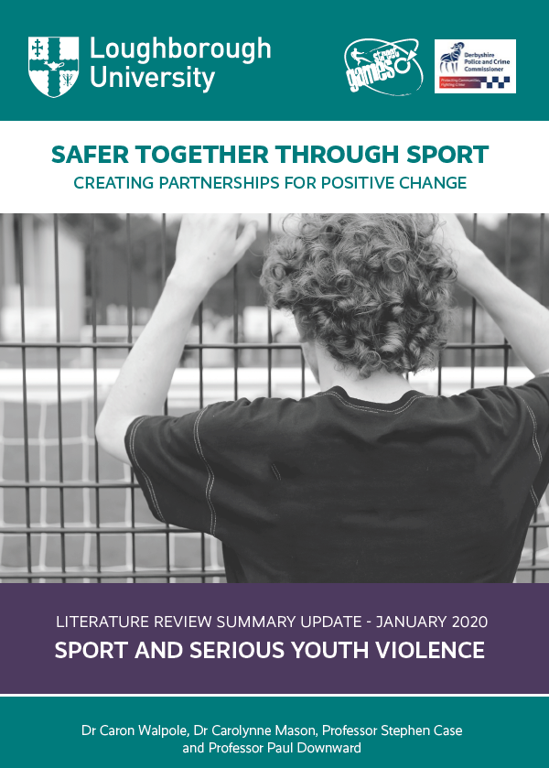



Journey so far
2015 to 2025

Slide 6
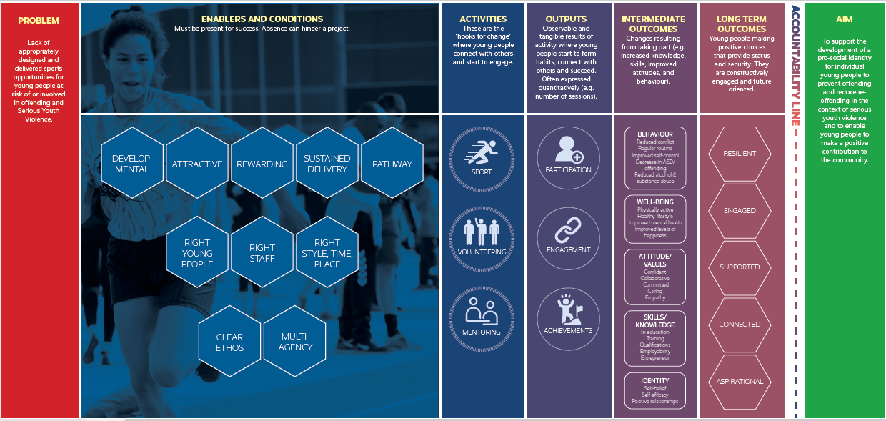
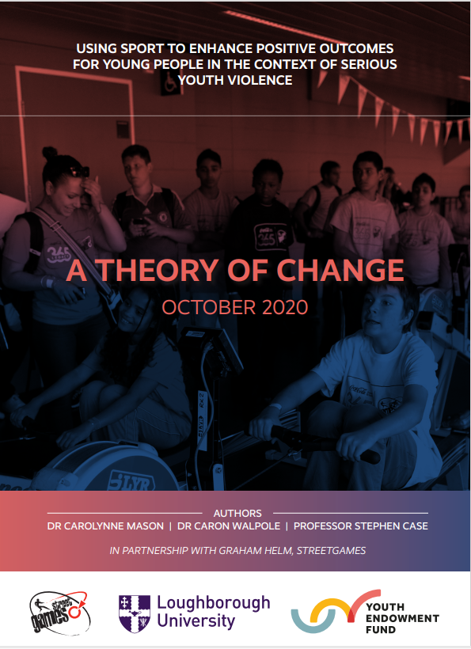
‘ChildFirst’ ‘Pro-Social’ ‘Strengths Based’

Slide 7
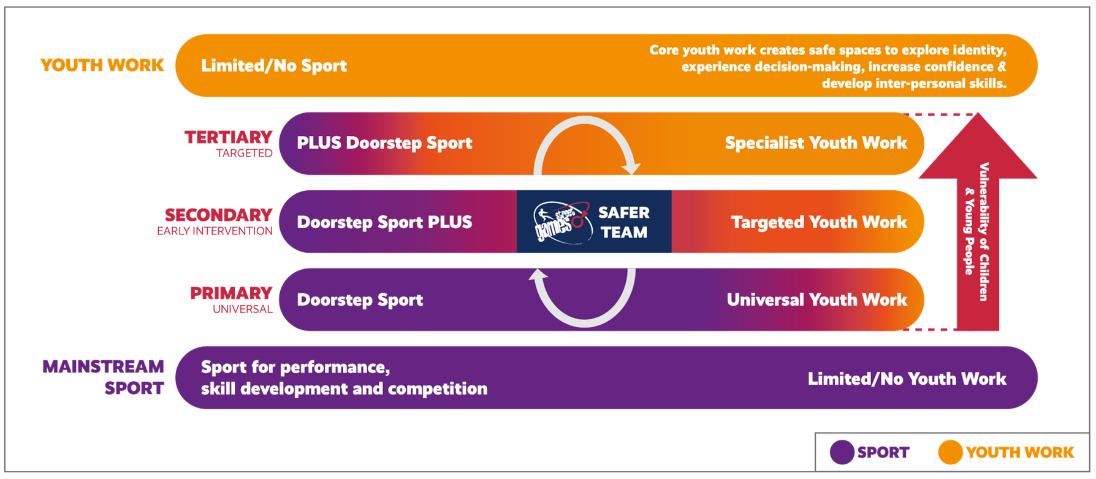
Taking a differentiated approach to the use of sport-based interventions

Slide 8
Contact details:
Graham.helm@streetgames.org
07976253469

Slide 9



Sport as a Catalyst for Violence Prevention
Notes:
Thanks to Nadine for arranging this meeting – we are pleased to be here.
I am Jimmy …We are also joined by Chris, who is our new project officer for this area of work

Slide 10
What is the concern?
The scale of violence affecting children report: YEF 2025
11,000 young people were surveyed
Almost one in five (18%) young people had been a victim of violence
One in eight (13%) admitted to carrying out violence themselves
Around a half (50%) of all those surveyed stated they had witnessed violence committed against someone else
Almost two-thirds of victims and perpetrators say it happened more than once and one in five (20%) reporting it happening at least five times
Notes:
Data from the 2025 Youth Endowment Fund report, which surveyed almost 11,ooo 13-17 years old in England and Wales
READ SLIDE points, then
If we extrapolate this, it would mean around 700,000 in England and Wales young people have been a victim of violence. ONS data approximately 3.5 million 13 -17 year olds
Bridge: When we look at data from social media the numbers are stark! CLICK

Slide 11
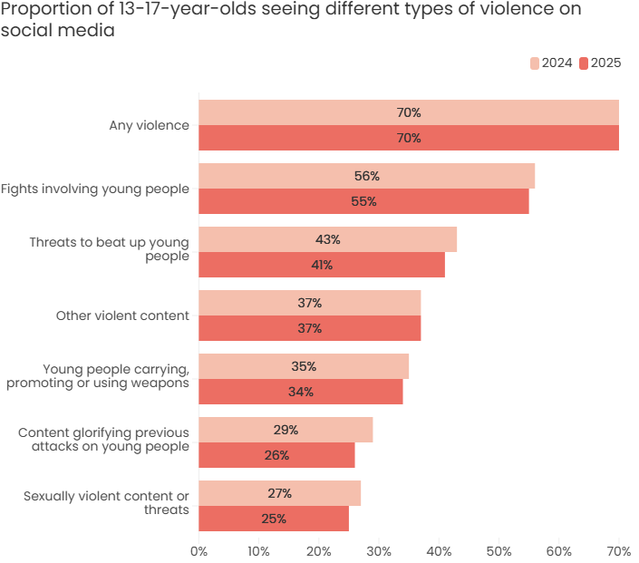
https://youthendowmentfund.org.uk/reports/children-violence-and-vulnerability-2025/scale-of-violence/
Notes:
LOOK AT:
Fights involving young people - Over half have seen videos involving young people
Around one third ⅓ have seen content promoting / using weapons AND
30% had seen content glorifying attacks on young people.
This is amplifying the normalisation of youth violence - which is becoming a particular problem for schools. CLICK

Slide 12
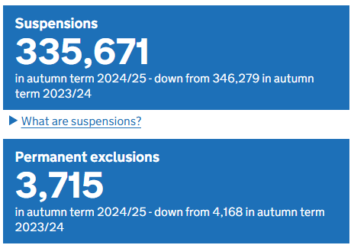
What is the concern?
School Exclusions:
ttps://explore-education-statistics.service.gov.uk/find-statistics/suspensions-and-permanent-exclusions-in-england/2024-25-autumn-term
Notes:
In autumn 2023 / 2024 there were 335,671 suspensions and 3715 permanent exclusions - JUST AUTUMN
Locally : Total 8629 / 148
Liverpool: 3987 / 86
Knowsley: 659 / 11
St Helens: 1549 / 25
Sefton: 983 / 9
Wirral: 1451 / 17
In Liverpool, approximately 6 percent of suspensions / exclusion are as a result of physical assault against an adult and it is around 16 percent for assault against another young person
That means approximately 1,900 students are suspended due to assaulting someone and around 250 young people were permanently excluded
So how can sport help prevent violence? CLICK

Slide 13
How can sport help?
Boys Move - (YST) 2019 / 20
Working class boys
Exclusion / unauthorised absence / youth violence / potential gang membership
Co-creation activities
Sporting Sanctuary
Social Action project
Fighting for a Future 2020 / 21
Theory of change - Street Games
Youth Endowment Fund Toolkit
Young mentors
Notes:
There IS lots of evidence about the effectiveness and impact sport has engaging and developing life skill in young people -
As Graham mentioned earlier, the Street Games Theory of Change shows that sport provides opportunities for the development of:
Social Capital
Pro-social behaviours and relationships. CLICK
What we do at LSSP? CLICK
Working in collaboration with the Youth Sport Trust we designed our first intervention programme.
On almost every metric working class boys were falling behind - GCSEs, university, decreasing engagement with school, increasing engagement with law enforcement. This is evident by local data!
Our first task was to speak to them (Co-creation) Issues: - relationships with teachers / anger / frustration / puberty / money / home life
Co-creation: time out / somewhere to let frustration out / pads - sporting sanctuary
The young people from Archbishop Beck also wanted to complete a Social Action project - build an ECO- GYM (unfortunately this didn’t happen, but I thought it was a great idea).
Learning from this pilot showed that school staff didn’t have the capacity to fully facilitate these types of projects.
This led to the development of Fighting for a Future:
Fighting For a Future: We looked at the YEF toolkit and developed a multi modal approach -
Sports: combat based sports to engage target group.
Mentors: young people from a local MMA gym who were focused on becoming professional athletes - role models
Like ASB, strong Pro-Social bonds / role models increase the likelihood of pro-social behaviours
Mentor training: Young mental health champions training / yoga and breathing techniques
Sport is the ‘hook’ that can expose young people to opportunities for the development to positive physical, -social and emotional development
Bridge: Our current iteration is I AM
CLICK

Slide 14
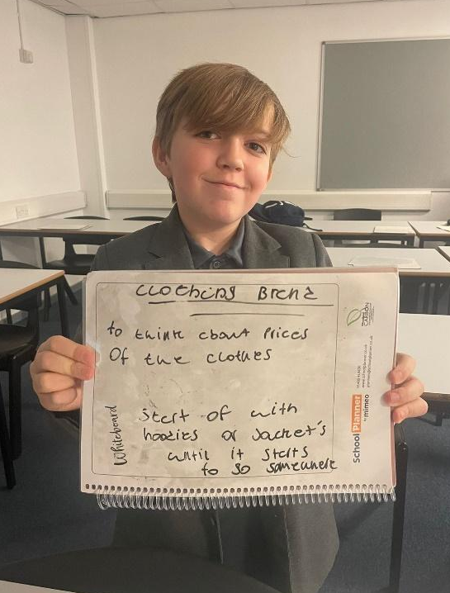
Students whose attendance levels stayed the same told us that their attitude and feelings around coming to school had positively changed
27% of students in one school showed a significant increase in attendance
Over half of the students in one school showed a significant decrease in the number of negative marks received
“Like, sometimes I can be very cheeky to the teachers and that doesn’t really happen anymore”
“...waking up earlier, sorted my routines…making breakfast & getting things ready, instead of asking my mum to do it”
Notes:
We paid for an independent researcher, Amelia McIntosh from LJMU, to evaluate the programme in the 23-24 and 24-25 academic year, to give us unbiased data, both qualitatively and quantitatively., through pre and post surveys through an online survey portal Koboca, and she used a focus group at two different schools

Slide 15
Pre-intervention
“Aggressive”
“Naughty”
“Anxious”
“Loud”
“A bad kid”
“Nervous”
Post-intervention
“A lot better as a student”
“My own person”
“Motivated”
“Confident”
“A good friend”
“A good listener”
“Trying to be more focused in lessons”
“The key benefits to the project that we have seen are improved attendance, improved attitudes towards going to school, improved behaviour, and increased self-awareness”
Notes:
WHY - self-awareness as opposed to to confidence. Explain confidence scores actually went down, but the qualitative data shows that pre intervention, confidence was mainly linked to sporting performance, but post intervention it was clear that the young people had expanded their knowledge!

Slide 16
How these programmes support with preventing CYP involvement in crime and violence:
Evidence from the YEF toolkit shows:
Social skills programmes reduce the number of children in crime by 32%, by focusing on:
Thinking before they act
Communicating effectively
Using strategies for managing impulsiveness or aggression
“Exploitation was one of our top priorities in school, and was
an area of most concern with our Y9 group. We’ve seen a
massive drop in concerns around exploitations in Y9 and
that’s down to us investing in the young people, by
investing in the project and we’re really pleased with their progress.”
Steven Panter, KLA
Notes:
Read slide.
All our work links to choice theory and staff take a trauma informed approach.

Slide 17
What is the challenge?
Catch 22 - literature review June 24
https://www.catch-22.org.uk/resources/the-prevalence-of-school-exclusions-in-the-uk/
‘...not only negatively impact an individual’s trajectory, but disproportionately affect certain students’
‘Prioritising disciplinary procedures within schools has been shown to have significant implications for on an individual’s academic achievement, mental health and risk of involvement in crime.’
Notes:
Catch 22: The prevalence of school exclusions in the UK, their root causes, and the importance of preventative offerings over reactive interventions (June 2024)
States that school exclusions - read 1
And that - read 2
The literature

Slide 18
What is the challenge?
Catch 22 - literature review June 24
https://www.catch-22.org.uk/resources/the-prevalence-of-school-exclusions-in-the-uk/
‘Embracing preventative approaches that strategically focus on targeted interventions within schools not only safeguards against immediate behavioural challenges but also holds the transformative power to significantly mitigate the risk of subsequent involvement in the criminal justice system for individuals.
Notes:
Catch 22: The prevalence of school exclusions in the UK, their root causes, and the importance of preventative offerings over reactive interventions (June 2024)
READ slide:
If used correctly sport can be the mechanism to proactively address the root causes of behavioural issues and ultimately leading to increased positive engagement is school and community.
Bridge: as the YEF found - CLICK

Slide 19
How can sport help?
Youth Endowment Fund:
sport is highly effective for engaging young people, offering significant physical, mental, and social benefits. Participation improves physical health, boosts mental well-being (reducing stress/anxiety), and fosters essential life skills like teamwork, discipline, resilience, and confidence. It also helps build social skills, a sense of belonging, and improved academic focus.
Just think about the impact sports have at your school?
Notes:
Interventions should be young person focussed - don’t see them as ‘the problem’
What we did at LSSP - CLICK

Slide 20
Contact Details:
Jimmy McGinn
Email: jmcginn@LSSP.co.uk
Mob: 07840 380228
Contact Details:
Chris Debar
Email: cdebar@LSSP.co.uk
Mob: 07447 649391
Follow us on socials:
LinkedIn, Instagram & X @Liverpool_SSP
Notes:
Thank you.

Slide 21






She Inspire Chief Constables & PCC Football Programme

Slide 22


She Inspires Chief Constable & PCC Football Programme | Liverpool FA
The She Inspires Journey so far
2022-23
2023-24
2024-25
2025-26
16 – 18
12 Sessions
Coach & Referee Courses
Women’s Euro Themed Tournament
600 Y7 & Y8
40 Schools
3 Mass Engagement Events
2 Stadium Visits
Continue themed Workshops
1000 Y6 Mixed
600 Y7 & Y8
80 Schools
3 Mass Engagement Events
Continue themed Workshops
Full time Staff
480 Y8 & Y9
24 Schools
24 Female Referees
2 Mass Engagement Events
Created themed Workshops
Notes:
Merseyside had sadly seen the murders of 4 females – Ava White (2021), Olivia Pratt Corbel (2023), Ashley Dale (2023), Elle Edwards (2023)
Merseyside Police and PCC launched in 2022 Violence Against W&G Strategy
Simple conversation after a W&G League meeting with a club coach who was an acting Police Officer, who asked “Could we use football as a way to engage with girls!” Our answer was simple – YES!
We convened a meeting and LCFA introduced EiTC & LFCF to the plan, everyone was on board
Initial fund of £15k to deliver 12x coaching sessions across Merseyside for girls aged 16-18yrs, Referee and Coaching Courses and deliver of Womens Euros themed Tournament.

Slide 23
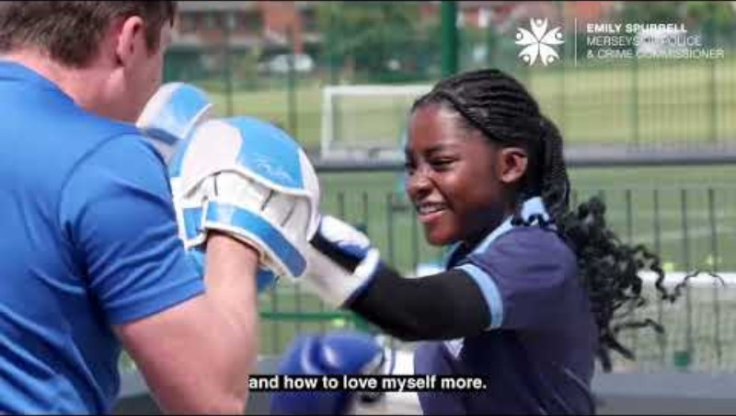
Women & Girls Engagement Event | Liverpool FA

Slide 24
She Inspires Chief Constable & PCC Football Programme | Liverpool FA
Last Season Journey Data (from 150 completed surveys)
Overall Feedback from Pupils | 5.62 | 7.48 | +1.86
Topic | Pre delivery | Post Delivery | Difference
Understanding of Aspirations | 4.45 | 7.79 | +3.34
Confidence in Yourself | 5.57 | 7.38 | +1.81
Comfortable being a Leader | 5.53 | 6.86 | +1.33
How Resilient are you? | 5.38 | 7.48 | +2.1
Understand how we can affect our Self-Esteem | 5.65 | 7.28 | +1.63
Importance of Teamwork | 7.12 | 8.10 | +0.98

Slide 25

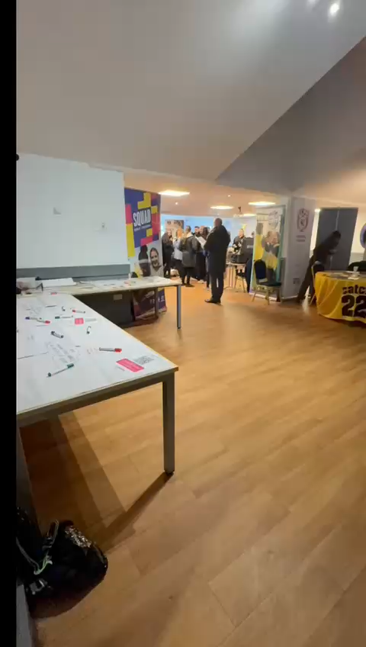
She Inspire Mass Engagement Event
March 2026
Primary Event
227 Y6 Girls & Boys
10 Schools
Secondary Event
132 Y7 & 8 Girls
10 Schools
Over 18 different organisations involved across the two events

Slide 26
Toxteth Elite

Slide 27



Merseyside children and young people feelings of safety and wellbeing survey
Background: LJMU was commissioned by the MVRP to conduct a youth-focused survey in schools, community groups, and universities.
Purpose: To build a robust evidence base on young people’s feelings of safety and wellbeing which will provide critical locally specific evidence, informing commissioning of local prevention and support services targeted at children and young people, and providing schools with their individual school level data.
Key Aims:
Understand young people’s perceptions of safety.
Identify at-risk socio-demographic groups.
Examine links between safety and risk/protective factors.
Explore levels of mental wellbeing, resilience, help-seeking, health behaviours, and educational outcomes.
Younger school children survey
Years 6- Year 8
Older school children survey
Years 9 onward (including sixth form and colleges)
Community groups and youth justice services (age 16+ years only)
University student survey

Slide 28
Next steps
Participation Process
You will have received an email from the MVRP on behalf of LJMU.
If your school is interested in taking part:
  Read and sign the gatekeeper consent, and contact the LJMU research team (details in the email).
      They will provide all the necessary study materials to you to implement the survey with your students
Survey Participation
Primary schools – survey is only suitable for Year 6 students
Secondary schools can choose which/how many year groups take part.
Two separate surveys:
  Younger pupils: Years 6–8
          Older pupils: Year 9 onwards including 6th form
Surveys are ideally completed online. Paper copies can be provided if needed
Consent Requirements
Children under 16: Require parental opt-in consent.
  LJMU will supply the relevant consent forms and information sheets.
Children 16 and over: Can provide their own consent.
To inform parents:
  Schools are encouraged to share survey details via their newsletter or a dedicated email.

Slide 29
Why your participation is important
Providing critical locally specific evidence on the extent and nature of children and young people’s, feelings of safety, supportive adults in their lives and wellbeing
Informing commissioning of local prevention and support services targeted at children and young people
Providing you with an insight to your student’s perceptions of safety and wellbeing (schools will receive their individual school high level findings at the end of the study
Email ssvarsurvey@ljmu.ac.uk for more information

Slide 30
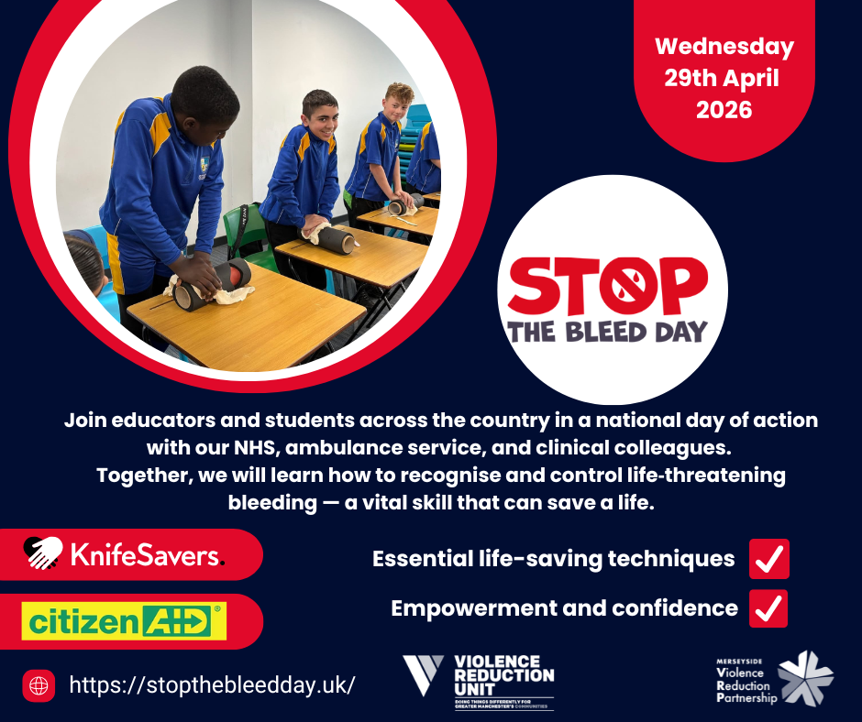

Slide 31



Sgt Tom Regan
Business and Service Delivery Lead
tom.regan@westyorkshire.police.uk

Slide 32



Purpose Statement
To empower children with knowledge and skills that help them stay safe and make positive informed choices.
Connection: Both aim to prevent harm and strengthen trust through proactive engagement.
Mission
A world where every child feels safe, confident, and supported to thrive without fear of harm
Connection: Both share a protection-first approach, using early intervention as a tool.
Vision
Pol-Ed delivers engaging, age-appropriate education that equips children with practical safety strategies, fosters resilience, and strengthens partnerships between schools, police, families, and wider communities
Connection: Both rely on collaboration and leadership support for greatest impact.
Notes:
Neighbourhood policing and Pol-Ed
Connection: Both rely on collaboration and leadership support for credibility and impact.

Slide 33




Pol-Ed Phases of Intervention
Phase 1
Phase 2
Phase 3
For Schools to deliver
For Forces and LAs
For Forces
Notes:
Neighbourhood policing and Pol-Ed
Connection: Both rely on collaboration and leadership support for credibility and impact.

Slide 34



Aims and Objectives
Policing Priorities
Curriculum Integration
Safeguarding
Early intervention and prevention
Greater understanding of Law, Crime, consequences and risks
Reduce demand on police
PSHE (Including RSHE)
Citizenship (Including British Values)
Wider Personal Development
Trauma Informed
Personal Reflection
Signposting
Notes:
Neighbourhood policing and Pol-Ed
Connection: Both rely on collaboration and leadership support for credibility and impact.

Slide 35

School Contents
Lessons
Phase 1
Assemblies
Passports
CPD
For Schools to deliver
Documents
Notes:
Neighbourhood policing and Pol-Ed
Connection: Both rely on collaboration and leadership support for credibility and impact.

Slide 36

Umbrella Topics
Relationships
Keeping Safe
Understanding the Law
Wellbeing
Consent
Domestic Abuse
Sexual Offences
Grooming
Bullying
Emergency Services
CCE
ASB
Gangs
Addiction
Responsible citizens
Stop and Search
Public Order
Hate Crime
Physical Health
Emotional wellbeing
Social Connections
Support
Lessons
Assemblies
Passports
CPD
Documents
Notes:
Neighbourhood policing and Pol-Ed
Connection: Both rely on collaboration and leadership support for credibility and impact.

Slide 37
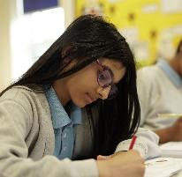
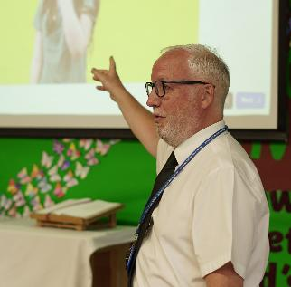

Relationships Progression
Phase 1
Year 8
Year 9
Year 10
Year 11
EYFS
Post 16
Year 1
Year 2
Year 5
Year 6
Year 7
Year 3
Year 4
How can I get ready for secondary relationships?
How can we be allies against racism?
How can we challenge sexism?
How can we respect different relationships?
What is debate?
What is my relationship with authority?
How do we manage stages of intimacy?
Who are your people?
How to spot and respond to coercive and control?
How should we end romantic relationships?
How do we develop our online brand?
What is harassment?
Are we responsible with social media?
How do I deal with unplanned encounters?
How can we deal with my friends using drugs and alcohol?
What are red flag in relationships (friendship & romantic)?
How can my adult relationships affect my future?
How do words have power?
What are my personal boundaries?
What are online friendships?
What is grooming?
What is media influence?
What is peer pressure?
How Can I be an ally?
How can I make friends?
What if my friends are making me feel sad?
What is bullying?
Why are safe hands important?
Why is name calling unkind
How are we the same?
How are we different?
How can I work with different people?
How do I share family worries?
What is a family?
Why are relationships important?
What are sexual offences?
What is victim blaming?
What is the difference between an arranged and forced marriage?
What is the impact of porn on relationships, so what?
What is my relationship with AI?
How should we treat people?
What can I do when friendships go wrong?
What do we mean by consent in friendships?
What is bullying?
Who are my key people?
How can we be role models?
What is a healthy friendship?
What is discrimination?
What is diversity?
What is peer influence?
Who makes up my community?
How can I be a good friend?
How can I make other children feel happy?
How can I play nicely with others?
How can adults at school help me?
What is consent in a relationship?
What is sexism?
What is child sexual exploitation?
What is the issues with nudes?
How does the media portray sex and relationships?
Is this banter or bullying?
What is child on child abuse?
How do I deal with conflict?
How can we deal with relationships breaking down?
Why is trust important?
What are my relationship values?
What is emotional abuse?
What is incel culture?
What is toxic culture?
What is image based sexual abuse?
For Schools to deliver
Lessons
Assemblies
Passports
CPD
Documents
Phase 2
For Forces and LAs
Phase 3
For Forces
Notes:
Neighbourhood policing and Pol-Ed
Connection: Both rely on collaboration and leadership support for credibility and impact.

Slide 38
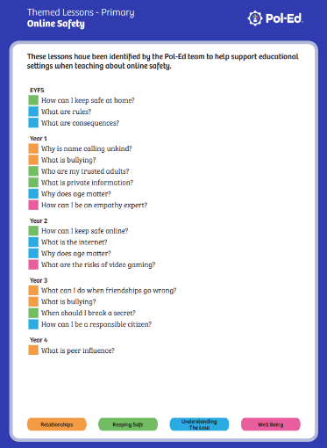
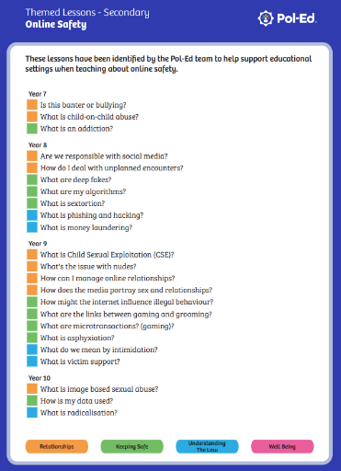
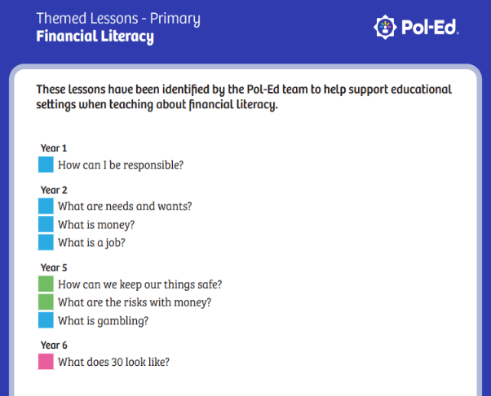
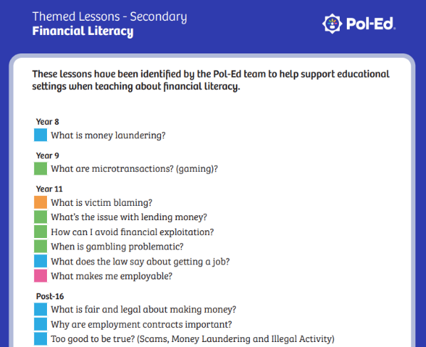
Lesson Grouping – Online Safety
Notes:
Neighbourhood policing and Pol-Ed
Connection: Both rely on collaboration and leadership support for credibility and impact.

Slide 39
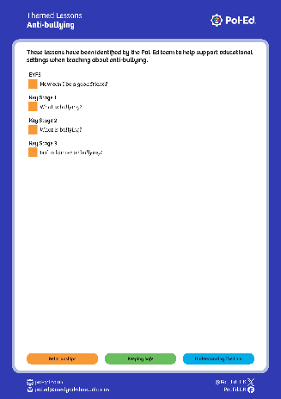
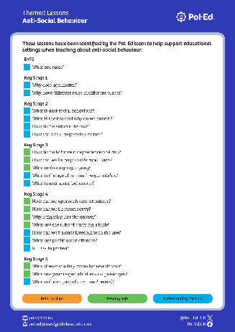
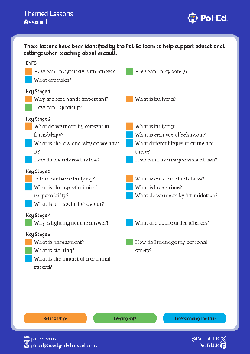
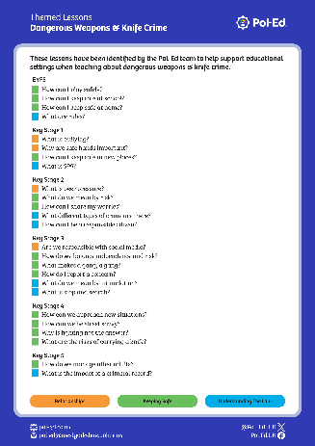
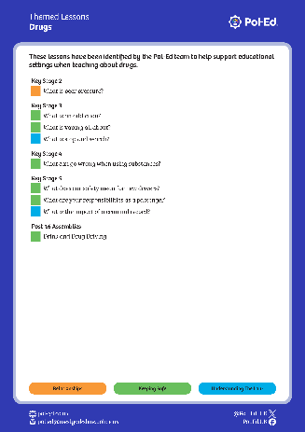
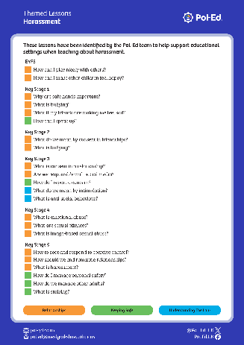
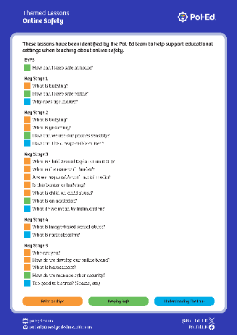
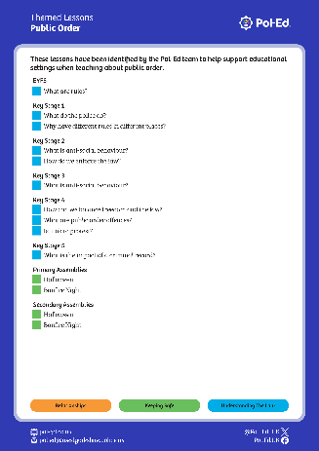
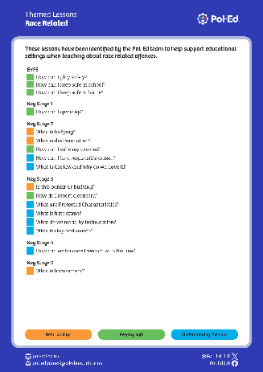
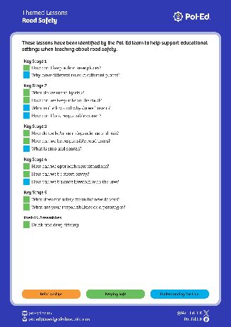
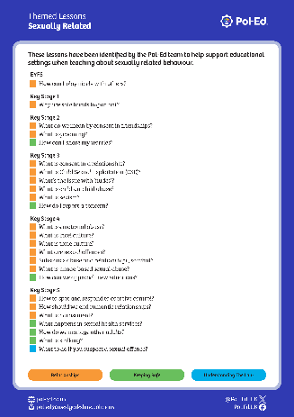
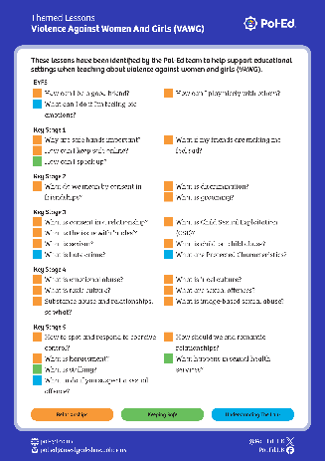
Themed Lesson Groupings
Lessons
Anti-bullying
Anti-social Behaviour
Assault
Dangerous Weapons & Knife Crime
Drugs
Financial Literacy
Harassment
Online Safety
Public Order
Race Related
Road Safety
Sexually Related
Violence Against Women & Girls (VAWG)
Notes:
Neighbourhood policing and Pol-Ed
Connection: Both rely on collaboration and leadership support for credibility and impact.

Slide 40

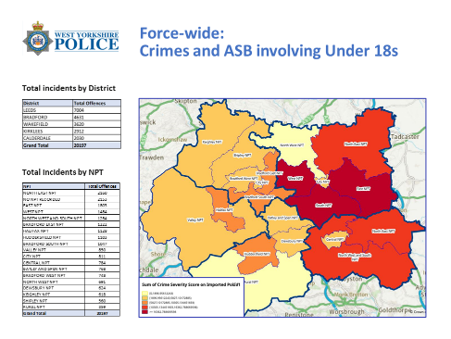
Themed Lesson Groupings
Notes:
Neighbourhood policing and Pol-Ed
Connection: Both rely on collaboration and leadership support for credibility and impact.

Slide 41

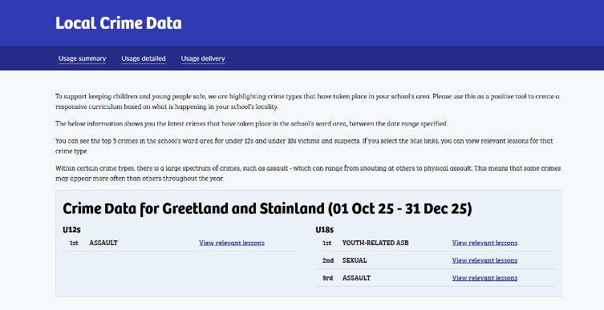
Crime Data

Slide 42
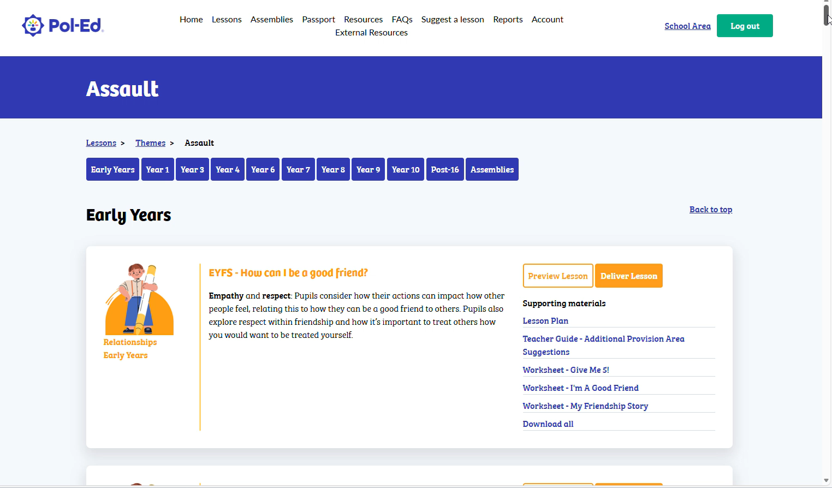
Lesson Groupings

Slide 43
Youth Crime
Over the force area, youth offending has dropped by 11% overall when compared to the year prior to Pol Ed project inception.
There were 6848 fewer youth crime offences in 2025 than there were in 2022.
93 Wards (or 70%) have seen an overall reduction in numbers, 38 wards (or 30%) have seen an overall increase, with one ward remaining at the same number of crimes.
Notes:
Neighbourhood policing and Pol-Ed
Connection: Both rely on collaboration and leadership support for credibility and impact.

Slide 44


Youth Crime data – County Wide
Notes:
The charts above compares data from the Pol-Ed go live date (02/06/25) to the 2nd December, against the same period last year.
Overall there has been a 31.8% reduction in youth crime.
Breaking this down further, between June and September (3 months of Pol-Ed) the reduction was at 21.4%. From September to December, this has increased to 40%, which reflects the increased usage of Pol-Ed.

Slide 45
Questions
Notes:
Neighbourhood policing and Pol-Ed
Connection: Both rely on collaboration and leadership support for credibility and impact.

Slide 46



Thank you
tom.regan@westyorkshire.police.co.uk
@Pol_Ed_UK
Pol-Ed
/Pol.Ed.UK
Notes:
Neighbourhood policing and Pol-Ed
Connection: Both rely on collaboration and leadership support for credibility and impact.

