Slide 1


Mentimenter.com
Username: Pol.ed@westyorkshire.police.uk
Password: Pol-Ed1234
Merseyside Launch Conference
Wednesday 15th April 2026
Notes:
Mentimenter.com
Username: Pol.ed@westyorkshire.police.uk
Password: Pol-Ed1234

Slide 2



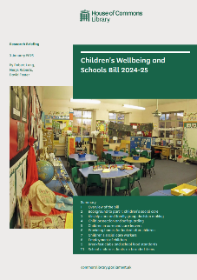
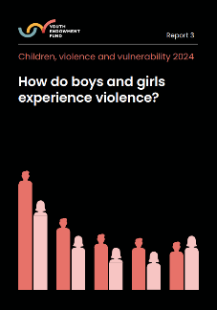
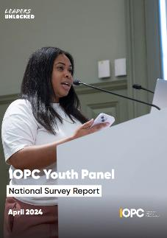

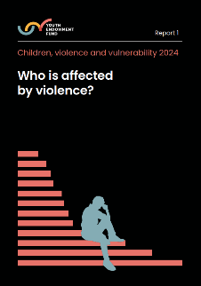
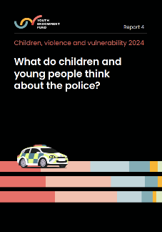

What is Pol-Ed?

Slide 3







Pol-Ed Phases of Intervention
Phase 1
Phase 2
Phase 3
For Schools to deliver
For Forces and LAs
For Forces
Policing Priorities
Curriculum Integration
Safeguarding
Early intervention and prevention
Greater understanding of Law, Crime, consequences and risks
Reduce demand on police
PSHE (Including RSHE)
Citizenship (Including British Values)
Wider Personal Development
Trauma Informed
Personal Reflection
Signposting
Notes:
Neighbourhood policing and Pol-Ed
Connection: Both rely on collaboration and leadership support for credibility and impact.

Slide 4
Aims and Objectives
Policing Priorities
Curriculum Integration
Safeguarding
Early intervention and prevention
Greater understanding of Law, Crime, consequences and risks
Reduce demand on police
PSHE (Including RSHE)
Citizenship (Including British Values)
Wider Personal Development
Trauma Informed
Personal Reflection
Signposting
Notes:
Neighbourhood policing and Pol-Ed
Connection: Both rely on collaboration and leadership support for credibility and impact.

Slide 5

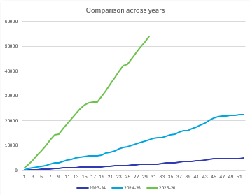
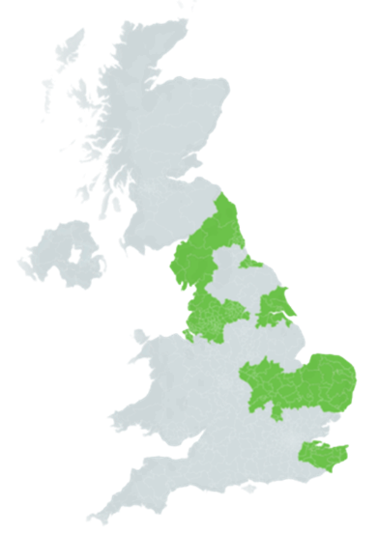
National Usage
Registered Schools: Over 5,868
Registered Users: Over 38,864
23-24 Academic Year
4,358 Lessons
Number of pupils who have accessed a
Pol-Ed Lesson since Sept 2025: Over 1,600,000
24-25 Academic Year
22,507 Lessons
25-26 Academic Year
(So far)
55,136 Lessons
Number of Pol-Ed assemblies delivered since Sept 2025: 4496
Notes:
Neighbourhood policing and Pol-Ed
Connection: Both rely on collaboration and leadership support for credibility and impact.

Slide 6

School Contents
Lessons
Phase 1
Assemblies
Passports
CPD
For Schools to deliver
Documents
Notes:
Neighbourhood policing and Pol-Ed
Connection: Both rely on collaboration and leadership support for credibility and impact.

Slide 7
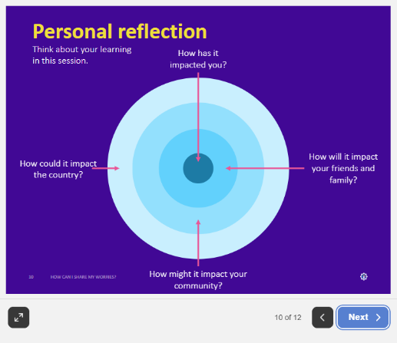
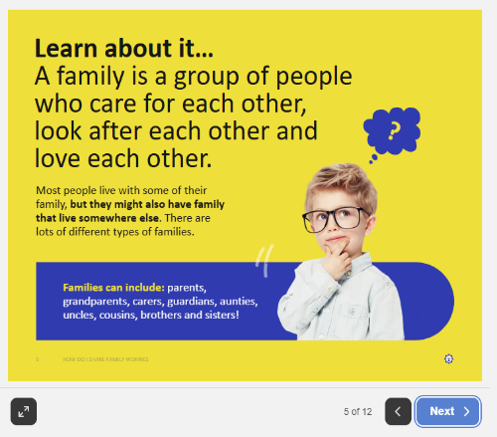
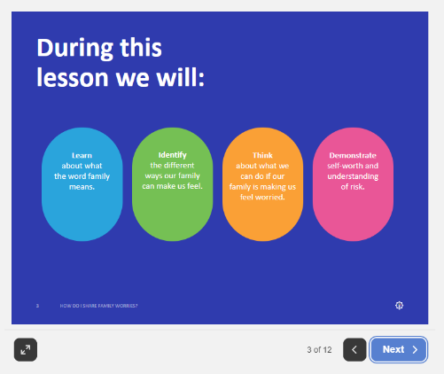
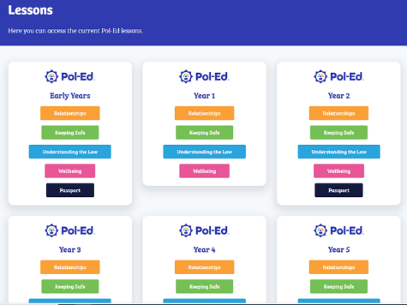
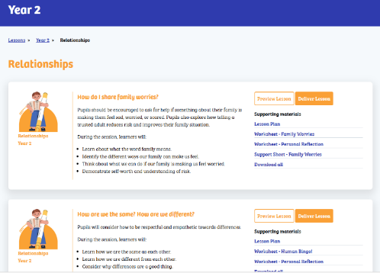
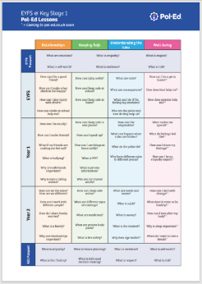

School Contents
Phase 1
For Schools to deliver
Content doubled
Cover all statutory
Progressive across themes (Year Groups)
Downloadable Lesson Plan
Optional worksheets
Lessons
Assemblies
Passports
CPD
Documents
Linked to academic calendar events and Police weeks of action
Phase 2
Holistic Approach
Focus on key values and attributes
Regular webinars around a range of themes
Improve teachers’ knowledge and awareness
Empower teachers to deliver Pol-Ed sessions with confidence
For Forces and LAs
Phase 3
For Forces
Notes:
Neighbourhood policing and Pol-Ed
Connection: Both rely on collaboration and leadership support for credibility and impact.

Slide 8
Umbrella Topics
Relationships
Keeping Safe
Understanding the Law
Wellbeing
Consent
Domestic Abuse
Sexual Offences
Grooming
Bullying
Emergency Services
CCE
ASB
Gangs
Addiction
Responsible citizens
Stop and Search
Public Order
Hate Crime
Physical Health
Emotional wellbeing
Social Connections
Support
Lessons
Assemblies
Passports
CPD
Documents
Notes:
Neighbourhood policing and Pol-Ed
Connection: Both rely on collaboration and leadership support for credibility and impact.

Slide 9

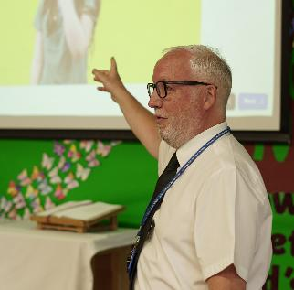
Relationships Progression
Phase 1
Year 8
Year 9
Year 10
Year 11
EYFS
Post 16
Year 1
Year 2
Year 5
Year 6
Year 7
Year 3
Year 4
How can I get ready for secondary relationships?
How can we be allies against racism?
How can we challenge sexism?
How can we respect different relationships?
What is debate?
What is my relationship with authority?
How do we manage stages of intimacy?
Who are your people?
How to spot and respond to coercive and control?
How should we end romantic relationships?
How do we develop our online brand?
What is harassment?
Are we responsible with social media?
How do I deal with unplanned encounters?
How can we deal with my friends using drugs and alcohol?
What are red flag in relationships (friendship & romantic)?
How can my adult relationships affect my future?
How do words have power?
What are my personal boundaries?
What are online friendships?
What is grooming?
What is media influence?
What is peer pressure?
How Can I be an ally?
How can I make friends?
What if my friends are making me feel sad?
What is bullying?
Why are safe hands important?
Why is name calling unkind
How are we the same?
How are we different?
How can I work with different people?
How do I share family worries?
What is a family?
Why are relationships important?
What are sexual offences?
What is victim blaming?
What is the difference between an arranged and forced marriage?
What is the impact of porn on relationships, so what?
What is my relationship with AI?
How should we treat people?
What can I do when friendships go wrong?
What do we mean by consent in friendships?
What is bullying?
Who are my key people?
How can we be role models?
What is a healthy friendship?
What is discrimination?
What is diversity?
What is peer influence?
Who makes up my community?
How can I be a good friend?
How can I make other children feel happy?
How can I play nicely with others?
How can adults at school help me?
What is consent in a relationship?
What is sexism?
What is child sexual exploitation?
What is the issues with nudes?
How does the media portray sex and relationships?
Is this banter or bullying?
What is child on child abuse?
How do I deal with conflict?
How can we deal with relationships breaking down?
Why is trust important?
What are my relationship values?
What is emotional abuse?
What is incel culture?
What is toxic culture?
What is image based sexual abuse?
For Schools to deliver
Lessons
Assemblies
Passports
CPD
Documents
Phase 2
For Forces and LAs
Phase 3
For Forces
Notes:
Neighbourhood policing and Pol-Ed
Connection: Both rely on collaboration and leadership support for credibility and impact.

Slide 10
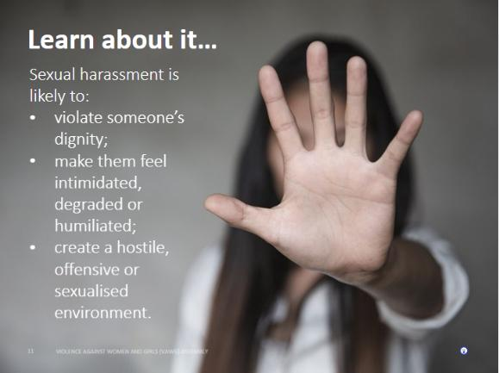
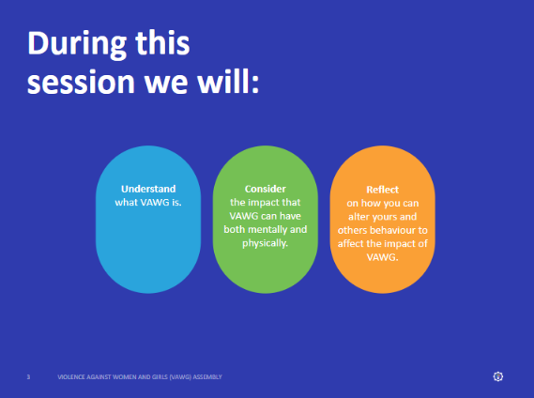
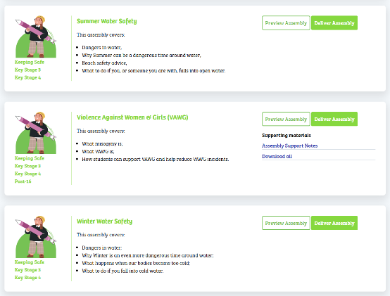
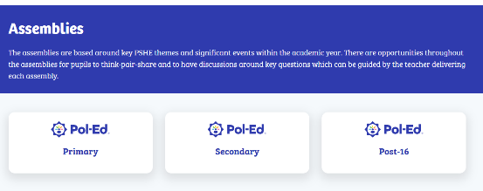
School Contents
Phase 1
For Schools to deliver
Assemblies
Linked to academic calendar events and Police weeks of action
Passports
CPD
Documents
Phase 2
Holistic Approach
Focus on key values and attributes
Regular webinars around a range of themes
Improve teachers’ knowledge and awareness
Empower teachers to deliver Pol-Ed sessions with confidence
For Forces and LAs
Phase 3
For Forces
Notes:
Neighbourhood policing and Pol-Ed
Connection: Both rely on collaboration and leadership support for credibility and impact.

Slide 11
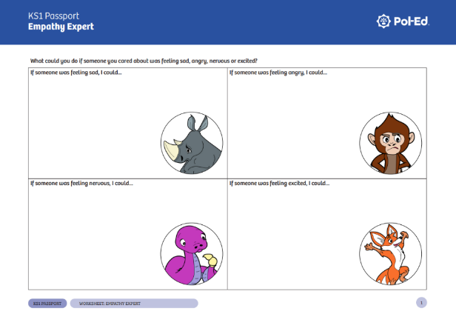
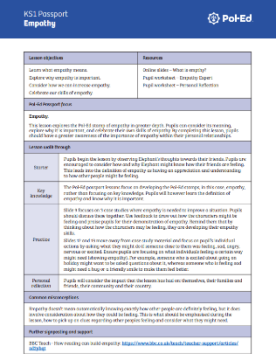
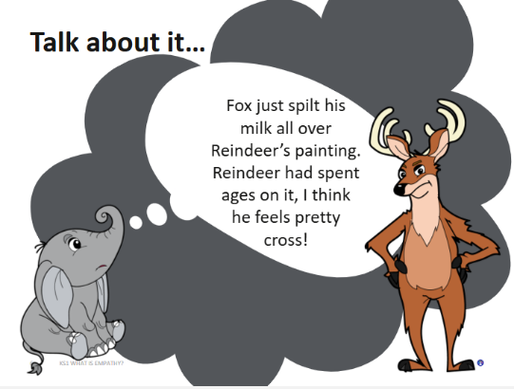
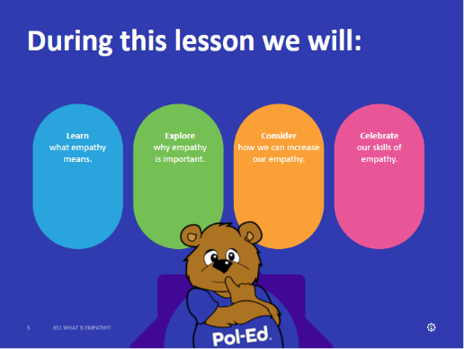
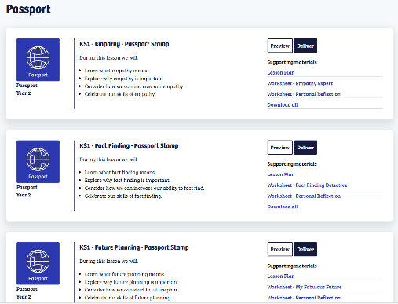

School Contents
Phase 1
Empathy
Resilience
Understanding Risk
Fact Finding
Future Planning
Informed Decision-Making
Respect
For Schools to deliver
Self-Worth
Passports
Holistic Approach
Focus on key values and attributes
CPD
Documents
Phase 2
Regular webinars around a range of themes
Improve teachers’ knowledge and awareness
Empower teachers to deliver Pol-Ed sessions with confidence
For Forces and LAs
Phase 3
For Forces
Notes:
Neighbourhood policing and Pol-Ed
Connection: Both rely on collaboration and leadership support for credibility and impact.

Slide 12
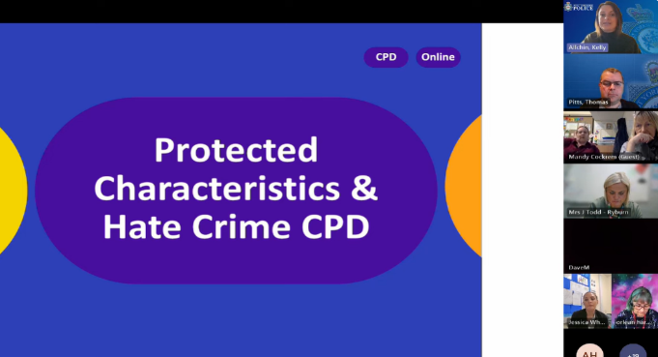
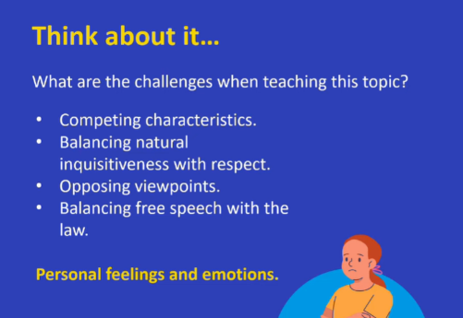


School Contents
Phase 1
For Schools to deliver
Regular webinars around a range of themes
Improve teachers’ knowledge and awareness
Empower teachers to deliver Pol-Ed sessions with confidence
CPD
Documents
Phase 2
For Forces and LAs
Phase 3
For Forces
Notes:
Neighbourhood policing and Pol-Ed
Connection: Both rely on collaboration and leadership support for credibility and impact.

Slide 13
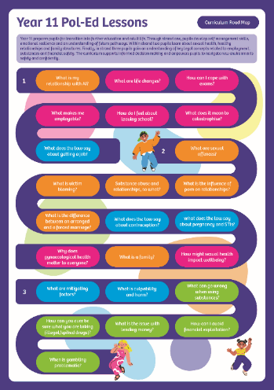
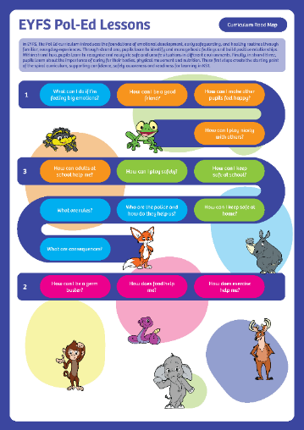
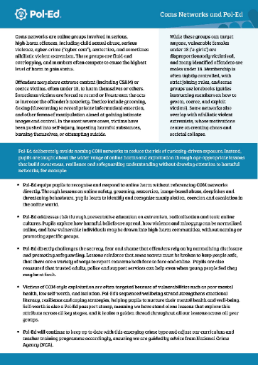
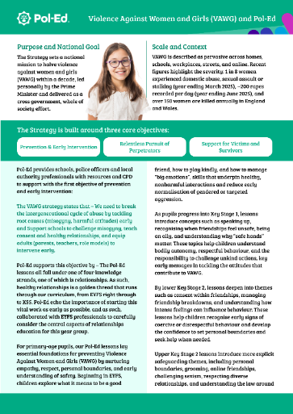

School Supporting Documents
Phase 1
For Schools to deliver
Documents
Lesson Road Maps
Statutory Guidance
Supportive Guidance
Linked to academic calendar events and Police weeks of action
Phase 2
Holistic Approach
Focus on key values and attributes
Regular webinars around a range of themes
Improve teachers’ knowledge and awareness
Empower teachers to deliver Pol-Ed sessions with confidence
For Forces and LAs
Phase 3
For Forces
Notes:
Neighbourhood policing and Pol-Ed
Connection: Both rely on collaboration and leadership support for credibility and impact.

Slide 14


Academic Research
Accessibility and usability of Pol-Ed materials
Easily accessible, access to all content from EYFS to KS5.
Usage Trends of Pol-Ed
The use of Pol-Ed has increased significantly and continues to do so daily. With many schools embedded Pol-Ed within their curriculum.
Positive aspects of using Pol-Ed
Teachers feel they can deliver Pol-Ed lessons with confidence, with several citing the accuracy, trustworthiness and reliability of the materials as being distinct features.
Notes:
Any suggestions for assemblies, again please do so via the ‘suggest a lesson’ on the website and we will always do our best to create content if we feel there is a wider need for this.

Slide 15

Pol-Ed. Statuary RSHE and
effective PSHE
Safeguards children and helps them effectively cope with existing and emerging issues.
Is inclusive both in terms of accessibility and topics/content.
Meets the statutory RHE/RSHE guidance and is informed by KCSiE.
Is age appropriate and progressive (spiral curriculum)
Assesses both knowledge and key skills and qualities.
Provides a learning environment, where teachers are supported and children feel safe.
Is collaborative.
Doesn’t sit still!

Slide 16

Effective PSHE
Child centred and personalised
– what do they need?
Safeguards children and helps them effectively cope with existing and emerging issues.
Is inclusive both in terms of accessibility and topics/content.
Meets the statutory RHE/RSHE guidance and is informed by KCSiE.
Is age appropriate and progressive (spiral curriculum)
Assesses both knowledge and key skills and qualities.
Provides a learning environment, where teachers are supported and children feel safe.
Is collaborative.
Doesn’t sit still!
Kelly Allchin
Educational Content and CPD Lead
kelly.allchin@westyorkshire.police.uk

Slide 17

PSHE can encompass many areas of study. Teachers are
best placed to understand the needs of their pupils and should be allowed flexibility to deliver high quality PSHE: DfE
Many areas:
Statutory content.
PSHE programme of study.
Best placed:
You understand the needs of your cohort.
Local needs.
National needs.
Flexibility:
Proactive
Reactive
Addressing significant safeguarding needs
Kelly Allchin
Educational Content and CPD Lead
kelly.allchin@westyorkshire.police.uk

Slide 18
Safeguards children…
National
Misogyny
British Values
Local / school based
Public order
Public order
Loss
KCSiE
Socio-economic
Apathy
Laws
Water safety
Mental health
Extremist views
Cyber bullying
Statutory RSHE
Navigating AI
Financial exploitation

Slide 19
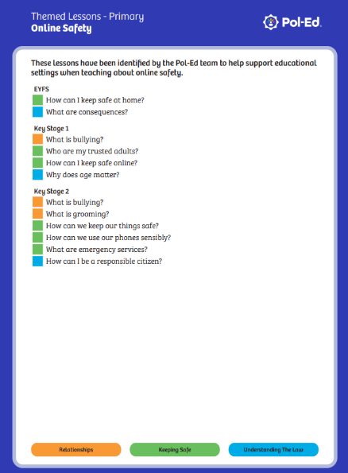
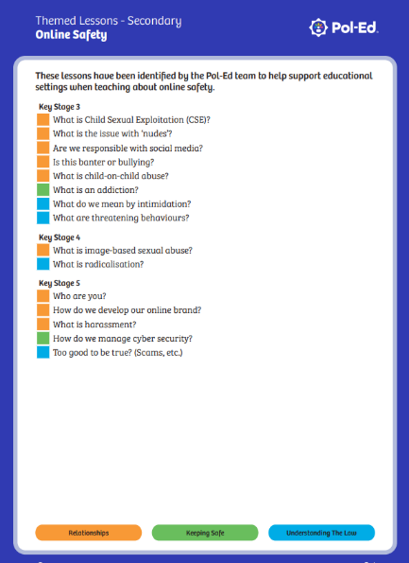
Themed lesson groupings to support safeguarding

Slide 20

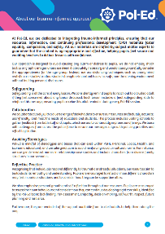
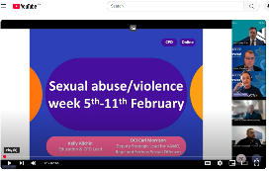
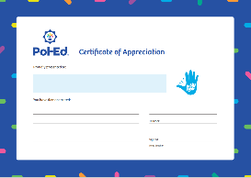
Provides a learning environment, where teachers are supported and children feel safe…
Regular CPD to provide training, pedagogy support and signposting to Pol-Ed resources.
Trauma informed guidance.
Use of distancing techniques.
Subject leader staff training presentation and presenter notes.
Award certificates.
20

Slide 21


Age appropriate, spiral curriculum…
How can I play nicely?
Why are safe hands important?
How do we manage stages of intimacy?
What is sexual assault?

Slide 22
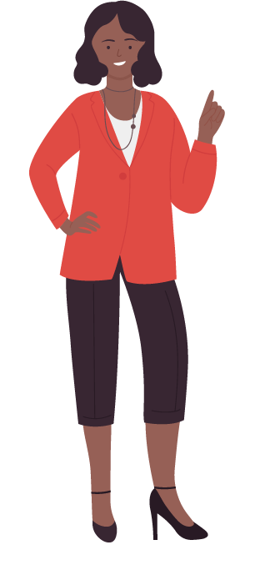
Assesses both knowledge and key skills and attributes…
Simply ‘knowing’ does not necessarily translate to making healthy and safe life choices.
Empathy
Assertive scripts
Do students know the facts?
Respect
Drugs
(law and impact)
Allyship
Self-worth
Can they demonstrate key skills?
Informed decision making
Resilience

Slide 23


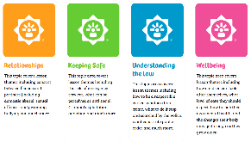

Pol-Ed Passports
Knowledge:
Keeping Safe
Relationships
Understanding the law
Wellbeing
Skills & Qualities (stamps):
Empathy
Resilience
Respect
Risk
Fact Finding
Future Planning
Decision Making
Self-worth

Slide 24
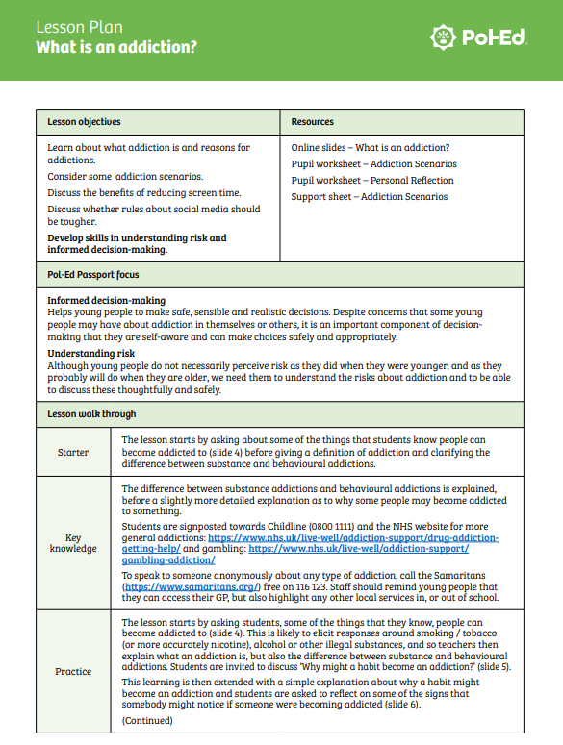
Every lesson has a knowledge focus
and a stamp focus:
Supporting teachers with providing feedback about both knowledge and skills/qualities demonstrated.
Stamp focus e.g. informed decision making and understanding risk.
Knowledge e.g. difference between substance addiction and behavioural addiction

Slide 25

Is inclusive…
Equality is a ‘golden thread’ including explicit lessons.
Diversity within case studies, language and imagery.
Careful consideration of cognitive overload, scaffolding and language.
External quality assurance and critical friends.
We have just begun a full SEND review.

Slide 26
If you know of a Merseyside colleague that would benefit from learning more about how Pol-Ed supports high quality PSHE, book onto our ‘Pol-Ed and effective PSHE’ CPD on the website.

Slide 27
Create Confidence
Our approach…
Analysis of new statutory content
Identifying gaps and amendments
Writing and amending new/existing lessons
Creating curriculum documentation
Mapping against existing lessons
Reduce Workload

Slide 28
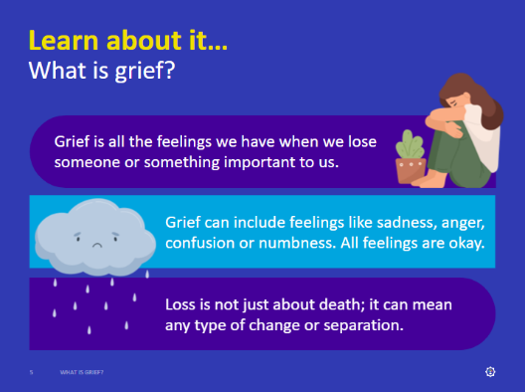
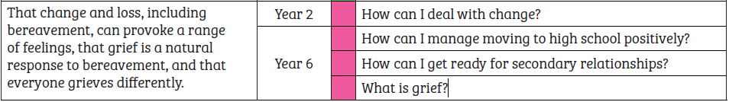
Our approach…
Statutory curriculum content:
That change and loss, including bereavement, can provoke a range of feelings, that grief is a natural response to bereavement, and that everyone grieves differently.

Slide 29
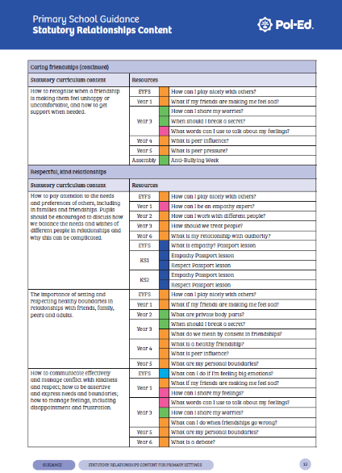
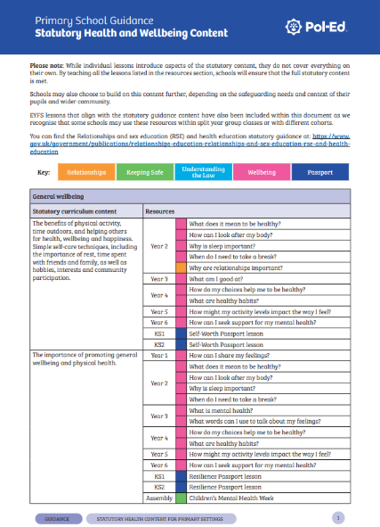
Statutory content…
Pol-Ed is 100% compliant with statutory guidance.
Documents are now available which show how and where the statutory curriculum content is met by Pol-Ed.

Slide 30
Statutory content…
Please note: While individual lessons introduce aspects of the statutory content, they do not cover everything on their own. By teaching all the lessons listed in the resources section, schools will ensure that the full statutory content is met.
Schools may also choose to build on this content further, depending on the safeguarding needs and context of their pupils and wider community.
EYFS and KS5 lessons that align with the statutory guidance content have also been included within this document as we recognise that some schools may use these resources within split year group classes or with different cohorts.

Slide 31
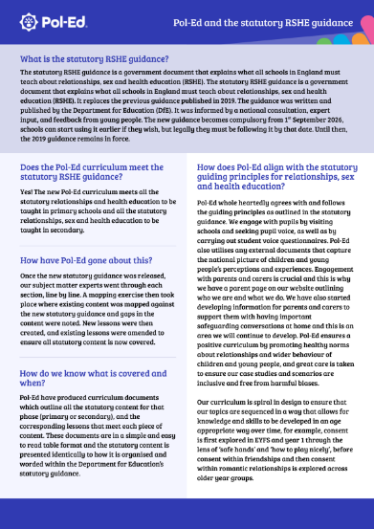
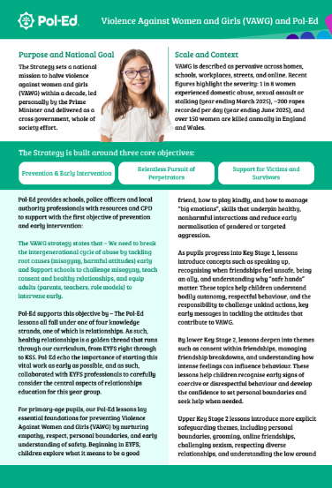
Other supporting documents…

Slide 32
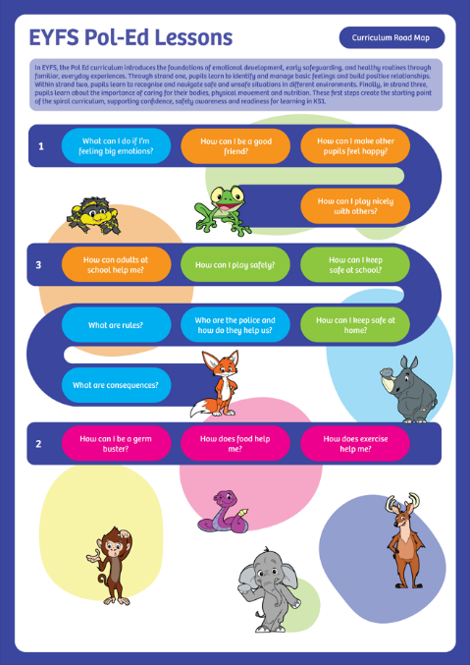
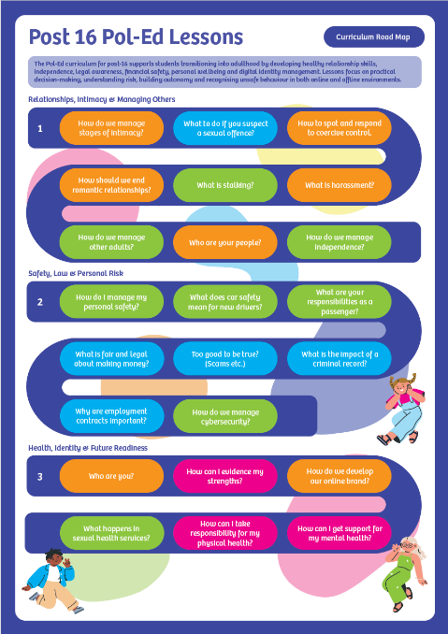
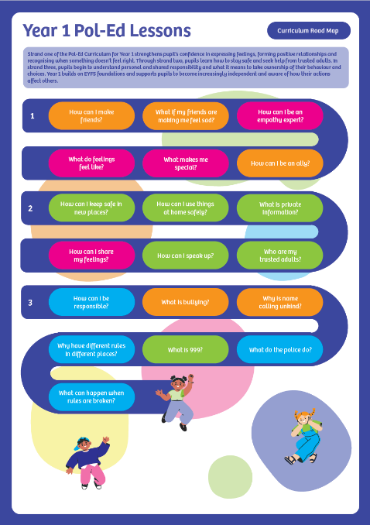
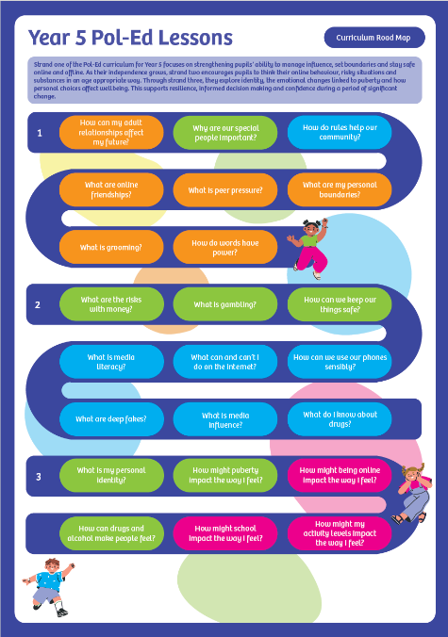
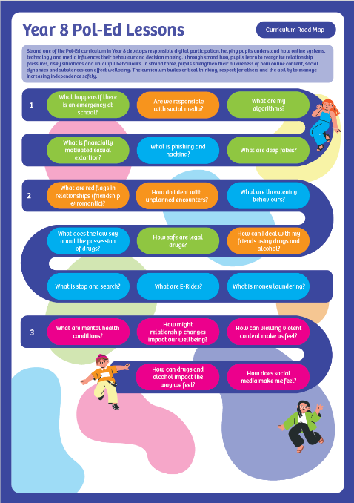

Slide 33
Although we are currently meeting the statutory guidance our curriculum will continue to grow inline with:
Pol-Ed will edit and update the statutory evidence documents termly.
New and emerging concerns
Keeping Children Safe In Education
Lesson suggestions
Statutory guidance

Slide 34
Pol-Ed – Using Crime Information
Safeguards children and helps them effectively cope with existing and emerging issues.
Is inclusive both in terms of accessibility and topics/content.
Meets the statutory RHE/RSHE guidance and is informed by KCSiE.
Is age appropriate and progressive (spiral curriculum)
Assesses both knowledge and key skills and qualities.
Provides a learning environment, where teachers are supported and children feel safe.
Is collaborative.
Doesn’t sit still!

Slide 35
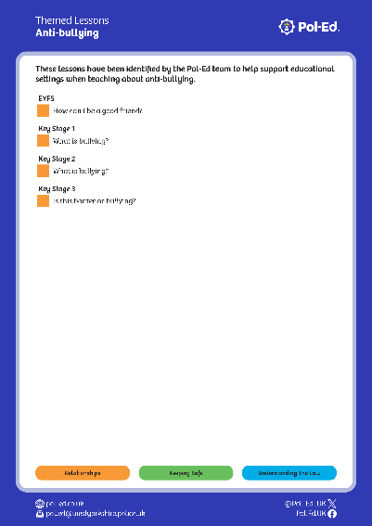
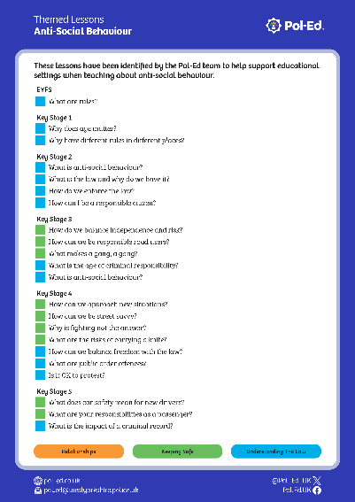









16 Themed lesson groupings including:
Anti-bullying
Anti-social Behaviour
Assault
Dangerous Weapons & Knife Crime
Drugs
Harassment
Online Safety
Public Order
Race Related
Road Safety
Sexually Related

Slide 36

Crime Data
Last 3 months
Under 18s – victim or suspects
Under 12s – victim or suspects
Note that we receive and work with data which drills down into much smaller areas.

Slide 37


Crime Data

Slide 38

Lesson Groupings

Slide 39


Thank you
tom.regan@westyorkshire.police.co.uk
Pol-Ed
/Pol.Ed.UK
Notes:
Neighbourhood policing and Pol-Ed
Connection: Both rely on collaboration and leadership support for credibility and impact.

