Slide 1

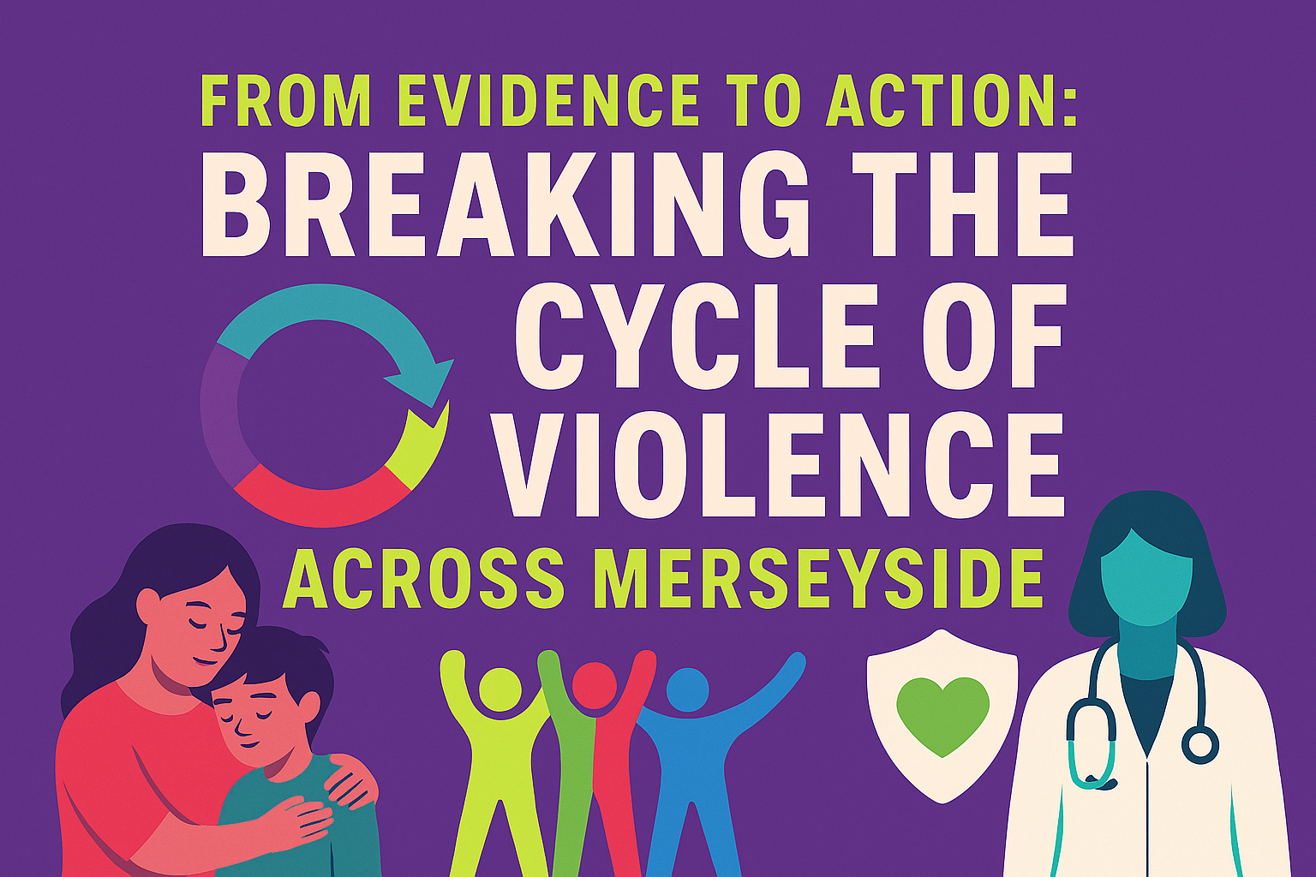

The Spine, Wednesday 10th July 2026

Slide 2




Welcome: Prof Zara Quigg, LJMU
Violence is a complex, preventable public health issue that requires a coordinated, cross-sector response (e.g. health, education, policing, local government, and communities)
Violence is shaped by wider factors - inequality, trauma, environment and opportunity
Building a strong and growing evidence base
Evidence and research are vital, but only effective when translated into action through services, practice and community support
Collaboration, early intervention, and listening to children, young people and communities are key to turning knowledge into meaningful change and improving outcomes across Merseyside

Slide 3

Welcome: Emily Spurrell

Slide 4
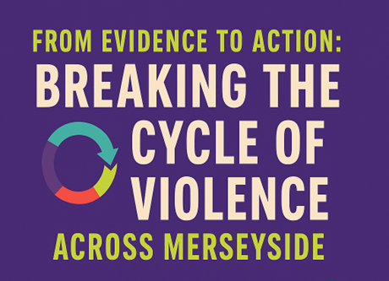
Housekeeping
Enjoy the conference, take breaks when needed & look after yourself
#EndViolenceMerseyside

Slide 5
Plenary 1 Harnessing a public health approach to violence prevention
Adverse Childhood Experiences: The cost of inaction and the case for intervention, Prof Mark A Bellis, Public Health Institute, LJMU
The role of multi-disciplinary partners in a public health approach to violence prevention across Merseyside, Dr Jane Harris, Public Health Institute, LJMU
Panel discussion: Challenges and solutions to adopting the public health approach to violence prevention, Merseyside Community Safety and Youth Justice Partners
Film: "Preventing Violence Together: A Public Health Story”, by Summer Hollick, Edward Porter, Thomas Hargreaves, Melanie Dixon (LJMU students)

